Slide 1
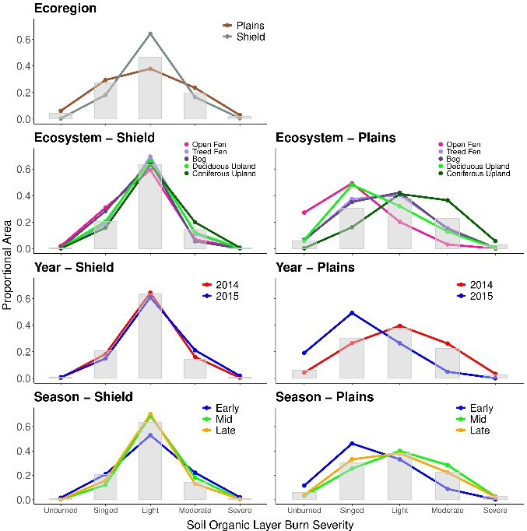
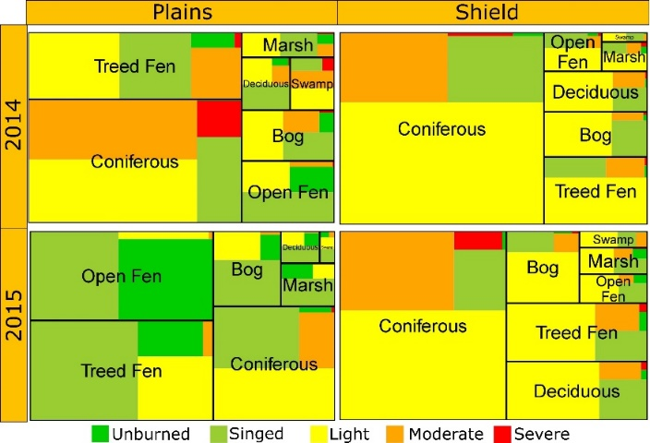
Assessing the Broadscale Effects of Wildfire Under Extreme Drought Conditions to Boreal Peatlands
Bourgeau-Chavez LL, Graham JA, Vander Bilt DJL, and Battaglia MJ (Dec. 2022). Frontiers in Forests and Global Change. doi.org/10.3389/ffgc.2022.965605
Background:
The fires that occurred in 2014 and 2015 in the Great Slave Lake area were some of the largest on record for the region, occurring during extreme drought conditions. This area contains abundant wetlands, including carbon sequestering peatlands.
Given the importance of belowground C in peatlands, a map of burn severity to the organic layer surface layers (peat) was produced as well as a map of peatland and upland ecotypes.
The upland and wetland ecotypes are expected to vary in vulnerability to burning, in terms of exposure (how much burned) and sensitivity (how severe was the burning).
Using an intersection of a spatial burn severity index (BSI) map, an ecotype cover map, and MODIS hotspot detections, we assessed proportionality of exposure and sensitivity by ecotype, ecoregion, year, and season.
Findings:
Peatlands were found to be more susceptible to wildfire on the Taiga shield where they are smaller and hydrologically isolated by the rocky landscape and abundance of lakes. Here there was less variability in exposure and sensitivity
The plains ecoregion, with deeper soils and a more continuous vegetated surface, exhibited greater heterogeneity in exposure and sensitivity, with more moderate and severe severity burning, as well as a greater abundance of unburned islands.
Upland conifer and treed fens had more area burning and at higher severity than expected, while bogs and open fens had less area and severity of burn.
Significance: Our geospatial analyses address peatland vulnerability to climate induced fire regime change and build the foundation for analyzing peatland resiliency through the study of post-fire succession and for modeling current and future fire regimes and resulting vegetation (e.g. black spruce) trajectories.
Analysis: Chi-squared goodness of fit tests were used to statistically compare actual and expected areas of exposure and sensitivity by ecotype, ecoregion, year, and season. Exposure was assessed by converting the severity product into a binary burned (BSI>0.5) or not burned (BSI<0.5) map and severity using each of the 5 BSI severity levels. Expected values were derived by assuming equal probability of burning using the ratio of the total area available for each ecotype per wildfire by the total area of all ecotypes available within each wildfire perimeter.
Treeplot of proportional area of severity of burn to the peat layers by ecotype, ecoregion and year.
Notes:
Citation: Tourian, M. J., Reager, J. T., & Sneeuw, N. (2018). The total drainable water storage of the Amazon river basin: A first estimate using GRACE. Water Resources Research, 54, 3290–3312. https://doi.org/10.1029/2017WR021674

