Slide 1
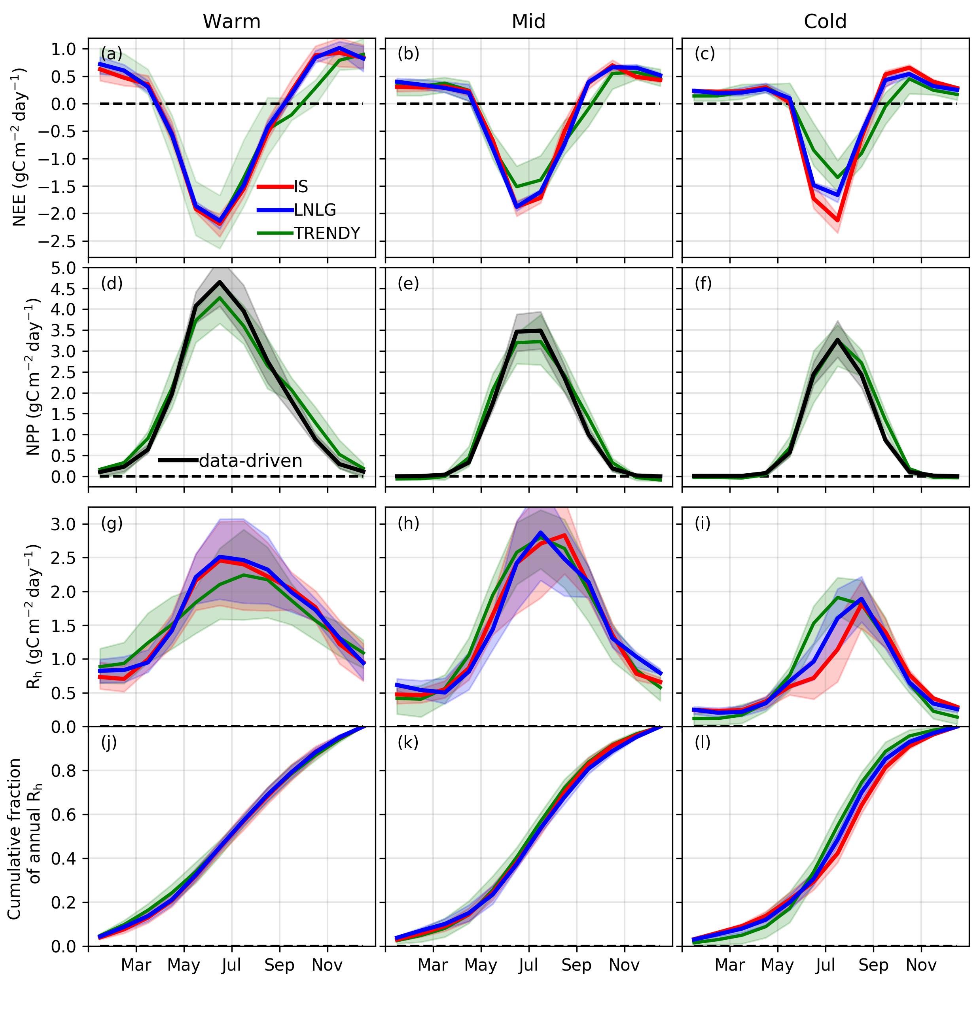
National Aeronautics and Space Administration
Jet Propulsion Laboratory
California Institute of Technology
Multi-year observations reveal a larger than expected autumn respiration signal across northeast Eurasia
Byrne et al. (2022), Biogeosciences, https://doi.org/10.5194/bg-19-4779-2022
(i)
Science Question: Site-level observations have shown pervasive cold season CO₂ release across Arctic and boreal ecosystems, impacting annual carbon budgets. Still, the seasonality of CO₂ emissions are poorly quantified across much of the high latitudes due to the sparse coverage of site-level observations. This study asks: can space-based remote sensing quantify seasonal carbon fluxes across data-sparse high latitude regions of northern Eurasia?
Data: OCO-2 X_{CO2} measurements are assimilated in global flux inversions to estimate net ecosystem exchange (NEE). In addition, remote-sensing-based gross primary production (GPP) datasets (FluxSat, FLUXCOM, VPM, and GOSIF) are employed to decompose top-down NEE into primary production and respiration components.
Permafrost type
Results:
Top-down NEE implies strong summer uptake followed by strong autumn release of CO₂ over the entire cold northeastern region of Eurasia.
This seasonality implies less summer heterotrophic respiration (Rh) and greater autumn Rh than would be expected given an exponential relationship between respiration and surface temperature.
This seasonality of NEE and Rh over northeastern Eurasia is not captured by the TRENDY v8 ensemble of dynamic global vegetation models (DGVMs).
We explain mismatch against TRENDY by respiration from soils at depth during the zero-curtain period, when sub-surface soils remain unfrozen up to several months after the surface has frozen, which is not well represented in models.
Significance: This study demonstrates that space-based CO₂ & GPP datasets provide insights about the boreal-arctic carbon cycle. And confirms the existence of a significant and spatially extensive early cold season CO₂ efflux in the permafrost-rich region of northeast Eurasia that is not well represented by current DGVMs.
(ii)
in-situ
OCO-2
Notes:
1
You may add comments here to clarify the work or the results.

Slide 2
National Aeronautics and Space Administration
Jet Propulsion Laboratory
California Institute of Technology
Multi-year observations reveal a larger than expected autumn respiration signal across northeast Eurasia
Byrne et al. (2022), Biogeosciences, https://doi.org/10.5194/bg-19-4779-2022
Contact:
Brendan Byrne, 233-200, Jet Propulsion Laboratory, Pasadena, CA 91109
brendan.k.byrne@jpl.nasa.gov
Citation:
Byrne, B., Liu, J., Yi, Y., Chatterjee, A., Basu, S., Cheng, R., Doughty, R., Chevallier, F., Bowman, K. W., Parazoo, N. C., Crisp, D., Li, X., Xiao, J., Sitch, S., Guenet, B., Deng, F., Johnson, M. S., Philip, S., McGuire, P. C., and Miller, C. E.: Multi-year observations reveal a larger than expected autumn respiration signal across northeast Eurasia, Biogeosciences, 19, 4779–4799, https://doi.org/10.5194/bg-19-4779-2022, 2022.
Data Sources:
TRENDY v8 gridded data were accessed by contacting Stephen Sitch following the TRENDY data policy described on their website: https://sites.exeter.ac.uk/trendy (Sitch et al., 2022). v9 OCO-2 MIP fluxes were downloaded from https://gml.noaa.gov/ccgg/OCO2_v9mip/ (Crowell et al., 2022). GFED data were downloaded from https://www.globalfiredata.org/ (Randerson et al., 2022). We downloaded version 10 of the ACOS OCO-2 lite files from the GES DISC (https://doi.org/10.5067/W8QGIYNKS3JC, OCO-2 et al., 2018). OCO-2 data were produced by the OCO-2 project at the Jet Propulsion Laboratory, California Institute of Technology, and obtained from the OCO-2 data archive maintained at the NASA Goddard Earth Science Data and Information Services Center. FluxSat data were downloaded from https://avdc.gsfc.nasa.gov/pub/tmp/FluxSat_GPP/ (Joiner, 2022). The GOSIF data product (Li and Xiao, 2019) is available at http://data.globalecology.unh.edu/, (Li and Xiao, 2019). ERA5-Land data are obtained from the Climate Data Store (https://doi.org/10.24381/cds.68d2bb30, Muñoz Sabater, 2019).
Technical Description of Figure:
(i) Permafrost extent over 2000–2016. Three regions are shown by different hatching patterns. The “Warm” (cross hatching) region does not have a zero-crossing date, the “Mid” (dots) region has a zero crossing date after 27 October, and the “Cold” (diagonal hatching) region has a zero-crossing date before 27 October. Note that some adjustments from these definitions are made so that the regions are contiguous. (ii) Monthly carbon cycle fluxes (average of 2015, 2016, and 2018; 2017 is excluded due to an OCO-2 data gap). (a–c) Mean (solid line) and interquartile range (shaded area) of NEE for the ensemble of IS (red) and LNLG (blue) v9 OCO-2 MIP and for the TRENDY ensemble (green). (d–f) NPP for the TRENDY ensemble (green) and estimated from data-driven GPP (black). (g–i) Rh simulated by the TRENDY ensemble (green) and calculated from combining the data-driven NPP with the IS (red) and LNLG (blue) v9 OCO-2 MIP NEE constraints. (j–l) Cumulative fraction of Rh over the growing season.
Scientific significance, societal relevance, and relationships to future missions:
This study demonstrates that the boreal-arctic carbon cycle can be tracked from space using atmospheric CO₂ and vegetation remote sensing datasets. The results of this analysis are also significant because we demonstrate that current dynamic global vegetation models (DGVMs) do not accurately represent seasonal carbon cycle dynamics in the permofrost-rich region of northeast Eurasia. This is of societal relevance because this regions is expected to undergo significant warming and permafrost thaw by the end of the century. Given the deficiencies of current DVGMs, projection of the carbon budget for this region may be flawed, potentially impacting warming projections resulting form different emission scenarios.

