Slide 1
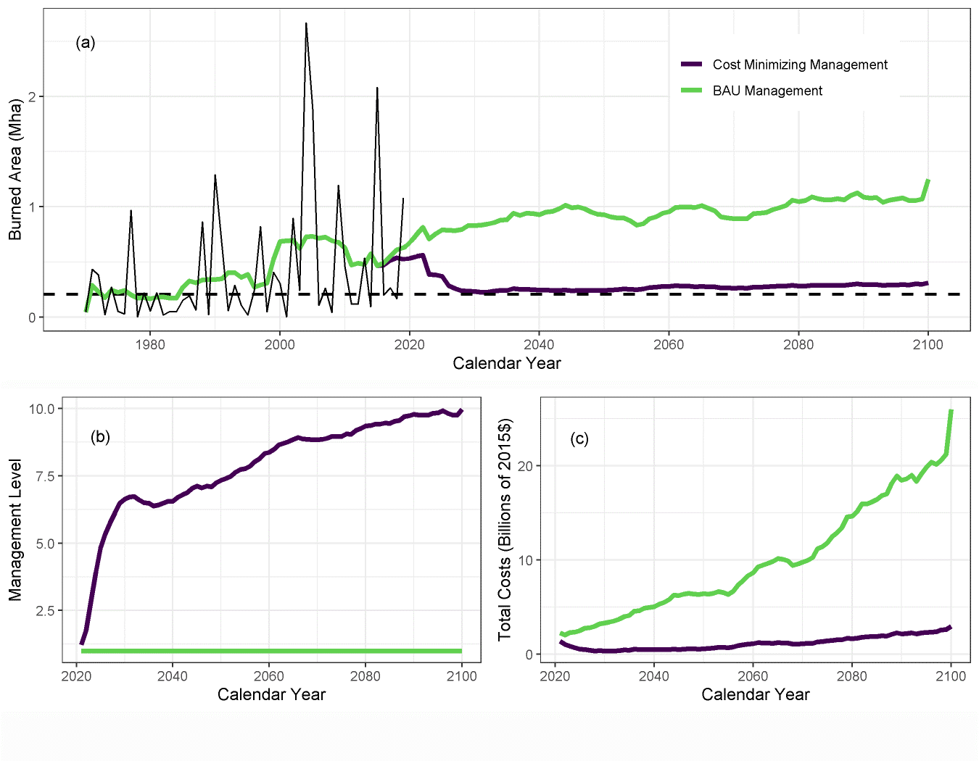
The Costs and Benefits of Fire Management for Carbon Mitigation in Alaska Through 2100
Elder, M., Phillips, C. A., Potter, S., Frumhoff, P. C., and Rogers, B. M. : The costs and benefits of fire management for carbon mitigation in Alaska through 2100, Environmental Research Letters, 17 (10), 105001, https://doi.org/10.1088/1748-9326/ac8e85, 2022.
Background:
Under current climate trends, burned area in Alaska is expected to double by the end of the century, barring significant changes in fire management.
Fires emit large amounts of CO₂ into the atmosphere, contributing to climate change and imposing economic costs.
Methods:
We created a model to project burned area across Alaska through 2100, incorporating the accelerating effect of climate change and the depressing effects of fire management and recent burning, as well as geographic variation in fire and management regimes.
We generated the projected annual cost of fire in each year by combining management costs and the social costs of emissions, using the Social Cost of Carbon, and calculated the optimal management level to minimize this combined cost.
Findings:
Combined management and social costs are minimized when burned area is constrained to near-historical levels by a large increase in management expenditures.
The social costs of unconstrained fires could reach over $20 billion annually by 2100, significantly exceeding current management spending.
Significance:
Our study is the first to project Alaskan fire regimes while allowing management to respond and affect burned area outcomes.
Our results suggest that in Alaska, the social costs of emissions far outweigh the costs of management at its current level.
Management level, burned area, and cost outcomes for cost-minimizing specification and business as usual (BAU) specifications. Annual burned area in Alaska has already increased relative to the historical baseline (dashed line) (a, left). Projected burned area continues to increase under BAU management (green line) but remains near historical levels under optimal management (a, right). Optimal management levels increase over the projection period (b). Projected total costs are shown in billions of 2015 dollars (c). All values display the 11-year moving average.
Notes:
Full citation: Elder, M., Phillips, C. A., Potter, S., Frumhoff, P. C., and Rogers, B. M. : The costs and benefits of fire management for carbon mitigation in Alaska through 2100, Environmental Research Letters, 17 (10), 105001, https://doi.org/10.1088/1748-9326/ac8e85, 2022.
Grants: This work was partially funded by ABoVE grant NNX15AU56A (Rogers TE (2014)).
Abstract: Climate change is intensifying fire regimes across boreal regions, and thus both burned area and carbon emissions from combustion are expected to increase significantly over the next several decades. Fire management through initial suppression of fires is effective at reducing burned area, but limited work has addressed the role that fire management can play in reducing wildfire carbon emissions and their impacts on climate change. In this work, we draw on historical data covering fire and fire management in Alaska to project burned area and management outcomes to 2100. We allow management to both respond to and impact variations in annual burned area and carbon emissions, while keeping decadal-average burned area at or above historical levels. The total cost of a fire is calculated as the combination of management expenditures and the social cost of carbon (SCC) emissions during combustion, using the SCC framework. Incorporating the tradeoff between management expenditures and burned area, we project that by 2100, increasing management effort by 5–10 times relative to current expenditures would minimize combined management and emissions costs. This is driven by the finding that the social costs of carbon emissions greatly exceed management costs unless burned area is constrained to near the average historical level. Our analysis does not include the many health, economic, and non-CO₂ climate impacts from fires, so we likely underestimate the benefits of increased fire suppression and thus the optimal management level. As fire regimes continue to intensify, our work suggests increased management expenditures will be necessary to counteract increasing carbon combustion and lower overall climate impact.

