Slide 1
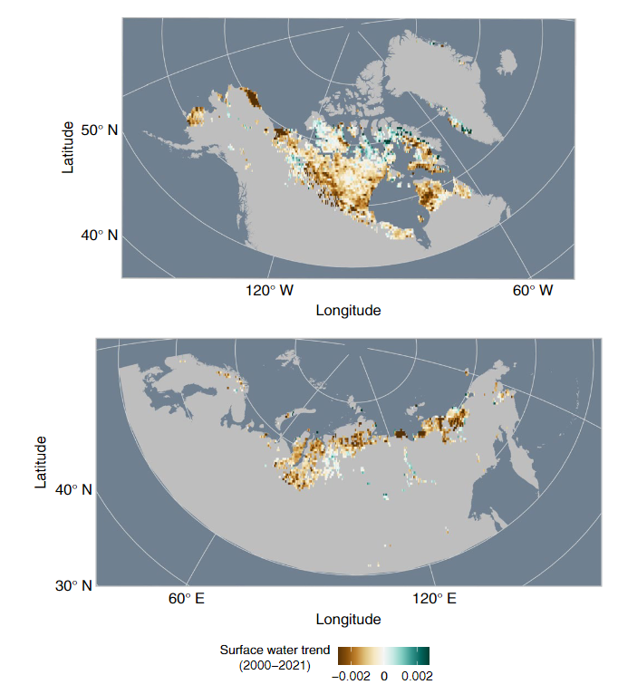
Permafrost thaw drives surface water declines across lake-rich regions of the Arctic Webb et al., (2020) Nature Climate Change https://doi.org/10.1038/s41558-022-01455-w
Background:
Lakes and ponds are more abundant in the Northern permafrost zone than in any other region worldwide.
Models propose that in response to climate change, initial permafrost thaw will result in increased lake area, with continued warming and advanced thaw eventually leading to decreased lake area after ~60-150 years.
Analysis:
MODIS-based superfine water index to quantify surface water change from 2000 to 2021
Machine learning to relate surface water trends to climate trends and landscape characteristics
Findings:
Across lake-rich regions of the Arctic, surface water declined over the past two decades
The climate drivers responsible for surface water declines were increases in annual air temperature and increases in autumn rain
Significance:
Widespread decreases in surface water are most likely due to permafrost thaw
The northern permafrost region is likely on a trajectory towards further surface water declines
Surface water decreases are observed decades to more than a century earlier than predicted by models.
Current and future estimates of carbon emissions from abrupt permafrost thaw are probably too high.
Notes:
Full citation: Webb, E.E., Liljedahl, A.K., Cordeiro, J.A. et al. Permafrost thaw drives surface water decline across lake-rich regions of the Arctic. Nat. Clim. Chang. (2022). https://doi.org/10.1038/s41558-022-01455-w
Award information: Lead author Webb was supported by NASA FINESST Award 80NSSC19K134

