Slide 1
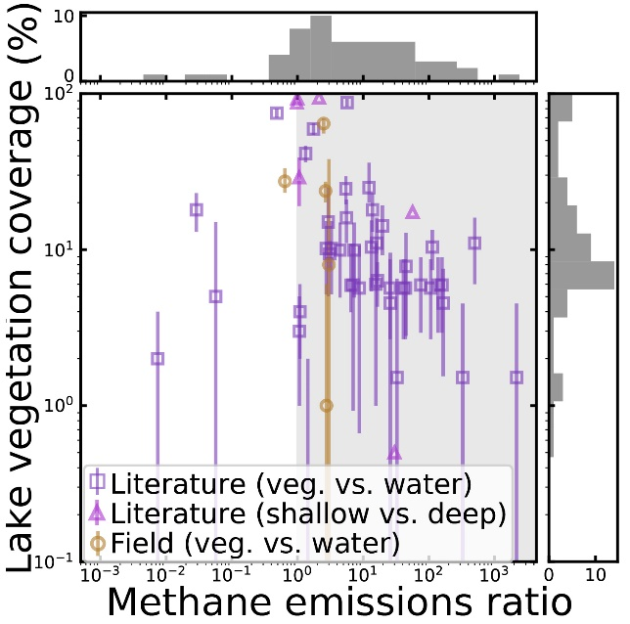
The Importance of Lake Vegetation for Arctic-Boreal Methane Emissions
Kyzivat, E.D., Smith, L.C., Garcia-Tigreros, F. et al. (2022), JGR:Biogeosciences, doi:10.1029/2021JG006635
Left: The study domain spans climate gradients and the Northern tree line. Lake vegetation can be detected by radar remote sensing if it emerges above the water.
Center: Plotting study lakes’ vegetated: open water emissions ratio against their vegetation coverage shows most would have higher estimated emissions (shaded area) if their vegetated zones are
accounted for separately.
Background
Areas of lakes that support aquatic vegetation emit disproportionately more methane than open water but are under-represented in upscaled methane estimates.
Analysis
We combine airborne ABoVE airborne UAVSAR mapping with field measurements of vegetated and open-water methane emissions.
Findings
We provide a first mapping of emergent aquatic vegetation in 4,572 Arctic-boreal lakes using airborne radar remote sensing.
Lake vegetation extent varies regionally from 1 to 59% of lake area and seasonally to a lesser degree, with a mean of ~16%.
Aquatic vegetation emits 6x more methane than open water per unit area, or 16x from Arctic-boreal regions only.
Significance
Accounting for vegetation could increase emissions estimates from Arctic-boreal lakes by +21%.
These uncounted emissions are equivalent to 9% of all natural emissions from these Arctic-boreal landscapes, a significant source of methane to the atmosphere.
Notes:
NASA resources and products used:
UAVSAR L-band from ABoVE airborne campaign
ABoVE Science Cloud
ABoVE, FINESST, and THP (SWOT) programs funded field (2 summers), lab, and analysis work
Previous ABoVE data products were used to augment training data (Kyzivat et al., 2018, 2019, 2020; Bourgeau-Chavez et al., 2017, 2019; Wang et al., 2019a, 2019b).
Above: Location map of study areas (YF = Yukon Flats; CSD = Canadian Shield, Daring Lake; CSB = Canadian Shield, Baker Creek; PAD = Peace-Athabasca Delta). Study area boundaries (red polygons) are derived from intersecting ABoVE UAVSAR airborne flight coverage with physiographic boundaries.
Above, center: Plotting study lakes in a flux ratio-emergent vegetation fraction feature space shows that most emit more methane from lake emergent vegetation (LEV) than from open water on a per-area basis (shaded region), leading to an overall median flux ratio of 6.1. Studies that partitioned fluxes into shallow versus deep, rather than vegetated versus open water zones (triangular markers) are shown for reference but are not used for further analysis. The distributions of both variables are shown as histograms along the relevant axes. Vertical error bars show the temporal range in coverage for the field data (orange circles) and the estimated mapping uncertainty for the literature data (purple squares) and can extend to zero (beyond axis limits). For scale, the uppermost square data point in the figure (peat pond, Ontario, Canada, ALEV = 88%, R = 5.7) corresponds to a 113% increase in emissions compared to the no LEV zone case. Note the logarithmically-scaled x and yaxes.
Paper abstract: Areas of lakes that support emergent aquatic vegetation emit disproportionately more methane than open water but are under-represented in upscaled estimates of lake greenhouse gas emissions. These shallow areas are typically less than ~1.5 m deep and can be estimated through synthetic aperture radar (SAR) mapping. To assess the importance of lake emergent vegetation (LEV) zones to landscape-scale methane emissions, we combine airborne SAR mapping with field measurements of vegetated and open-water methane flux. First, we use Uninhabited Aerial Vehicle SAR (UAVSAR) data from the NASA Arctic-Boreal Vulnerability Experiment (ABoVE) to map LEV in 4,572 lakes across four Arctic-boreal study areas and find it comprises ~16% of lake area, exceeding previous estimates, and exhibiting strong regional differences (averaging 59 [50–68]%, 22 [20-25]%, 1.0 [0.8-1.2]%, and 7.0 [5.0-12]% of lake areas in the Peace-Athabasca Delta, Yukon Flats, and northern and southern Canadian Shield, respectively). Next, we account for these vegetated areas through a simple upscaling exercise using paired methane fluxes from regions of open water and LEV. After excluding vegetated areas that could be accounted for as wetlands, we find that inclusion of LEV increases overall lake emissions by 21 [18-25]% relative to estimates that do not differentiate lake zones. While LEV zones are proportionately greater in small lakes, this relationship is weak and varies regionally, underscoring the need for methane-relevant remote sensing measurements of lake zones and a consistent criterion for distinguishing wetlands. Finally, Arctic-boreal lake methane upscaling estimates can be improved with more measurements from all lake zones.
Plain Language Summary: Lakes are one of the largest natural sources of the greenhouse gas methane and are especially common in high latitudes. Shallow, near-shore areas of lakes having emergent aquatic vegetation emit disproportionately more methane than open water areas but are under-represented in broad-scale estimates of lake greenhouse gas emissions. While lake depths are difficult to map from remote sensing, emergent vegetation, which typically grows in water less than ~ 1.5 m deep, can be detected via radar remote sensing. To assess the importance of these areas to landscape-scale methane emissions, we combine airborne radar mapping with field measurements of vegetated and open-water methane emissions. Zones of emergent vegetation vary regionally and comprise ~16% of lake area on average. A simple estimate that accounts for both open water and emergent vegetation methane emissions results in 21% increased overall lake methane emissions estimates. Emergent aquatic vegetation coverage has only a weak relationship with lake size, making it hard to predict. Therefore, to better estimate broad-scale methane emissions, we suggest using remote sensing to create lake vegetation distribution maps and measuring methane emissions from both vegetated and open water zones within lakes.
Citation:
Kyzivat, E. D., Smith, L. C., Garcia-Tigreros, F., Huang, C., Wang, C., Langhorst, T., Fayne, J. v, Harlan, M. E., Ishitsuka, Y., Feng, D., Dolan, W., Pitcher, L. H., Wickland, K. P., Dornblaser, M. M., Striegl, R. G., Pavelsky, T. M., Butman, D. E., & Gleason, C. J. (2022). The Importance of Lake Emergent Aquatic Vegetation for Estimating Arctic-Boreal Methane Emissions. Journal of Geophysical Research: Biogeosciences, 127(6), e2021JG006635. https://doi.org/10.1029/2021JG006635
Award Information:
This research was supported by the National Aeronautics and Space Administration Terrestrial Ecology Program (NNH18ZDA001N-Task A4.) under NASA Award number 80NSSC19M0104 and was part of the NASA Arctic-Boreal Vulnerability Experiment.
Additional funding was provided by NASA FINESST (grant number 80NSSC19K1361); NASA SWOT Science Team (grant numbers 80NSSC20K1144 and NNX16AH83G), and the US Geological Survey (USGS) LandCarbon Program.
Resources supporting this work were provided by the NASA High-End Computing (HEC) Program through the NASA Center for Climate Simulation (NCCS) at Goddard Space Flight Center via the ABoVE Science Cloud.

Slide 2
Notes
Citation:
Kyzivat, E. D., Smith, L. C., Garcia-Tigreros, F., Huang, C., Wang, C., Langhorst, T., Fayne, J. v, Harlan, M. E., Ishitsuka, Y., Feng, D., Dolan, W., Pitcher, L. H., Wickland, K. P., Dornblaser, M. M., Striegl, R. G., Pavelsky, T. M., Butman, D. E., & Gleason, C. J. (2022). The Importance of Lake Emergent Aquatic Vegetation for Estimating Arctic-Boreal Methane Emissions. Journal of Geophysical Research: Biogeosciences, 127(6), e2021JG006635. https://doi.org/10.1029/2021JG006635
Award Information:
This research was supported by the National Aeronautics and Space Administration Terrestrial Ecology Program (NNH18ZDA001N-Task A4.) under NASA Award number 80NSSC19M0104 and was part of the NASA Arctic-Boreal Vulnerability Experiment.
Additional funding was provided by NASA FINESST (grant number 80NSSC19K1361); NASA SWOT Science Team (grant numbers 80NSSC20K1144 and NNX16AH83G), and the US Geological Survey (USGS) LandCarbon Program.
Resources supporting this work were provided by the NASA High-End Computing (HEC) Program through the NASA Center for Climate Simulation (NCCS) at Goddard Space Flight Center via the ABoVE Science Cloud.

