Slide 1
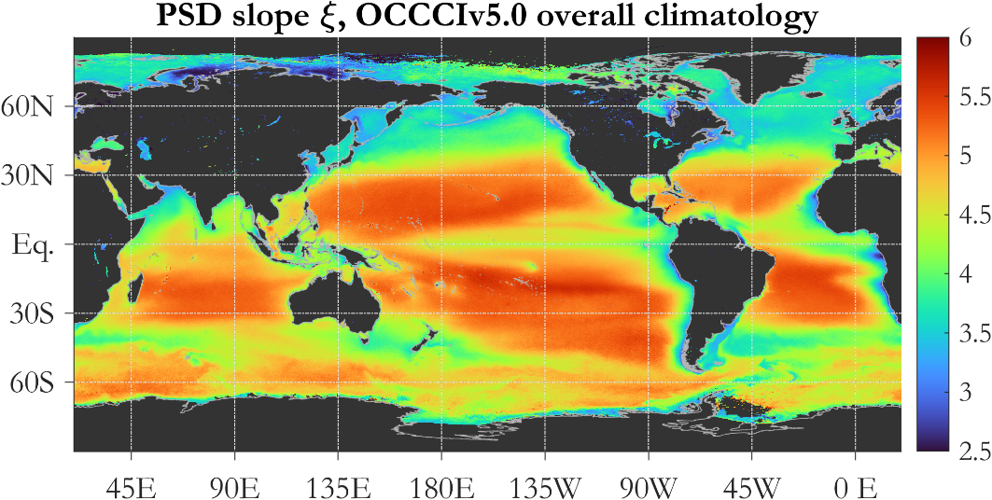
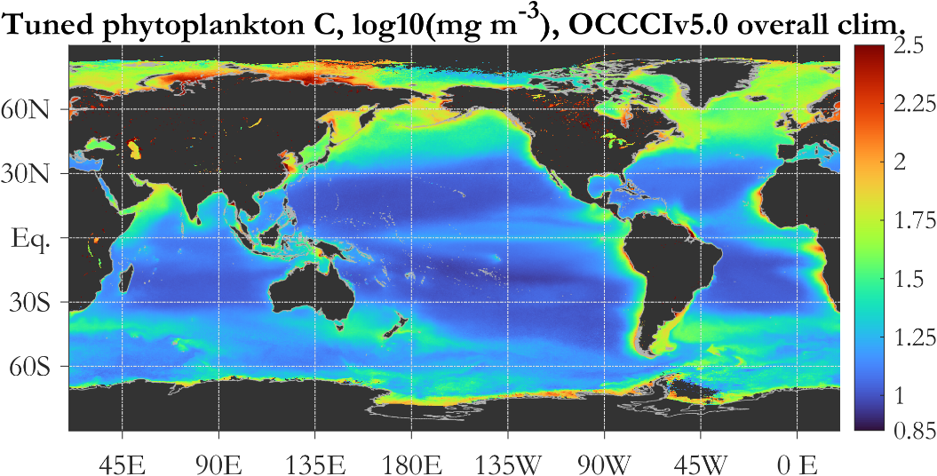
Particle Size Distribution and Size-partitioned Phytoplankton Carbon from Ocean Color – Data Set and Code Kostadinov et al (2022) (doi: 10.1594/PANGAEA.939863 and doi: 10.5281/zenodo.6354654)
Background and Significance
Retrieval of the particle size distribution (PSD) and size-partitioned phytoplankton carbon from space is important for advancing our mechanistic understanding of ocean ecosystem structure and function and their role in the carbon cycle and climate. The PSD affects phytoplankton ecology and biogeochemistry, as well as optical properties.
Methods/Analysis & Results
A novel backscattering-based PSD/phytoplankton carbon ocean color algorithm has been developed, using a two-particle-populations model (phytoplankton modeled as coated spheres, and NAP). The novel algorithm was used to create the presented data set based on the merged OC-CCI v5.0 data, which uses: SeaWiFS, MERIS, Aqua-MODIS, VIIRS and OLCI, spanning from 1997 to 2020. The algorithm allows partitioning of phyto C to any size classes. An empirical tuning is suggested to achieve more realistic absolute values; however initial validation results indicate ambiguity with respect to the need for tuning. It is important to measure phyto C in-situ and maintain and expand quality controlled global databases like SeaBASS.
Overall climatologies of the PSD slope (top) and total phytoplankton carbon (bottom, with empirical tuning) derived using the novel PSD/phytoplankton carbon algorithm and the OC-CCI v5.0 data set.

Slide 2
Notes
Citations below refer to the data set created using the novel satellite algorithm and the scientific code (operational and algorithm development) (not peer-reviewed). Associated peer-reviewed publication is in prep.
Data set:
Kostadinov, Tihomir Sabinov; Robertson-Lain, Lisl; Kong, Christina Eunjin; Zhang, Xiaodong; Maritorena, Stéphane; Bernard, Stewart; Loisel, Hubert; Jorge, Daniel S F; Kochetkova, Ekaterina; Roy, Shovonlal; Jönsson, Bror; Martinez-Vicente, Victor; Sathyendranath, Shubha (2022): Particle Size Distribution and Size-partitioned Phytoplankton Carbon Using a Two-Component Coated-Spheres Bio-optical Model: Monthly Global 4 km Imagery Based on the OC-CCI v5.0 Merged Ocean Color Satellite Data Set. PANGAEA, https://doi.org/10.1594/PANGAEA.939863
Scientific Code:
Tihomir Sabinov Kostadinov, Lisl Roberston-Lain, Stewart Bernard, Xiaodong Zhang, & Hubert Loisel. (2022). PSD_PhytoC_v2021: Ocean Color Algorithm for the Retrieval of the Particle Size Distribution and Size-Partitioned Phytoplankton Carbon: Algorithm Development and Operational Code (v1.0). Zenodo. https://doi.org/10.5281/zenodo.6354654
Award Information:
Title of the solicitation (including ROSES call number): The Science of TERRA, AQUA, and SUOMI NPP (A37)
NASA Award/contract number:
This research was supported by NASA Award number 80NSSC19K0297

