Slide 1
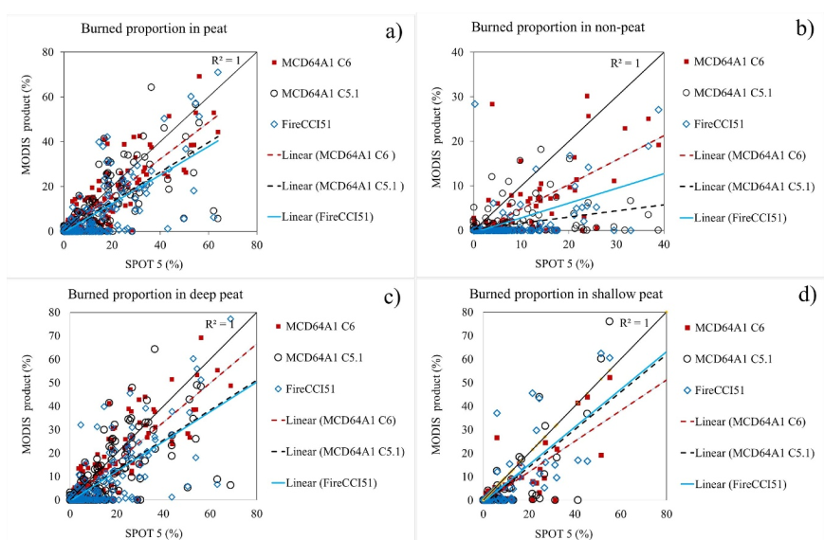
Evaluating accuracy of four MODIS-derived burned area products for tropical peatland and non-peatland fires Yenni Vetrita LAPAN, Mark A. Cochrane UMCES, Suwarsono LAPAN, M. Priyatna LAPAN, K.A.D. Sukowati LAPAN, M.R. Khomarudin 2021, Environ. Res. Lett. 16 035015
Science Question
How accurate are global burned area (BA) products (MCD45 C5, FireCCI C51,MCD64A1 C5.1 and C6) at detecting peatland and non-peatland fires? What are the effects of small area fire patches and extending the temporal window of detection, as well as implications for fire-related emissions models?
Analysis
Using SPOT-5 images as a high-resolution reference map, BA products were assessed. Regressions and error matrices were used to compare effects of burn area size, temporal window length and peat depth among products.
Results
The MCD64A1 Col. 6 (OE, CE) was the best performing burned area product but detected half or less of all burned area. Despite its higher spatial resolution, the FireCCI51 BA product was poorer at detecting smaller burned areas (<100 ha) than MCD64A1. Dense clouds and smoke limited the accuracies of all burned area products, even when the temporal window for detection was lengthened.
Significance
The findings show that emissions calculations for peatlands, based on BA products, are likely inaccurate and worsen during the most severe/smoky years.
Fig.1 Regression of the proportion of area burned in each 5X5 km² grid square of the various BA products and the SPOT-5 derived reference map, during the 2014 fire season.
The R² ranging from 0.5-0.8 (peatland) and 0.2-0.5 (non-peatland). The lower accuracy in non-peatland was associated with the cropland.
Burned area detection in peatlands was best with MCD64A1 C6 (48%), improving modestly (57%) when excluding smaller burns (<100ha).
Notes:
Vetrita, Y., M.A. Cochrane, Suwarsono, M. Priyatna, K.A.D Sukowati and M.R. Khomarudin. 2021. Evaluating Accuracy of Four MODIS-derived Burned Area Products for Tropical Peatland and Non-peatland Fires. Environmental Research Letters: 16; 035015. http://iopscience.iop.org/article/10.1088/1748-9326/abd3d1

