Slide 1
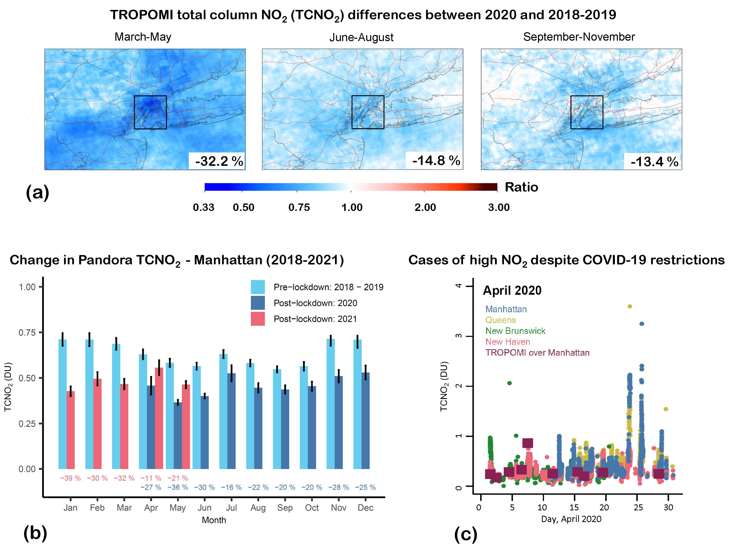
Declines and peaks in NO₂ pollution during the multiple waves of the COVID-19 pandemic in the New York metropolitan area
M. Tzortziou, C. Kwong, D. Goldberg, L. Schiferl, R. Commane, N. Abuhassan, J. Szykman, L. Valin Atmos. Chem. Phys., 22, 1–19, 2022 https://doi.org/10.5194/acp-22-1-2022
Background
The COVID-19 pandemic resulted in multifaceted impacts on human behavior that affected various pollutant sectors and their relative contributions to urban NOx emissions. Yet, the impact of multiple pandemic waves on NO₂ pollution and the role of meteorology and sector-specific emissions in the New York metropolitan area was not previously examined
Analysis
Merged measurements from ground-based Pandora network, TROPOMI, meteorological data, mobility trends, and atmospheric transport model simulations.
Findings
Sudden drop in total column NO₂ in spring 2020, by up to 36% in Manhattan, and a clear weakening (by 16%) of the typical weekly NO₂ cycle.
Declines and peaks in NO₂ pollution in the NY/NJ//CT area, captured by TROPOMI (a) and Pandora (b,c).
Gradual recovery in NO₂ across the NY/NJ/CT tri-state area in summer and fall 2020, as social restrictions eased, followed by a second decline in NO₂ coincident with the second wave of the pandemic in winter 2021.
Meteorology did not have a strong NO₂ biasing effect in NYC after the first pandemic wave, but it played a key role in shaping the relative contributions from different emission sectors to NO₂ pollution in the city, driving particularly high NO₂ pollution episodes in Manhattan, even during – and despite - the stringent early lockdowns.
Significance
Results have important implications for air quality management, and highlight the value of high resolution NO₂ retrievals in assessing the effects of rapid meteorological changes on air quality conditions and the effectiveness of sector-specific NOx emission control strategies and their impacts on air quality and human health.
Notes:
Maria Tzortziou submitted
Full citation:
Tzortziou, M., Kwong, C. F., Goldberg, D., Schiferl, L., Commane, R., Abuhassan, N., Szykman, J. J., and Valin, L. C.: Declines and peaks in NO₂ pollution during the multiple waves of the COVID-19 pandemic in the New York metropolitan area, Atmos. Chem. Phys., 22, 2399–2417, https://doi.org/10.5194/acp-22-2399-2022, 2022.
Grants: This research was supported by NASA Rapid Response and Novel research in the Earth Sciences (RRNES) Program (grant no. 80NSSC20K1287), NASA Interdisciplinary Science
(IDS) Program (grant no. 80NSSC17K0258), NOAA Earth System Sciences and Remote Sensing Technologies (award no. NA16SEC4810008), and NOAA Climate Program Office’s Atmospheric
Chemistry, Carbon Cycle, and Climate program (grant no. NA20OAR4310306).

