Slide 1
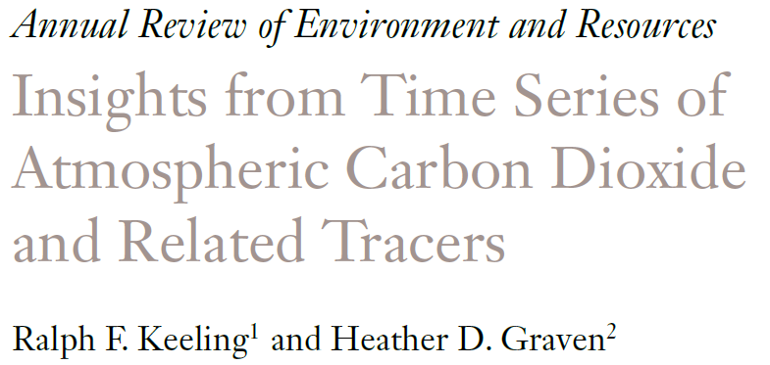
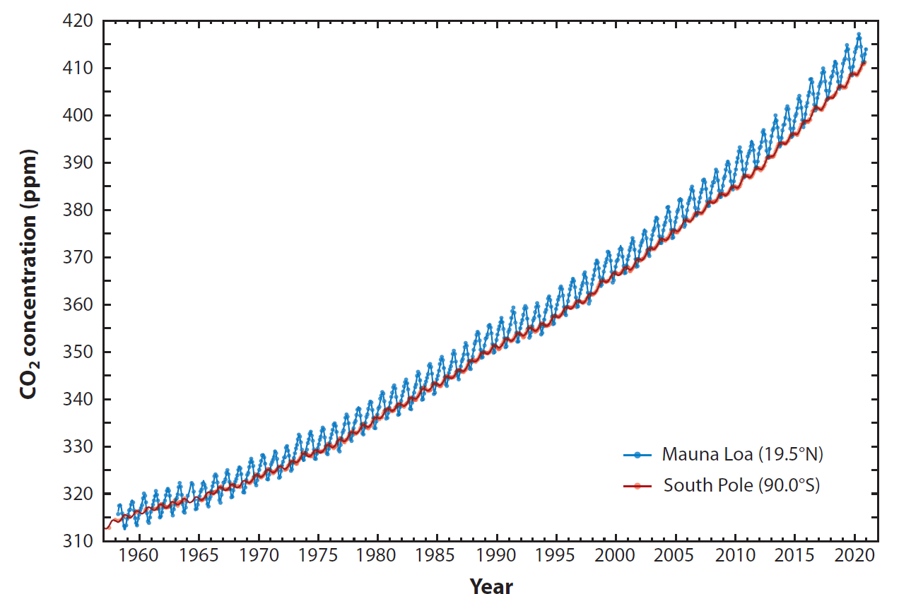
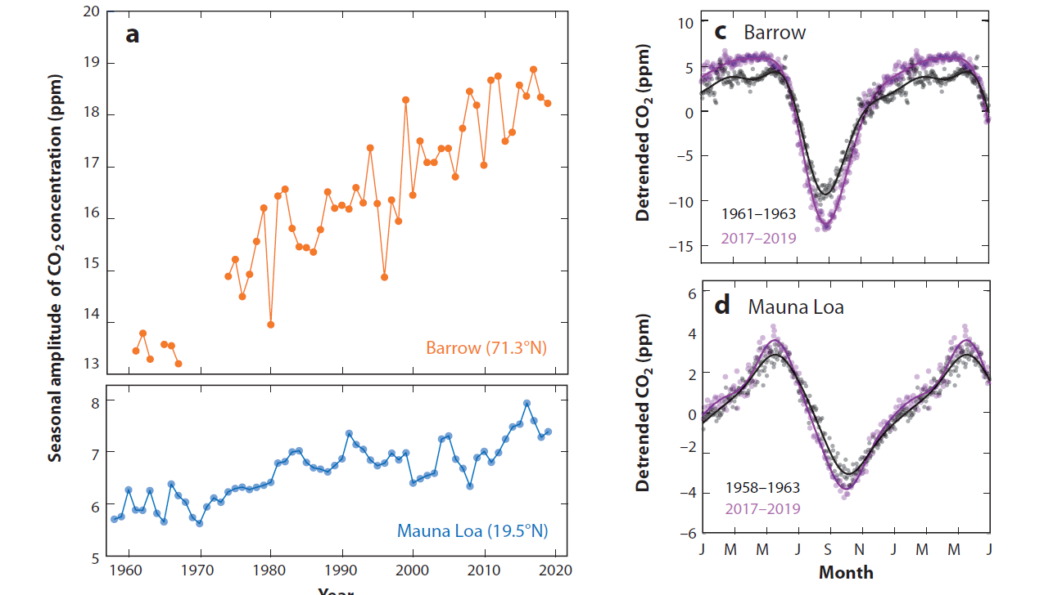
Multiple lines of evidence for carbon sinks having grown roughly in proportion to emissions and for large increases in global photosynthesis over the last 60 years.
Ann Rev. Env. and Res. (2021) 45: 85-110
Notes:
Science questions: What has been learned from long-term observations of CO2 and related tracers using updated records? What will future measurements tell us additionally?
Methods: Literature review. Access to updated records, including data for CO₂ and CO₂ isotopes funded by NASA.
Results: Broad review of literature. Update of iconic plots.

