Slide 1
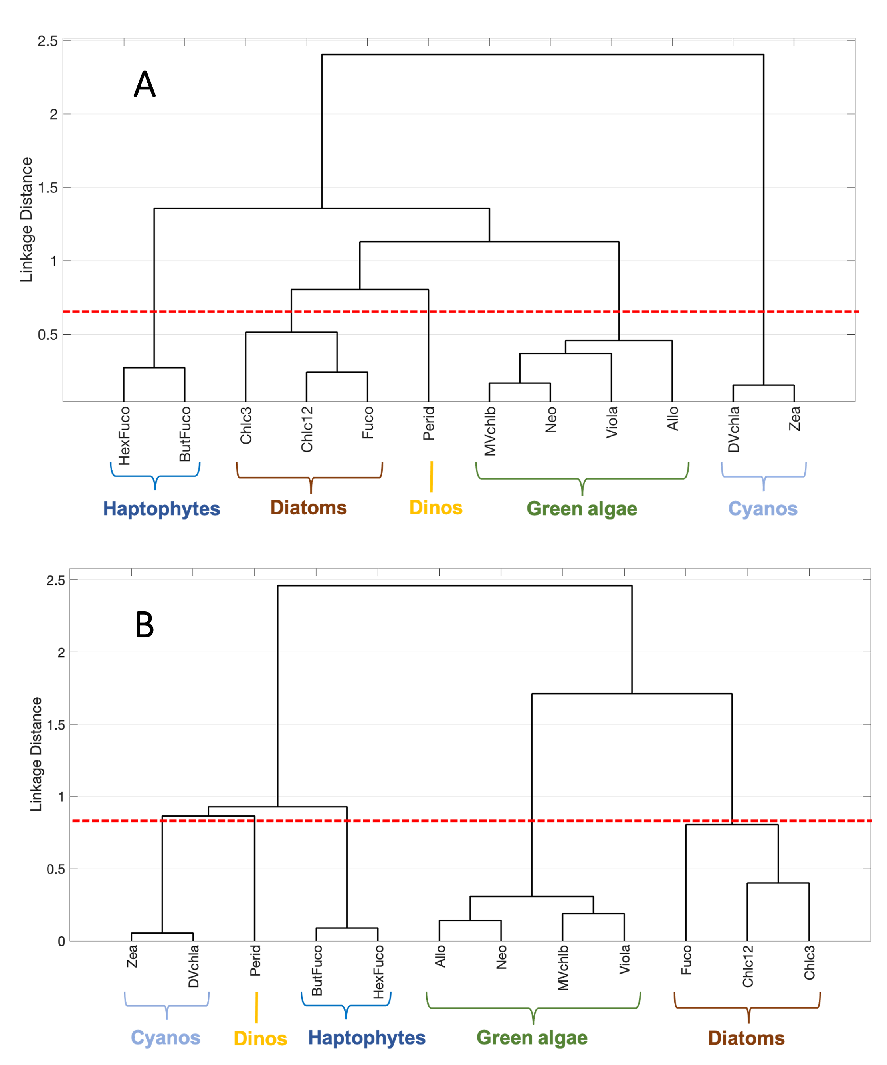
Modeling global surface ocean phytoplankton pigments from hyperspectral reflectance
Kramer, S.J. et al. (2022), Rem Sens of Envi, 270, https://doi.org/10.1016/j.rse.2021.112879.
Science Question: Characterizing phytoplankton community composition from space is a major goal of PACE. Phytoplankton contain pigments that can be used to broadly separate taxonomic groups. Can we develop robust methods for quantifying phytoplankton pigment concentrations from hyperspectral reflectance?
Analysis: We compiled an in situ dataset of 145 samples: matching phytoplankton pigments and hyperspectral remote sensing reflectance (R_{rs}). We also modeled hyperspectral R_{rs}, and the difference between modeled and measured R_{rs} (𝛿R_{rs}) varied across the visible spectrum, corresponding with pigment composition. The second derivative of the difference spectrum (𝛿”R_{rs}) was used to model phytoplankton pigment concentrations.
Results: Through principal components regression modeling, the concentrations of 13 distinct phytoplankton pigments were modeled from 𝛿”R_{rs}. The relationships between and among these pigments remained consistent from measured (Fig. A) to modeled (Fig. B) pigments.
Significance: These results demonstrate that we can reliably model phytoplankton pigment concentrations from hyperspectral R_{rs}. While pigments are not a perfect measure of phytoplankton taxonomy, they provide more resolution than chlorophyll-a measurements from space.
(A) Measured phytoplankton pigments cluster into 5 broad taxonomic groups; (B) the same groups then cluster from the modeled pigments reconstructed from hyperspectral R_{rs}.
Notes:
Citation: Kramer, S.J., D.A. Siegel, S. Maritorena, D. Catlett (2022). Modeling surface ocean phytoplankton pigments from hyperspectral remote sensing reflectance on global scales. Remote Sensing of Environment, 270, 1-14, https://doi.org/10.1016/j.rse.2021.112879.
Award Information: This research was supported by the NASA Earth Science Division PACE Science and Applications Team (NNH19ZDA001N-PACESAT) to Dave Siegel and Stéphane Maritorena under NASA Award number 80NSSC20M0226.

