Slide 1
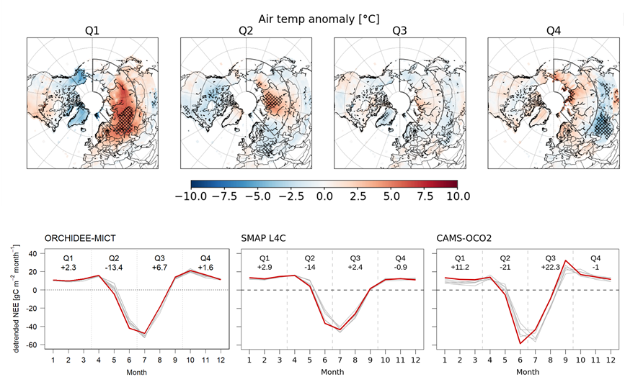
Recent Siberian heatwave increased spring CO₂ uptake but not annual CO₂ uptake
Kwon, Ballantyne, Ciais, et al. 2021. Env. Res. Lett., https://doi.org/10.1088/1748-9326/ac358b
Problem: Siberia has vast permafrost areas vulnerable to Arctic warming, where carbon emissions from thawing permafrost may be degrading the northern land sink for Atm. CO₂. Siberia experienced an extreme heatwave in 2020, with uncertain impacts to the ecosystem carbon (CO₂) sink.
Methods: Integrated analysis of carbon flux estimates from satellite observations (SMAP L4C), land surface models (ORCHIDEE-MICT), and Atm. CO₂ inversions (CAMS-OCO2) using global reanalysis climate data (ERA5, 1979-2020).
Findings: The heatwave produced earlier and stronger photosynthetic CO₂ uptake in spring (~22 gC m⁻²), which was offset by larger CO₂ respiration losses in the other seasons and a summer drought-induced decline in photosynthesis. The large seasonal compensation led to a net annual CO₂ sink (~3 g C m⁻² y⁻¹) that was only slightly lower than previous less warm years.
Impact: Seasonal compensation of enhancements in both photosynthetic CO₂ uptake and respiration losses from amplified Arctic warming and permafrost thaw may limit northern carbon sink capacity.
Top: Quarterly surface temperature anomalies in 2020 showing anomalous Siberian heatwave. Bottom: Detrended monthly anomalies in net ecosystem CO₂ exchange (NEE) in 2020 over Siberia from SMAP L4C, ORCHIDEE-MICT, and CAMS-OCO2 (in red) in relation to other recent years (2015-2019, in grey); NEE shows earlier and stronger photosynthetic CO₂ uptake in spring and early summer, which is offset by enhanced CO₂ respiration losses in the other seasons.
Notes:
Full citation:
Kwon, M.J., A.P. Ballantyne, P. Ciais, A. Bastos, F. Chevallier, Z. Liu, J.K. Green, C. Qiu, and J.S. Kimball, 2021. Siberian 2020 heatwave increased spring CO2 uptake but not annual CO2 uptake. Environmental Research Letters, https://doi.org/10.1088/1748-9326/ac358b.
Abstract:
Siberia experienced an unprecedented strong and persistent heatwave in winter to spring of 2020. Using bottom-up and top-down approaches, we evaluated seasonal and annual CO₂ fluxes of 2020 in the northern hemisphere (north of 30ºN), focusing on Siberia where the pronounced heatwave occurred. We found that over Siberia, CO₂ respiration loss in response to the pronounced positive winter temperature anomaly was greater than in previous years. However, continued warming in spring enhanced photosynthetic CO₂ uptake, resulting in the largest seasonal transition in NEE—the largest switch from the net CO₂ loss in winter to net CO₂ uptake in spring until June. However, this exceptional transition was followed by the largest reduction in CO₂ uptake in later summer, due to multiple environmental constraints, including a soil moisture deficit. Despite a substantial increase of CO₂ uptake by 22 ± 9 gC m⁻² in spring in response to the heatwave, the mean annual CO₂ uptake over Siberia was negligible (3 ± 13 gC m⁻² year⁻¹) and different from the average of the previous five years. These results highlight the highly dynamic response of seasonal carbon fluxes to extreme temperature anomalies at high latitudes, indicating a seasonal compensation between abnormal uptake and release of CO₂ in response to extreme warmth that may limit carbon sink capacity in high northern latitudes.

