Slide 1
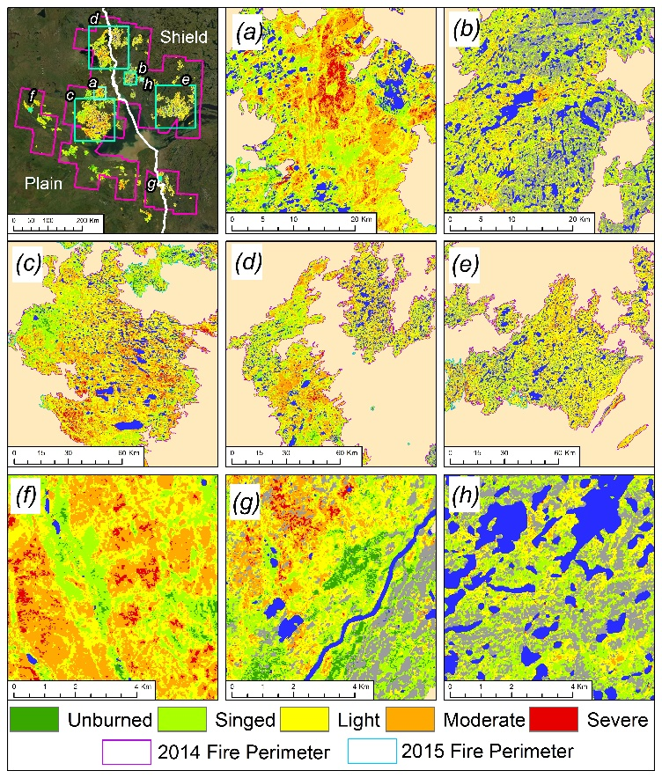
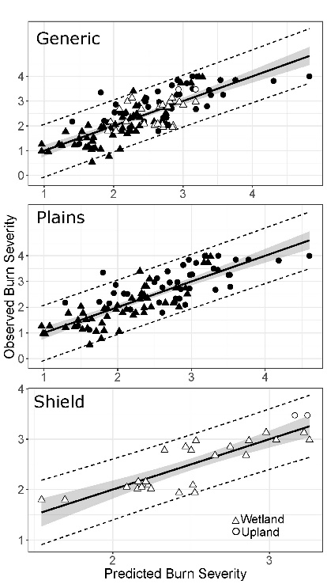
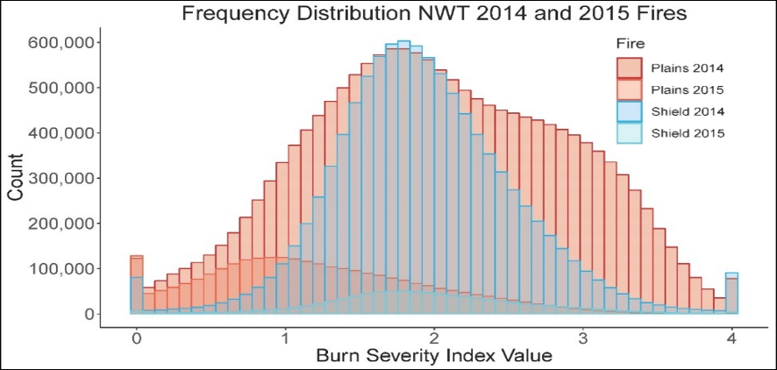
Quantifying Surface Severity of the 2014 and 2015 Fires in the Great Slave Lake Area of Canada
French NH, Graham JA, Whitman E, Bourgeau-Chavez LL (Aug. 2020). International Journal of Wildland Fire. doi: 10.1071/WF20008
Background:
The 2014 and 2015 fire seasons in the Great Slave Lake area generated some of the largest fires on record for the region, burning over 34,000 km² across the shield and plains ecoregions and numerous ecosystem types.
The severity of these burns, in particular to the organic surface layer, has several meaningful implications, including: direct carbon emissions, post-fire carbon balance, and on the successional trajectory of ecosystem structure and function.
Historically fire severity has focused on canopy severity in upland ecosystems and is generally inferred from the remote sensing metric, dNBR.
Using post-fire field data this study developed a model for predicting severity to the organic layer in both upland and peatland ecosystems specifically for this region that improves upon the use of dNBR.
Findings:
Data from the near and mid-range infrared bands were the best predictors of burn severity.
Multiple linear regression models reasonably predicted severity, though separate models were created due to the inherent differences between the plains (R²=0.67) and shield (R²=0.73).
Severity in the 2014 plains was more severe than the shield or either ecoregion in 2015, with just 4% of burnable surface left unburned, suggesting it was a remarkable event.
Significance:
This study generated maps using Landsat 8 that provides a reliable estimate of burn severity to the organic soil layer .
These maps can be used in future studies for assessment of post-fire recovery, or combined with other spatial products for further analyses (e.g. ecosystem classification maps to investigate ecosystem level effects)
While dNBR is a useful generic metric, in general it overestimated burn severity in this region; models generated from field data provide improved metrics of burn severity to soils or canopy
Analysis: Field data of the burn severity index, a field metric developed to quantify fire severity to the organic surface layer was collected at 90 sites (53 peatland, 37 upland) was paired with pre- and post-fire Landsat 8 data to create multiple linear regression models to predict severity. Models were cross-validated and further validated using field data on 2016 fires, then applied to mosaicked Landsat 8 data to create burn severity maps
Notes:
Citation: Tourian, M. J., Reager, J. T., & Sneeuw, N. (2018). The total drainable water storage of the Amazon river basin: A first estimate using GRACE. Water Resources Research, 54, 3290–3312. https://doi.org/10.1029/2017WR021674

