Slide 1
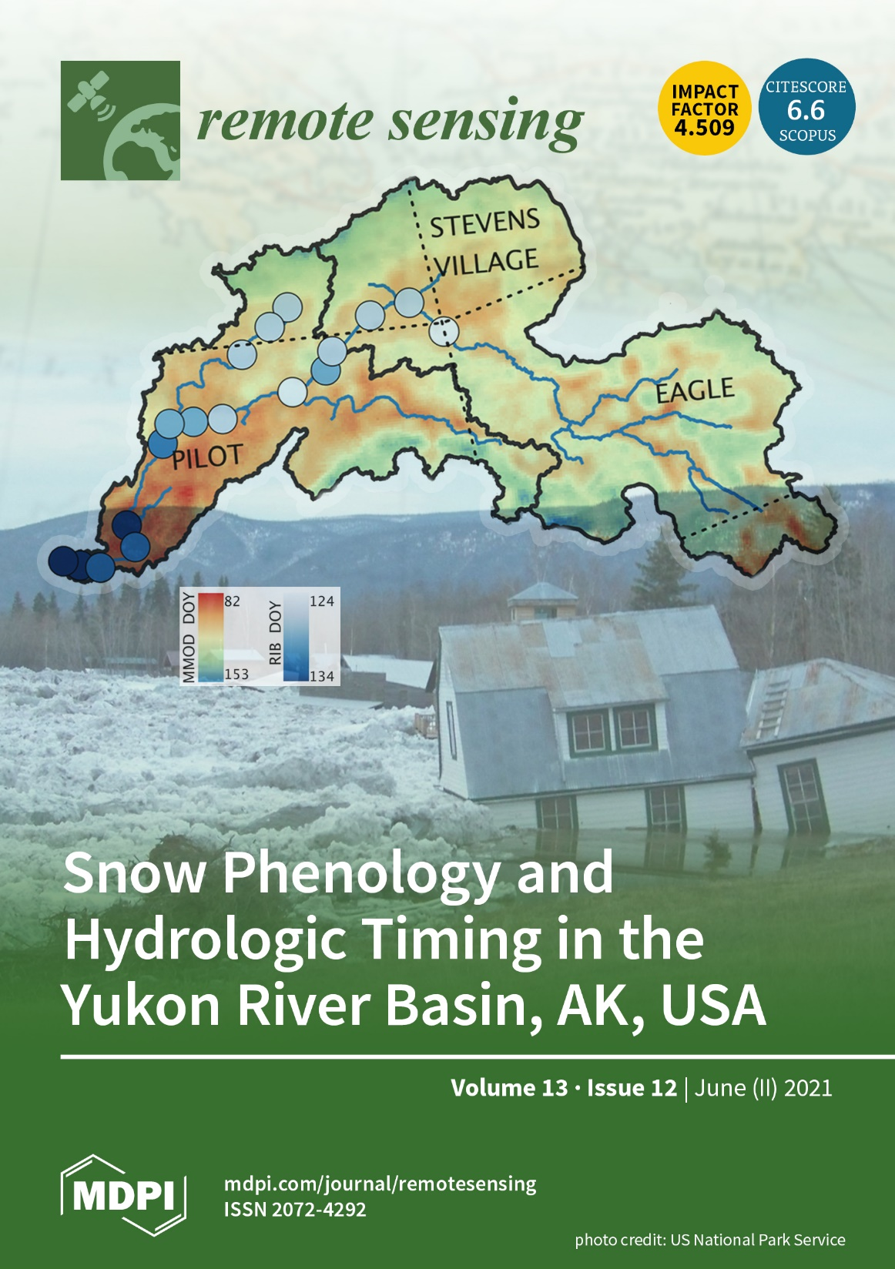
Satellite Monitoring of Snow Phenology and the Spring Flood Pulse in the Yukon Basin
Pan, Kirchner, Kimball, Du, and Rawlins, 2021. Remote Sensing 13, https://doi.org/10.3390/rs13122284
Background: The Yukon basin encompasses 832,000 km² and one of the largest boreal-Arctic rivers. The river hydrology is characterized by a long winter frozen season followed by an abrupt spring snowmelt-driven flood pulse. Capabilities for regional monitoring & forecasting of the flood pulse and river ice breakup (RIB) in the Yukon and other northern basins is limited, but critical to informing flood related risks to regional communities.
Analysis: We used satellite multi-frequency daily microwave brightness temperatures (18.7, 36.5 GHz) from SSM/I & AMSR sensors to derive a consistent multi-year record (1988-2016) of key spring snow metrics, including the Main Melt Onset Date (MMOD), mapped to a consistent 6.25 km grid resolution. Satellite retrievals were compared & validated against stream flow, river ice breakup (RIB), and snowmelt observations from regional weather stations.
Findings: The satellite MMOD retrievals showed good agreement with station observed MMOD (mean bias from 1 to -3.6 days) and RIB (r=0.61); the MMOD retrieval was also found to be an effective 14-27 day leading indicator for RIB within a catchment.
Significance: New capability for all-weather satellite monitoring & forecasting of the spring flood pulse and RIB in the Yukon and other northern basins.
Figure: Journal issue cover image showing satellite observed MMOD in the Yukon basin relative to mean RIB timing (1988-2016) from 19 measurement stations (circles); background image shows flood damage following RIB along the Yukon river.
Notes:
Kahru, M., Z. Lee, B.G.Mitchell1and C.D. Nevison (2016), Effects of sea ice cover on satellite-detected primary production in the Arctic Ocean, Biology Letters, 12: 20160223.
http://dx.doi.org/10.1098/rsbl.2016.0223.
Satellite Data:
OCTS - Ocean Color Temperature Scanner (NASDA)
SeaWiFS - Sea-Viewing Wide Field-of-View Sensor (NASA)
MERIS - MEdium Resolution Imaging Spectrometer (ESA)
MODIS-Aqua (NASA)
Primary productivity (NPP) in the Arctic Ocean has increased by 47% from the first half (1998-2006) to the 2nd half of the series (2007-2015) but changes after 2011 have been minor. NPP per open water area has actually decreased. Increased open water area is related to increased NPP in the summer with the strongest effect in June. In northern Barents Sea, sea ice retreat has become earlier at a rate of -4.5 day/year and the high-productivity season is starting earlier at a rate of -3.0 day/year. Freeze-up is occurring later but the timing of the end of the high NPP period has not changed.

Slide 2
Full Citations & Abstract
Article citation:
Pan, C.G., P.B. Kirchner, J.S. Kimball, J. Du, and M.A. Rawlins, 2021. Snow phenology and hydrologic timing in the Yukon River basin, AK, USA. Remote Sensing 13, 12, 2284, https://doi.org/10.3390/rs13122284 (cover article).
Data citations:
Pan, C.G., P.B. Kirchner, J.S. Kimball, and J. Du. 2021. ABoVE: Passive Microwave-derived Annual Snowpack Main Melt Onset Date Maps, 1988-2016. ORNL DAAC, Oak Ridge, Tennessee, USA. https://doi.org/10.3334/ORNLDAAC/1841.
Pan, C.G., P.B. Kirchner, J.S. Kimball, and J. Du. 2021. ABoVE: Passive Microwave-derived Annual Snow Melt Duration Date Maps, 1988-2016. ORNL DAAC, Oak Ridge, Tennessee, USA. https://doi.org/10.3334/ORNLDAAC/1843.
Abstract: The Yukon River basin encompasses over 832,000 km² of boreal Arctic Alaska and northwest Canada, providing a major transportation corridor and multiple natural resources to regional communities. The river seasonal hydrology is defined by a long winter frozen season and a snowmelt-driven spring flood pulse. Capabilities for accurate monitoring and forecasting of the annual spring freshet and river ice breakup (RIB) in the Yukon and other northern rivers is limited, but critical for understanding hydrologic processes related to snow, and for assessing flood-related risks to regional communities. We developed a regional snow phenology record using satellite passive microwave remote sensing to elucidate interactions between the timing of upland snowmelt and the downstream spring flood pulse and RIB in the Yukon. The seasonal snow metrics included annual Main Melt Onset Date (MMOD), Snowoff (SO) and Snowmelt Duration (SMD) derived from multi-frequency (18.7 and 36.5 GHz) daily brightness temperatures and a physically-based Gradient Ratio Polarization (GRP) retrieval algorithm. The resulting snow phenology record extends over a 29-year period (1988–2016) with 6.25 km grid resolution. The MMOD retrievals showed good agreement with similar snow metrics derived from in situ weather station measurements of snowpack water equivalence (r = 0.48, bias = −3.63 days) and surface air temperatures (r = 0.69, bias = 1 day). The MMOD and SO impact on the spring freshet was investigated by comparing areal quantiles of the remotely sensed snow metrics with measured streamflow quantiles over selected sub-basins. The SO 50% quantile showed the strongest (p < 0.1) correspondence with the measured spring flood pulse at Stevens Village (r = 0.71) and Pilot (r = 0.63) river gaging stations, representing two major Yukon sub-basins. MMOD quantiles indicating 20% and 50% of a catchment under active snowmelt corresponded favorably with downstream RIB (r = 0.61) from 19 river observation stations spanning a range of Yukon sub-basins; these results also revealed a 14–27 day lag between MMOD and subsequent RIB. Together, the satellite based MMOD and SO metrics show potential value for regional monitoring and forecasting of the spring flood pulse and RIB timing in the Yukon and other boreal Arctic basins.
Acknowledgement: This study was funded by NASA (NNX15AT74A, 80NSSC18K0980) and the National Park Service Southwest Alaska in support of the Arctic Boreal Vulnerability Experiment (ABoVE).

