Slide 1
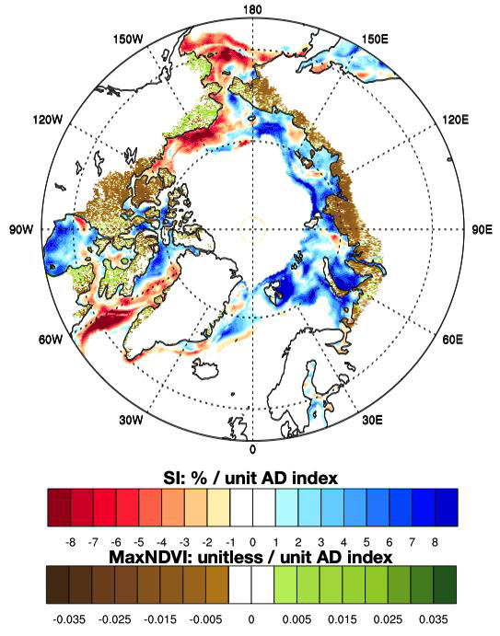
Climate drivers and Arctic tundra variability and change using an indicators framework
Bhatt, US, DA Walker, MK Raynolds, JE Walsh, PA Bieniek, L Cai, JC Comiso, HE Epstein, GV Frost, R Gersten, AS Hendricks, JE Pinzon, LV Stock, and CJ Tucker. 2021. Environmental Research Letters 16:055019.
Arctic tundra greenness has increased since 1982, but trends and variability have become more complex since the early 2000s.
Have links between tundra greenness, spring sea-ice extent, and summer temperature changed recently?
How do continentality, summer precipitation, and the Arctic Dipole—a pattern of atmospheric sea level pressure variability associated with winds in the transpolar drift region that influence the export of sea-ice out of the Arctic—influence tundra productivity?
Can we predict tundra productivity in advance using indicators?
Analysis
We analyzed correlations among climate variables and Normalized Difference Vegetation Index (NDVI) data from the Advanced Very High Resolution Radiometer (AVHRR) using an indicators framework.
Results
Changes in sea-ice drive variability in the other indicators. As ice declines, Arctic climate becomes less continental.
Arctic greening trends have become more heterogeneous as sea ice retreats
The winter Arctic Dipole is correlated with Eurasian productivity
Significance
Winter (Arctic Dipole) and spring (sea-ice) indicators are potential predictors of tundra vegetation productivity a season or two in advance
Award Information
This work was supported in part by ABoVE Award #NNH16CP09C.
Spring Sea-ice Extent
Continentality Index
Trends in (a) spring sea-ice extent and (b) and continentality index. As sea-ice has decreased, Arctic climates have shifted to a more maritime regime.
Regression coefficients of spring sea-ice (SI) and maximum NDVI on the winter Arctic Dipole (AD). The winter AD is well correlated with spring sea-ice extent in Eurasia. This teleconnection index has potential for predicting tundra greenness about 6 months in advance through its impact on spring sea ice.
Notes:
This slide contains a sample of the contents of an MSR Slide that we suggest

