Slide 1
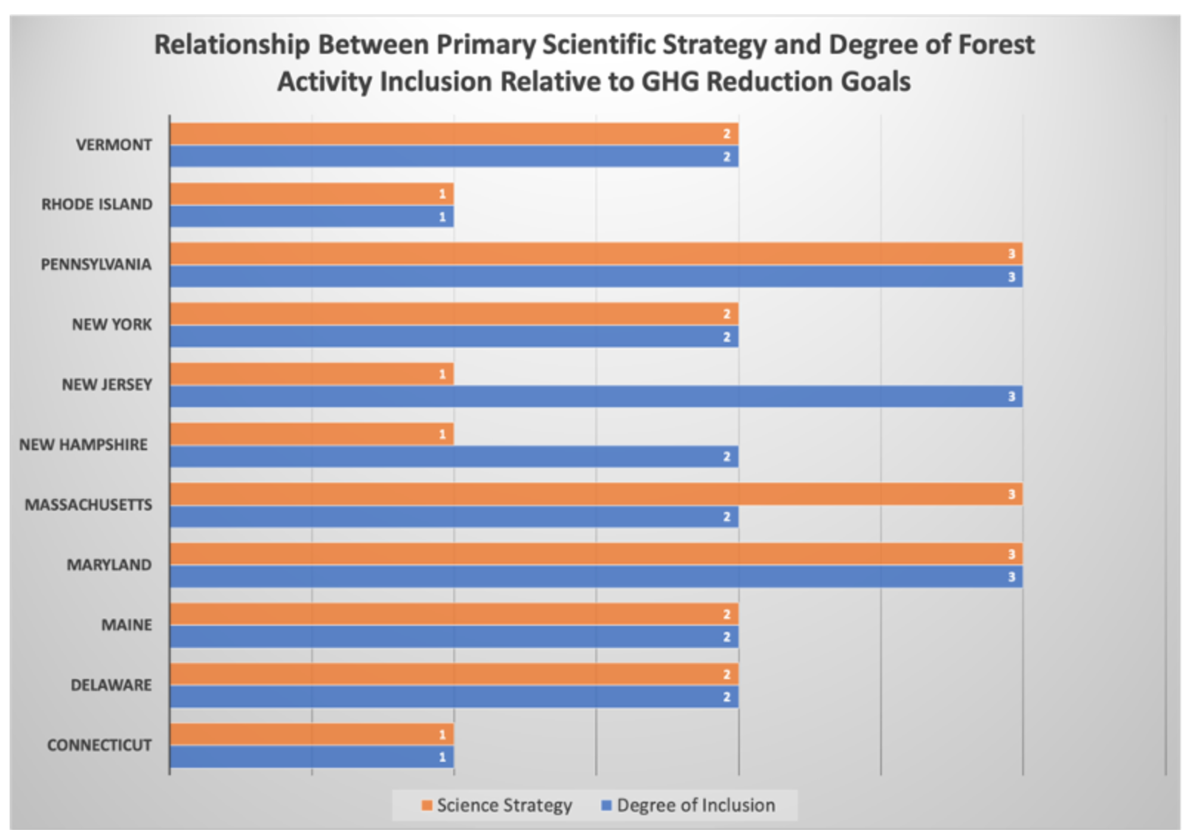
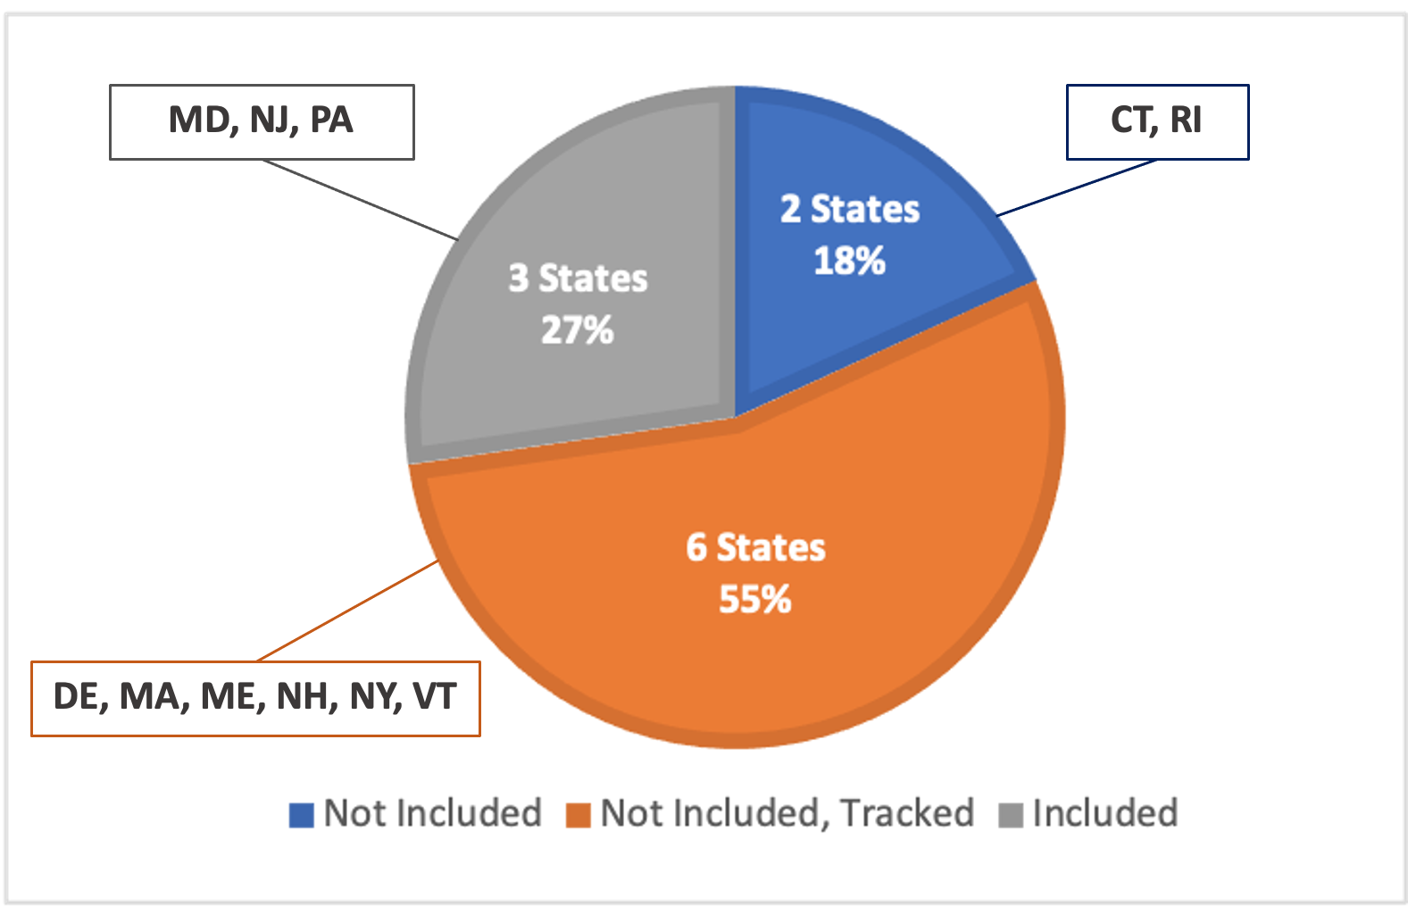
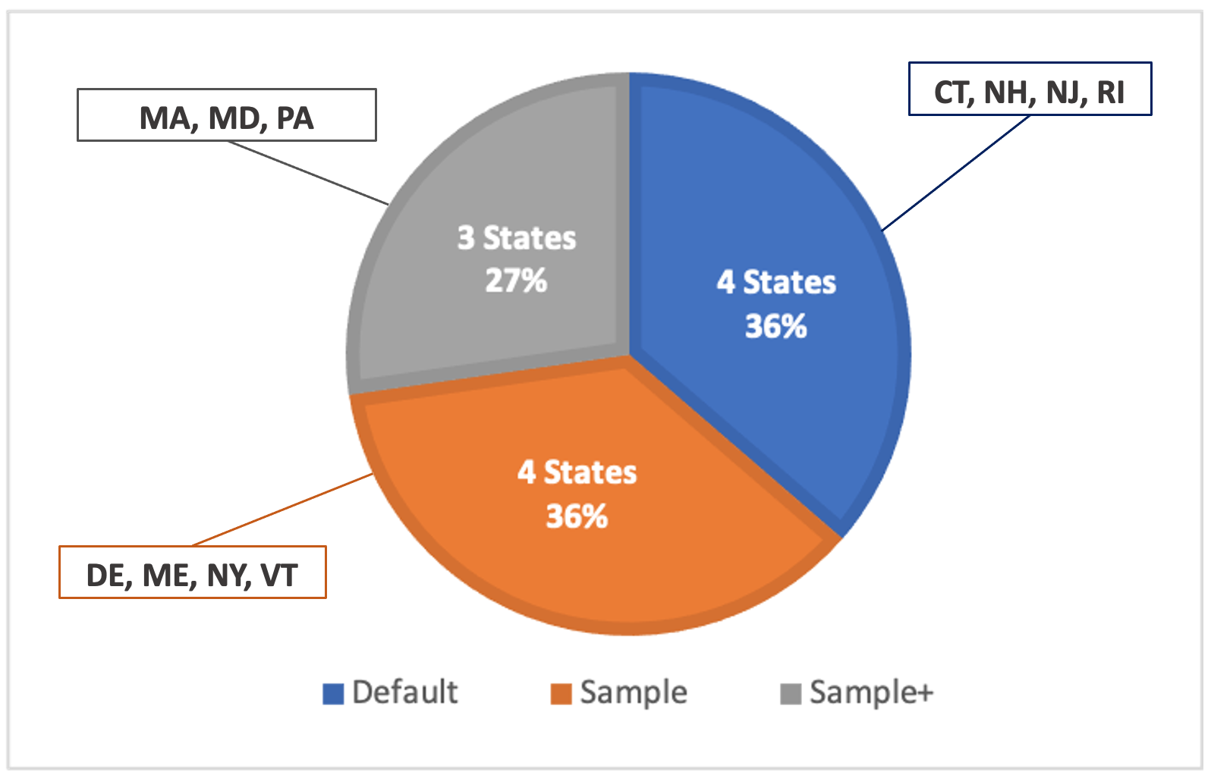
Context and future directions for integrating forest carbon into sub-national climate mitigation planning in the RGGI region of the US
Rachel Lamb, George Hurtt, Tee Jay Boudreau, Elliott Campbell, Edil Sepúlveda Carlo, Hong-Hanh Chu, Jennifer de Mooy, Ralph O. Dubayah, Dena Gonsalves, Maddie Guy, Nathan E Hultman, Shawn Lehman, Bennet Leon, Andrew Lister, Cary Lynch, Lei Ma, Christopher R. Martin, Nathan P. Robbins, Alex Rudee, Carlos E Silva, Christopher Skoglund, and Hao Tang, Environ. Res. Lett.., https://doi.org/10.1088/1748-9326/abe6c2
Science Question
Science Policy Relationships
Regional Patterns
What is the scientific and policy context for integrating forest carbon into state climate mitigation planning across the Regional Greenhouse Gas Initiative (RGGI) domain?
Method
Topical review across 11 states (CT, DE, MA, MD, ME, NH, NJ, NY, PA, RI, VT).
Using published gov documents and presentations, for each state we reviewed the: 1) policy framework for climate mitigation, 2) GHG reduction goals, 3) inclusion of forest activities in the state's climate action plan, 4) existing science used to quantify forest carbon estimates, and 5) stated needs for forest carbon monitoring science.
Paper includes co-authors/participants from each state.
Figure 2: Degree to which forest activities are included towards greenhouse gas (GHG) reduction goals.
Results/ Significance
Nearly 3/4 of all states do not include forest activity towards GHG reductions; those that do use range of scientific methods with various levels of planning detail and guidance.
Most states demonstrate commensurate levels of science sophistication and policy inclusion.
All states expressed a need for new high-resolution data and models on forest carbon to advance their science and planning.
A common carbon monitoring system would provide for the scientific needs of each state, facilitate comparisons between states, and operate more efficiently than multiple systems.
Figure 1: State-by-state relationships between the degree to which forest activities are included towards greenhouse gas (GHG) emissions reduction goals and the primary scientific strategy employed to generate related forest carbon estimates.
Science Strategies (1-Default, 2-Sample, 3-Sample+)
Degree of Inclusion (1-Not Included, 2-Not Included, Tracked, 3-Included)
Where levels are the same, the scientific strategy and degree of policy inclusion are considered to be commensurate.
Simulated vegetation carbon map in 2000 of four rules
Figure 3: Primary scientific strategy employed by states to estimate forest carbon stocks and fluxes within their climate mitigation plans or greenhouse gas inventories.
Sponsor: NASA-CMS (80NSSC17K0710) and NASA-NIP (80NSSC18K0708)

