Slide 1
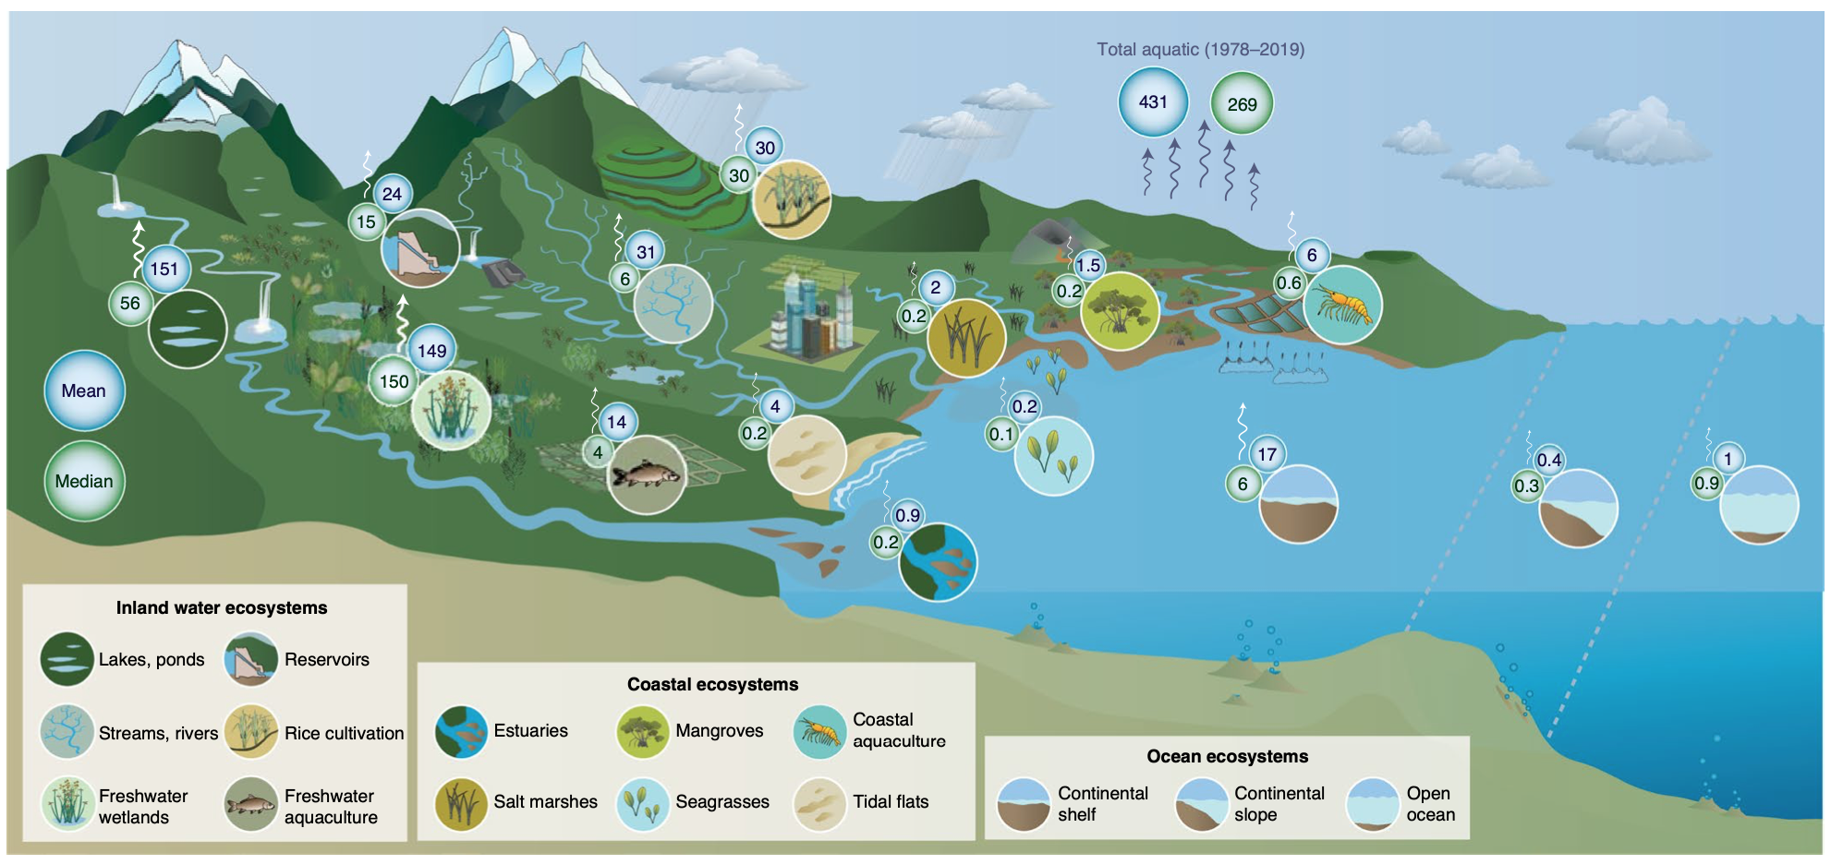
Half of global methane emissions come from
highly variable aquatic ecosystem sources
Rosentreter, JA…B Poulter, et al., Nature Geoscience (2021)
Science Question
Atmospheric methane concentrations are increasing rapidly, with 2020 having the largest growth on record. Methane is the second most important greenhouse gas after carbon dioxide in terms of its total radiative forcing since the industrial revolution. The drivers of growth of atmospheric methane is highly uncertain and due to a combination of oil and gas activities, agriculture, and wetland-climate feedbacks. Without a comprehensive understanding of the global methane budget, mitigation strategies will struggle in terms of their evaluation and effectiveness.
Analysis
A comprehensive meta-analysis of existing datasets of natural and managed wetland methane emissions was carried out. A statistical assessment and global upscaling of these fluxes was used to develop a global flux for each of 15 different wetland types.
Figure Caption
Global wetlands emit 269-431 TgCH₄ yr⁻¹, with freshwater wetlands contributing the largest amount (148-150 TgCH₄ yr⁻¹), and lakes (55-150 TgCH₄ yr⁻¹) and aquaculture ponds (4-14 TgCH₄ yr⁻¹) having the highest uncertainty.
Results
Fifteen natural and managed wetland types were identified, emitting 269-431 TgCH₄ yr⁻¹, the equivalent of 41-53% of total global emissions. Impacted aquatic systems, such as aquaculture ponds, reservoirs, and freshwater wetlands (in contrast to coastal and oceanic ecosystems) have the greatest rates of emissions. Upscaling using mean led to higher global-sectoral fluxes than upscaling using median.
Significance
This study is the first global assessment of wetland methane emissions from natural and managed ecosystems. Managed and constructed wetlands contribute to almost 20% of global wetland methane emissions. There remains considerable uncertainty in the range of wetland methane emissions, but also opportunity to manage and reduce emissions in constructed wetlands through reductions in nutrient loading, organic inputs, and modifications in hydrologic conditions.

