Slide 1
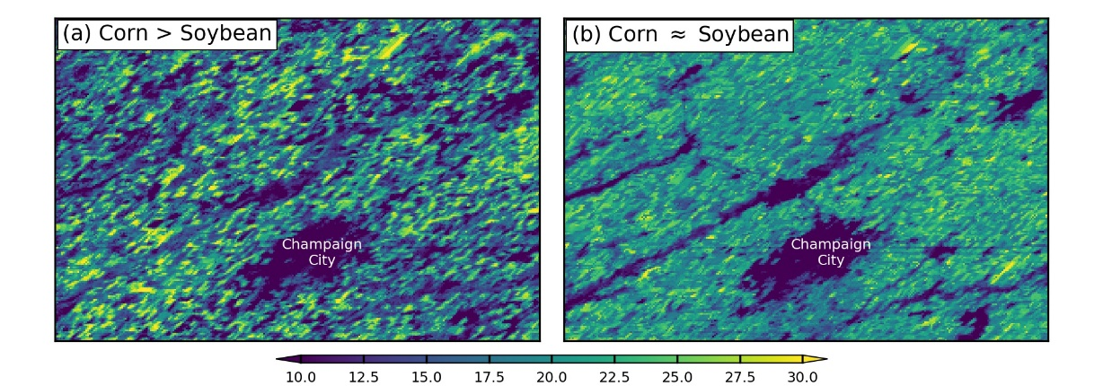
SLOPE: A daily, 250m and real-time gross primary productivity product (2000–present) covering the CONUS Jiang. C.*, Guan. K.*, Wu. G., Peng. B., Wang. S. 2021. Earth System Science Data 10.5194/essd-13-281-2021
Background: Gross primary productivity (GPP) is largest terrestrial carbon flux. To date, a high-spatiotemporal-resolution, low-latency, and observation-based GPP product is lacking.
Methods: SatelLite Only Photosynthesis Estimation (SLOPE)
Photosynthetically active radiation (PAR) by coupling machine learning models with MODIS atmosphere and land products.
Gap-free soil-adjusted near-infrared reflectance of vegetation (SANIRv) from MOD/MYD09 surface reflectance data.
C4 crop dynamics by coupling temporal pattern recognition with a long-term cropland data layer product.
Results:
SLOPE has higher spatial (250m vs. >500m) and temporal (daily vs. 8 d) resolution, higher instantaneity (1 d vs, >2 weeks) than previously available products.
SLOPE explained 85% of spatiotemporal GPP radiation from 49 AmeriFlux eddy-covariance sites.
Significance: SLOPE is promising for carbon monitoring, especially for agro-ecosystems.
Daily GPP in growing season in 2020. The Corn Belt is a hotspot.
gC m²/day
GPP in Illinois on (a) 10 July and (b) 20 Aug, 2020 show difference between corn and soybean
Notes:
Full citation: Jiang, C.*; Guan, K.*; Wu, G.; Peng, B.; Wang, S. A Daily, 250 m, and Real-Time Gross Primary Productivity Product (2000–Present) Covering the Contiguous United States. Earth Syst. Sci. Data 2021, 13 (2), 281–298. https://essd.copernicus.org/articles/13/281/2021/
Financial support: This research has been supported by NASA CMS program “Improving the monitoring capability of carbon budget for the US Corn Belt - integrating multi-source satellite data with improved land surface modeling and atmospheric inversion” (80NSSC18K0170). PI: Kaiyu Guan
Data availability: The archived dataset is available at ORNL DAAC: https://doi.org/10.3334/ORNLDAAC/1786.

