Slide 1
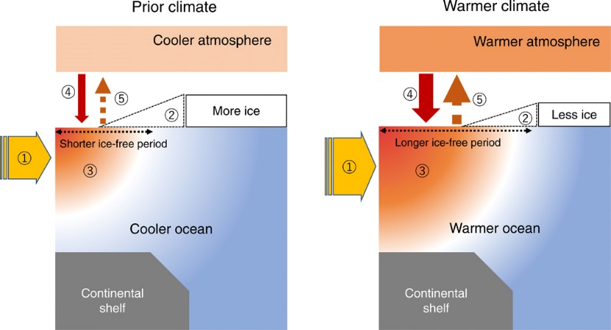
Increasing River Heat Influx Triggers Arctic Sea Ice Decline
Park, Watanabe, Kim, Polyakov, Oshima, Zhang, Kimball, Yang, 2020. Science Advances, DOI:10.1126/sciadv.abc4699
Science Question: Rivers deliver relatively warm freshwater to the Arctic Ocean, affecting the upper ocean heat budget & potentially enhancing sea ice decline. However, the amount & impact of riverine heat on sea ice dynamics & ocean-Atm. energy exchange has been uncertain, until now.
Analysis: State-of-the-art numerical modeling of coupled land-ocean-sea ice processes over the pan-Arctic. Quantification of riverine heat inputs & impacts over the six major Arctic shelf regions from 1980-2015. Validation of model land freeze-thaw (FT) & ocean sea ice concentration (SIC) dynamics using satellite microwave retrievals (SMMR, SSM/I, SSMIS).
Results: A positive trend in river heat inputs contributed up to 10% of the regional sea ice reduction over the Arctic shelves from 1980-2015 (A, B). Increasing river heat inputs are promoting earlier seasonal breakup & delayed autumn sea ice formation.
Significance: A positive river heat-sea ice feedback nearly doubles the river heat effect, where increasing ice-free area is promoting a warmer Arctic Ocean in summer, reinforcing atmospheric warming (C).
A
B
C
(A) Increasing trend in river heat inputs to the Arctic Ocean, with (B) associated annual reduction (%) in mean sea ice thickness over the Arctic shelves; (C) Schematic of river heat-driven positive ocean-ice-atmosphere warming feedback.
Notes:
This slide contains a sample of the contents of an MSR Slide that we suggest

Slide 2
Notes
Citation:
Park, H., E. Watanabe, Y. Kim, I. Polyakov, K. Oshima, X. Zhang, J.S. Kimball, and D. Yang, 2020. Increasing riverine heat flux triggers Arctic sea-ice decline and oceanic and atmospheric warming. Science Advances, 6, 45, DOI:10.1126/sciadv.abc4699.
Award Information:
This research was partially supported by the NASA Terrestrial Ecology, MEaSUREs and Water Quality Programs under NASA Award numbers: NNX15AT74A, 80NSSC18K0980, 80NSSC19K0649.
This research also supported the NASA Terrestrial Ecology Arctic-Boreal Vulnerability Experiment.

