Slide 1
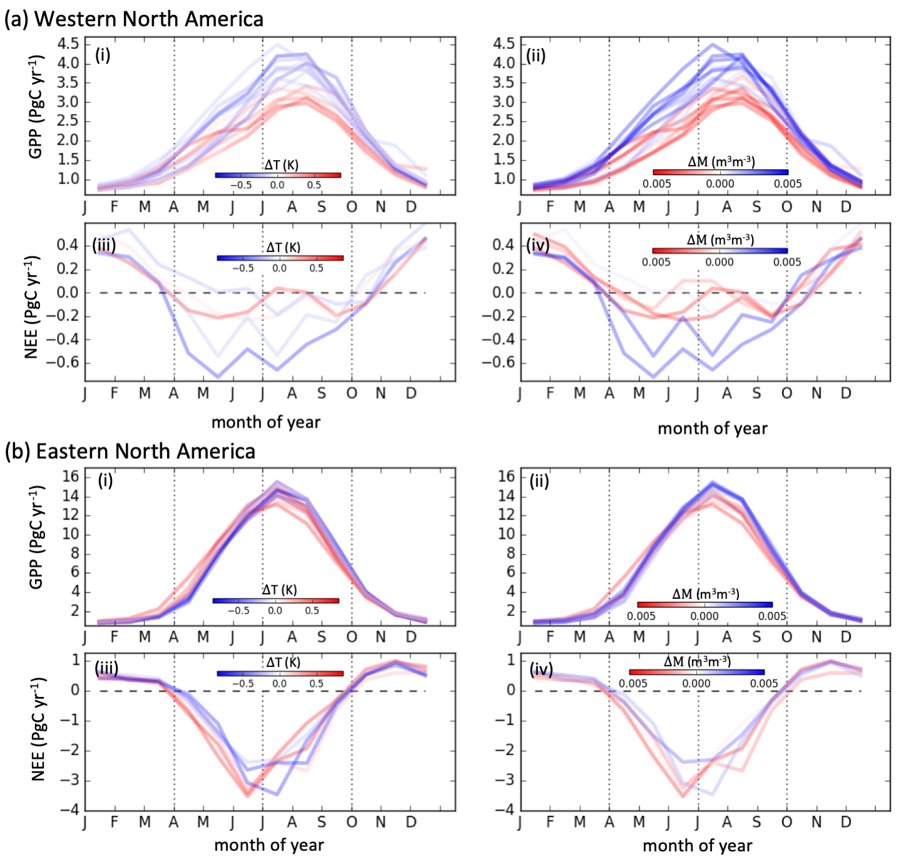
Contrasting regional carbon cycle responses to seasonal climate anomalies across the east-west divide of temperate North America Byrne, B. et al. (2020), Glob. Biogeochem. Cycles, DOI:10.1029/2020GB006598
National Aeronautics and Space Administration
Jet Propulsion Laboratory
California Institute of Technology
(a)
Science Question: Temperate North America is characterized by an east-west gradient in water availability and mean temperature, where ecosystems in the west are more moisture limited, and the east has lower annual mean temperature. These differences in climate are expected to lead to differences in the response of these ecosystems to climate variability. In this study, we employ state-of-the-science flux products to address two questions: (1) Can we identify east-west differences in interannual variability (IAV) from top-down constraints on gross primary productivity (GPP) and net ecosystem exchange (NEE)? And (2) what drives IAV differences in GPP and NEE between the east and west?
Data and Results: We used the NEE constraints from Byrne et al. (2020, https://doi.org/10.1029/2019JD032029), which provides top-down NEE estimates over 2010-2015 by assimilating space- and surface-based CO₂ measurements. We employ GPP estimates from FluxSat, which are derived from MODIS observations and calibrated against FLUXNET and SIF measurements. We find that (1) The GPP and NEE datasets show agreement in IAV over the two domains, with the west characterized by an amplification in productivity between years (e.g., some year are more productive throughout the growing season) and the east characterized by seasonal compensation between the spring and summer (e.g., years with increased spring productivity have reduced summer productivity). (2) We find that IAV in the west is closely associated with moisture, with cooler-wetter years being more productive. In the east, we find that variability is most closely associated with temperature, with warmer years having more productive springs and less productive falls.
Significance: This study demonstrates that atmospheric CO₂ measurements can inform IAV in NEE over sub-continental regions within North America. It also provides a better mechanistic understanding of carbon dynamics over these regions, linking CO₂ data assimilation research to the terrestrial ecology community. Three important insights into the carbon cycle of North America are (1) amplification of uptake with cooler-wetter conditions in the west, (2) seasonal compensation in the east associated with temperature, and (3) comparatively large growing season IAV in NEE in the west relative to the east due to the dominance of amplification relative to compensation in IAV.
(b)
(c)
Notes:
1
You may add comments here to clarify the work or the results.

Slide 2
National Aeronautics and Space Administration
Jet Propulsion Laboratory
California Institute of Technology
Contact:
Brendan Byrne, 233-200, Jet Propulsion Laboratory, Pasadena, CA 91109
brendan.k.byrne@jpl.nasa.gov
Citation:
Contrasting regional carbon cycle responses to seasonal climate anomalies across the east-west divide of temperate North America, Byrne, B., Liu, J., Bloom, A. A., Bowman, K. W., Butterfield, Z., Joiner, J., Keenan, T. F., Keppel-Aleks, G., Parazoo, N. C., Yin, Y. Glob. Biogeochem. Cycles, 2020, accepted
Data Sources:
Posterior NEE fluxes from Byrne et al. (2020) were downloaded from https://cmsflux.jpl.nasa.gov/. CarbonTracker CT2017 results provided by NOAA ESRL, Boulder, Colorado, USA from the website at http://carbontracker.noaa.gov. CarbonTracker Lagrange NEE fluxes were downloaded from https://doi.org/10.15138/3dw1-5c37. CAMS NEE fluxes were obtained from https://atmosphere.copernicus.eu/. FLUXNET2015 data were obtained from https://fluxnet.org. We downloaded MODIS/Terra Monthly Vegetation Indices Global 1x1 degree V005 (MODVI) dataset from Earthdata (https://earthdata.nasa.gov). MERRA-2 products were downloaded from MDISC [https://gmao.gsfc.nasa.gov/reanalysis/MERRA-2/], managed by the NASA Goddard Earth Sciences (GES) Data and Information Services Center (DISC). ESA CCI soil moisture data was downloaded from https://www.esa-soilmoisture-cci.org/.
Technical Description of Figure:
Seasonal cycles of GPP (2001–2017) and NEE (2010-2015) over eastern and western North America. (a) The spatial extent of western (orange) and eastern (yellow) regions of North America. (b) Seasonal cycles of (i-ii) GPP and (iii-iv) NEE over western North America. (c) Seasonal cycles of (i-ii) GPP and (iii-iv) NEE over eastern North America. Colors indicate the Apr-Sep ∆T ((i) and (iii)) or Apr-Sep ∆M ((ii) and (iv)).
Scientific significance, societal relevance, and relationships to future missions:
This study demonstrates that atmospheric CO₂ measurements can inform IAV in NEE over sub-continental regions. This is an important step for the CO₂ flux inversion community as it shows that we can examine IAV on sub-continental scales, and that increasing observational coverage from future XCO₂ observing missions will help refine these types of analysis. It also demonstrates that CO₂ flux inversions can inform our mechanistic understanding of carbon cycle dynamics on these scales. Such insights are critical for understanding the sensitivity ecosystems to climate change, and will be critical for predicting the response of these ecosystems to climate change and predict future carbon uptake by these ecosystems.

