Slide 1
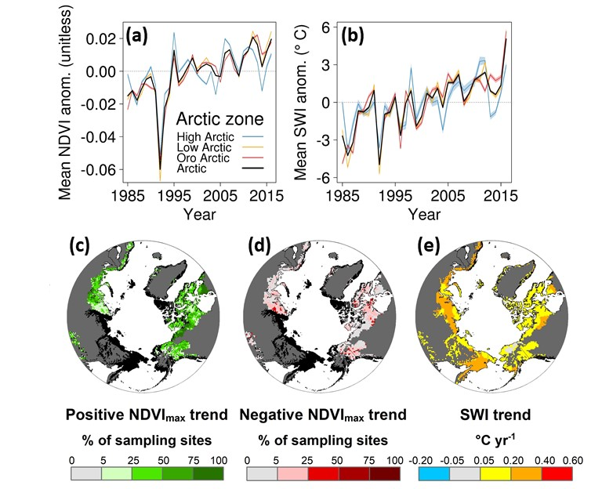
Summer warming explains widespread but not uniform greening in the Arctic tundra biome
Logan Berner, Richard Massey, Patrick Jantz, Bruce Forbes, Marc Macias-Fauria, Isla Myers-Smith, Timo Kumpula, Gilles Gauthier, Laia Andreu-Hayles, Ben Gaglioti, Pat Burns, Pentii Zetterberg, Rosanne D'Arrigo, and Scott Goetz (2020) Nature Communications, https://doi.org/10.1038/s41467-020-18479-5
Background:
Arctic warming can influence tundra ecosystem function with consequences for climate feedbacks, wildlife and human communities. Yet ecological change across the Arctic tundra biome remains poorly quantified due to field measurement limitations and reliance on coarse-resolution satellite data.
Methods:
We generated phenologically-modeled time series of annual maximum summer Normalized Difference Vegetation Index (NDVImax) from 1985 to 2016 for 50,000 sampling sites across the Arctic tundra biome using cross-calibrated surface reflectance measured by Landsat 5, 7, and 8.
We evaluated NDVImax trends, correlations with summer air temperatures, associations with environmental characteristics, and links with field measurements of plant productivity from biomass harvests, flux towers, and shrub dendroecology.
Findings:
Landsat NDVImax increased (greening) at ~37% of sampling sites from 1985-2016 but decreased (browning) at ~5% of sites during this period. There was no change at most (58%) sites. Extensive greening was also evident from 2000-2016.
Arctic greening was associated with rising summer air temperatures.
Landsat NDVImax was positively correlated with spatial and temporal variability in plant productivity measured at field sites across the Arctic.
Significance:
Our analysis provides unique evidence that summer warming stimulated plant productivity across much, but not all, of the Arctic tundra biome during recent decades.
Widespread increase in plant productivity across the Arctic affects wildlife habitat, carbon storage, surface energy balance, and land use by northern human communities.
Overall, our assessment highlights tundra greening as a bellwether of global climatic change that has wide-ranging consequences for life in northern high-latitude ecosystems and beyond.
The Landsat satellites show an overall greening of the Arctic from 1985-2016 (a). Greening was widespread (b) while browning was uncommon (c). Greening was associated with rising summer air temperatures (b,e), which were quantified using the summer warmth index (SWI) derived from an ensemble of five climate datasets. Similar changes were evident from 2000-2016.
Notes:
Full citation: Berner, L. T., Massey, R., Jantz, P., Forbes, B. C., Macias-Fauria, M., Myers-Smith, I. H., Kumpula, T., Gauthier, G., Andreu-Hayles, L., Gaglioti, B., Burns, P. J., Zetterberg, P., D'Arrigo, R., and Goetz, S. J.: Summer warming explains widespread but not uniform greening in the Arctic tundra biome, Nature Communications, In Press, https://doi.org/10.1038/s41467-020-18479-5, 2020.
Grants: This study was funded by the National Aeronautics and Space Administration (NASA) Arctic Boreal Vulnerability Experiment (ABoVE) and Carbon Cycle Science grants (NNX17AE44G, 80NSSC19M0112, and NNX17AE13G) to Scott Goetz.
Abstract: Arctic warming can influence tundra ecosystem function with consequences for climate feedbacks, wildlife and human communities. Yet ecological change across the Arctic tundra biome remains poorly quantified due to field measurement limitations and reliance on coarse-resolution satellite data. Here we assess decadal changes in Arctic tundra greenness using time series from the 30 m resolution Landsat satellites. From 1985 to 2016 tundra greenness increased (greening) at ~37.3% of sampling sites and decreased (browning) at ~4.7% of sampling sites. Greening occurred most often at warm sampling sites with increased summer air temperature, soil temperature, and soil moisture, while browning occurred most often at cold sampling sites that cooled and dried. Tundra greenness was positively correlated with graminoid, shrub, and ecosystem productivity measured at field sites. Our results support the hypothesis that summer warming stimulated plant productivity across much, but not all, of the Arctic tundra biome during recent decades.

Slide 2
Summer warming explains widespread but not uniform greening in the Arctic tundra biome
Citation: Berner, L. T., Massey, R., Jantz, P., Forbes, B. C., Macias-Fauria, M., Myers-Smith, I. H., Kumpula, T., Gauthier, G., Andreu-Hayles, L., Gaglioti, B., Burns, P. J., Zetterberg, P., D'Arrigo, R., and Goetz, S. J.: Summer warming explains widespread but not uniform greening in the Arctic tundra biome, Nature Communications, 2020, https://doi.org/10.1038/s41467-020-18479-5.
Funding: NASA Arctic Boreal Vulnerability Experiment (ABoVE) and Carbon Cycle Science grants (NNX17AE44G, 80NSSC19M0112, and NNX17AE13G) to Scott Goetz. Additional support provided by the National Science Foundation, Academy of Finland, United Kingdom National Environmental Research Council, Joint Fire Science Program, Lamont-Doherty Earth Observatory Climate Center, Natural Science and Engineering Research Council of Canada, Environment and Climate Change Canada, ArcticNet, and the Polar Continental Shelf Program.
NASA Goddard news feature: https://www.nasa.gov/feature/goddard/2020/warming-temperatures-are-driving-arctic-greening
Altmetric summary of online attention: https://www.nature.com/articles/s41467-020-18479-5/metrics

