Slide 1
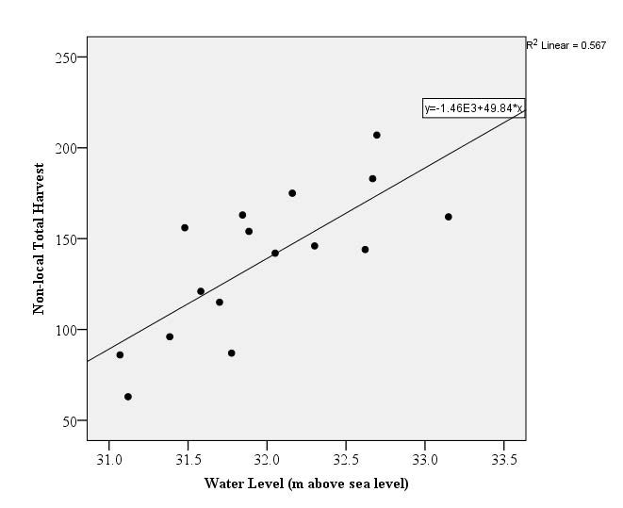
Quantifying effects of environmental factors on moose hunting success in Interior Alaska
Hasbrouck, T.R., et al. (in review). Journal of Wildlife Management
Background: Interior Alaskan hunters who rely on moose as a subsistence resource have expressed concern that warmer air temperatures are altering moose behavior, delayed leaf drop is decreasing sightability, and low water levels are limiting access to hunting areas.
Analysis: We assessed annual changes in 1) temperature, 2) leaf drop date, 3) water level used for access to hunting grounds, and 4) impacts of these changes on local and non-local moose hunter effort and success. We used satellite imagery, weather station data, and river gauging station data, and moose harvest records from 2000-2016.
Findings: We found no temporal trends in the environmental data nor any relationship between leaf drop and harvest. We found a positive relationship between daily water level and non-local harvest throughout September, and an inverse relationship between mean daily temperature and non-local hunter harvest for the same time period. Local hunters increased the number of days they hunted over time and harvest had a positive relationship with water levels from 16-20 Sept.
.
Significance: This research provided information on previously untested hypotheses regarding the impacts of environmental conditions on moose hunter harvest. In general, non-local harvest level was more affected by environmental factors. The negative association between air temperature and non-local harvest may be linked to moose behavior. Local harvesters may be less affected because of increased opportunity to switch hunting areas or select good hunting days. Water levels impacted both local and non-local harvest, as high water allows access into shallow sloughs.
Relationship between water level and non-local total harvest from 2000-2016 in our study area.

Slide 2
Notes
Citation: Hasbrouck, T.R., T.J. Brinkman, E. Trochim, G. Stout, and K. Kielland. Quantifying effects of environmental factors on moose hunting success in Interior Alaska. Prepared for submission to Journal of Wildlife Management.
Award Information:
This research contributes to the Arctic-Boreal Vulnerability Experiment Project “Biophysical Characteristics and Mechanisms of Environmental Disturbances Influencing Human Access to Ecosystem Services in Boreal Alaska” (NASA Award number NNX15AT83A).

