Slide 1




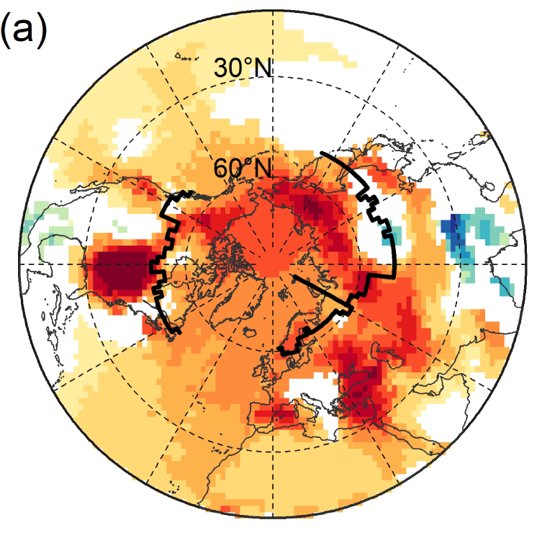
Siberian and temperate ecosystems shape Northern Hemisphere atmospheric CO₂ seasonal amplification
Xin Lin, Brendan M. Rogers, Colm Sweeney, Frédéric Chevallier, Mikhail Arshinov, Edward Dlugokencky, Toshinobu Machida, Motoki Sasakawa, Pieter Tans, Gretchen Keppel-Aleks (2020), PNAS, doi/10.1073/pnas.1914135117.
Background:
The seasonal cycle amplitude (SCA) of atmospheric CO₂ has increased by 30–50% in the Northern Hemisphere (NH) since the 1960s, suggesting widespread ecological changes in northern extratropical land ecosystems. Despite the large signal, we have limited knowledge of the geographic regions and underlying processes contributing to this amplification.
Methods:
We present a quantitative regional attribution of CO₂ seasonal amplification over the past four decades using a tagged tracer transport model with prescribed fluxes from CO₂ inversions.
We tagged 13 regions/ecosystems in GEOS-Chem transport model, ran the model and extracted simulated SCA at surface stations as well as aircraft sampling sites for evaluation and attribution.
After model evaluation, we conducted pixel-based analyses for the 3-D concentration fields to reveal the spatial patterns of trends in SCA and dominant contributors.
Findings:
Seasonal flux changes in Siberian and temperate ecosystems dominate the observed amplitude increases in the NH.
At the surface of northern high latitudes, enhanced seasonal carbon exchange in Siberia is the dominant contributor. Arctic-boreal North America shows much smaller changes in flux seasonality and has only localized impacts on the atmospheric ΔSCA.
Significance:
Our top-down approach corroborates satellite vegetation greening and browning trends from field and remote-sensing observations, which show more greening over Siberia and heterogeneous greening and browning over North America, providing independent evidence for regionally divergent ecological responses and carbon dynamics to global change drivers.
Our study suggests different mechanisms may be responsible for the regional divergence of high latitude ecosystems in response to global drivers, namely warming temperature and CO₂ fertilization.
Spatial patterns of ∆SCA and their dominant driving region in NH at the surface (a, b). Panel (c) shows flux amplification in Siberia is responsible for roughly 50% of the CO₂ annual cycle amplification in the high latitude atmosphere (orange) while Siberia and temperate ecosystems have equable contributions in the midlatitude atmosphere (green).
Notes:
Full citation: Lin, X., Rogers, B. M., Sweeney, C., Chevallier, F., Arshinov, M., Dlugokencky, E., Machida, T., Sasakawa, M., Tans, P., Keppel-Aleks, G. (2020) Siberian and temperate ecosystems shape Northern Hemisphere atmospheric CO₂ seasonal amplification. Proc. Natl. Acad. Sci., doi/10.1073/pnas.1914135117.
Associated data archives:
Lin, X., Keppel-Aleks, G., Rogers, B. M., Birch L. (2020) Simulated CO₂ tracer concentrations in the Northern Hemisphere from a tagged transport model GEOS-Chem v12.0.0 [dataset]. University of Michigan Library Deep Blue. https://doi.org/10.7302/rp59-rw535. Deposited 16 April 2020.
Grants: This study was funded by the National Aeronautics and Space Administration (NASA) Carbon Cycle Science and Arctic-Boreal Vulnerability Experiment (ABoVE) grant (NNX17AE13G) to X.L., G.K.-A., and B.M.R., as well as the NASA ABoVE grant (NNX17AC61A) to C.S.
Abstract: The amplitude of the atmospheric CO₂ seasonal cycle has increased by 30–50% in the Northern Hemisphere (NH) since the 1960s, suggesting widespread ecological changes in the northern extratropics. However, substantial uncertainty remains in the continental and regional drivers of this prominent amplitude increase. Here we present a quantitative regional attribution of CO₂ seasonal amplification over the past four decades, using a tagged atmospheric transport model prescribed with observationally-constrained fluxes. We find that seasonal flux changes in Siberian and temperate ecosystems together shape the observed amplitude increases in the NH. At the surface of northern high latitudes, enhanced seasonal carbon exchange in Siberia is the dominant contributor (followed by temperate ecosystems). Arctic-boreal North America shows much smaller changes in flux seasonality and has only localized impacts. These continental contrasts, based on an atmospheric approach, corroborate heterogeneous vegetation greening and browning trends from field and remote-sensing observations, providing independent evidence for regionally divergent ecological responses and carbon dynamics to global change drivers. Over surface mid-latitudes and throughout the mid-troposphere, increased seasonal carbon exchange in temperate ecosystems is the dominant contributor to CO₂ amplification, albeit with considerable contributions from Siberia. Representing the mechanisms that control the high-latitude asymmetry in flux amplification found in this study should be an important goal for mechanistic land surface models moving forward.

Slide 2
Siberian and temperate ecosystems shape Northern Hemisphere atmospheric CO₂ seasonal amplification
Citation: Lin, X., Rogers, B. M., Sweeney, C., Chevallier, F., Arshinov, M., Dlugokencky, E., Machida, T., Sasakawa, M., Tans, P., Keppel-Aleks, G. (2020) Siberian and temperate ecosystems shape Northern Hemisphere atmospheric CO₂ seasonal amplification. Proc. Natl. Acad. Sci., www.pnas.org/cgi/doi/10.1073/pnas.1914135117
Funding: NASA Carbon Cycle Science and Arctic-Boreal Vulnerability Experiment (ABoVE) grant (NNX17AE13G) to G.K.-A., and B.M.R.; NASA ABoVE grant (NNX17AC61A) to C.S.

