Slide 1
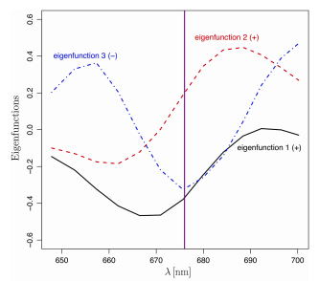
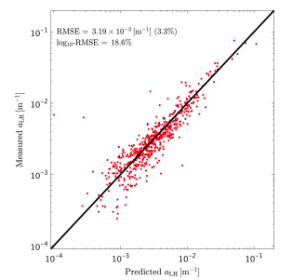
Chlorophyll absorption and phytoplankton size information inferred from hyperspectral particulate beam attenuation
Houskeeper, H. F., D. Draper, R. M. Kudela,and E. Boss (Jul 2020). Applied Optics Vol 59: 22. DOI: 10.1364/AO.396832
Background:
Near 676nm spectral feature is observed in particulate attenuation spectra in the ocean and is likely due to anomalous dispersion which is due to the absorption of particles near 676nm (chlorophyll a) and depends on size of absorbing particles.
Analysis:
Analysis of spectral particulate attenuation coefficient collected on board the R/V Tara globally.
Use principal component analysis.
Compare to absorption line height (a_{LH} around 676nm).
Left: 1st three spectral eigenfunctions associated with the anomalous dispersion feature in spectral particulate beam attenuation. Right: validation of prediction of absorption line-height due to chlorophyll based on measured (y-axis) and predicted from spectral attenuation (x-axis).
Findings:
Multiple linear regression of a_{LH} on the amplitude functions enables an independent estimate of a_{LH}, with RMSE of 3.19·10⁻³ m⁻¹ (3.3%) or log10-RMSE of 18.6%, and a raw-scale R² value of 0.9 based on the Tara Oceans Expedition data. This means a resolution of chlorophyll to +/-0.01mg m⁻³.
Projection to eigenfunction is consistent with size parameter obtained independently from the particulate attenuation spectral slope.
Significance:
Novel method to obtain chlorophyll concentration from a more robust instrument then currently available
Suggest novel design for autonomous measurements.
Notes:
Revised figure

