Slide 1
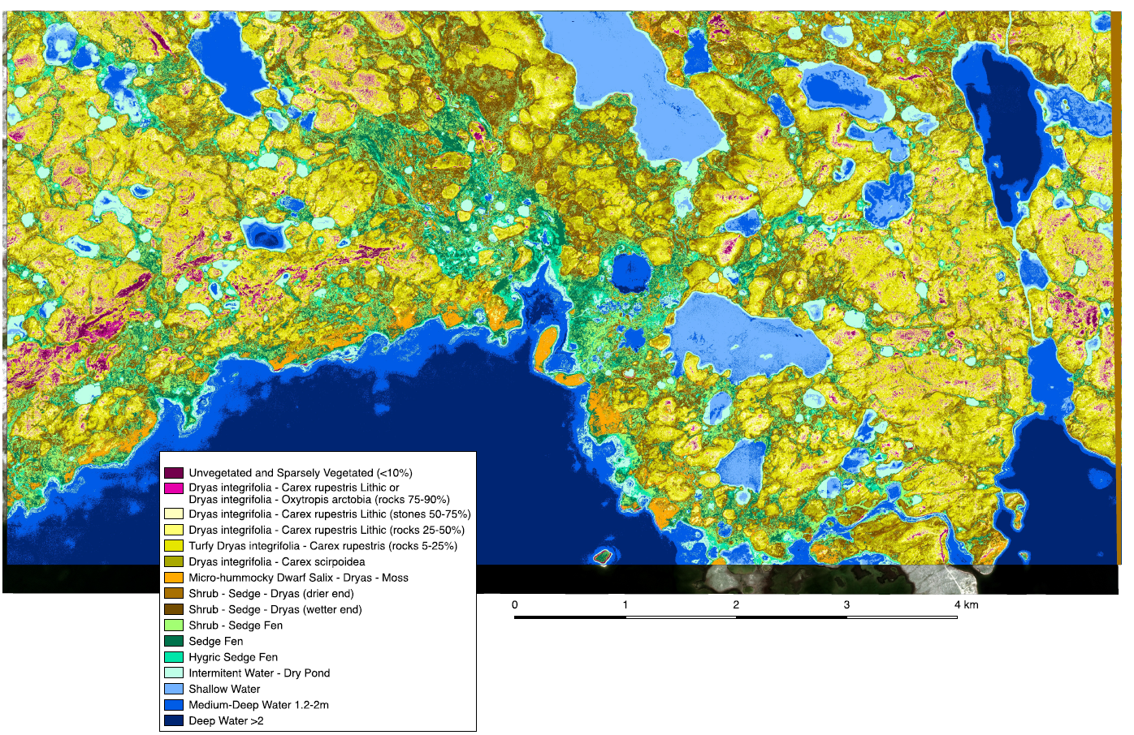
High resolution ecosystem map provides a testable model of tundra landscape composition, pattern and process
Ponomarenko, S., D. McLennan, D. Pouliot & J. Wagner. (2019). CJRS. DOI: 10.1080/07038992.2019.1682980
Background
The map was developed from (50 cm) WV2 imagery (ABoVE Cloud) to guide long term interdisciplinary research in the Intensive Monitoring Area (IMA) at the Canadian High Arctic Research Station (CHARS), Nunavut.
Approach
For each map unit the approach provides a prediction of vegetation composition (species list) and structure (height class), soil characteristics (strata, texture, organic material) and a qualitative assessment of key ecosystem drivers (flooding, snow protection, soil moisture/nutrients) – creating a useful and testable model of landscape composition, pattern and process.
Ongoing Work
The map is a component of a multi-scalar inventory for the CHARS ERA, ranging from 2 cm drone-based NDVI studies, to 10 m Sentinel 2 maps for large areas such as Victoria Island (217,291km²).
Quantification of key ecosystem attributes is underway (soil/foliar nutrients, active layer depths, snow depths, C stores).
Applications
The maps are being used to design ecosystem surveys, long term monitoring experiments, DNA inventories, as well as wildlife and hydrology studies. We are working to link plant functional groups to hyperspectral imagery (2017 and 2019 AVIRIS), and ecosystem units to ABoVE-linked CH₄ hotspot mapping. Maps will also form an ecosystem template for assessing multi-scalar changes in NDVI, shrubification, and caribou habitat using climate-driven, process-based change models.
Notes:
Revised figure

