Slide 1
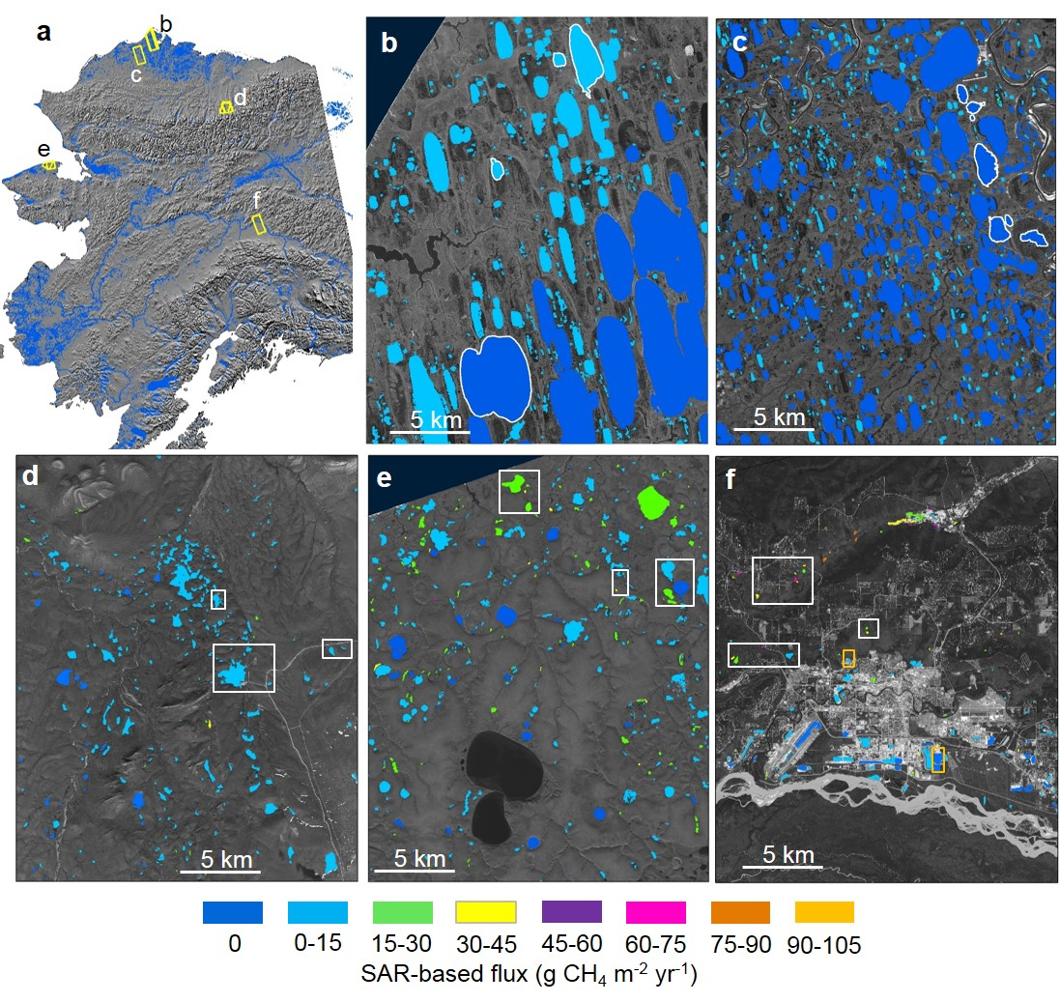
Remote sensing Arctic lake ebullition with synthetic aperture radar (SAR) Engram, Melanie et al. (2020), Nature Climate Change, doi: 10.1038/s41558-020-0762-8
Science Question
Lakes are significant sources of atmospheric methane (CH₄), a potent greenhouse gas, yet large uncertainties exist in quantifying lake-source CH₄, especially discrepancies between higher bottom-up and lower top-down estimates.
Analysis
Used L-band SAR imagery of early winter lake ice (PALSAR from the Alaska Satellite Facility).
Inverted empirical regression model correlating SAR to field measurements on 48 lakes to estimate CH₄ flux from 5000+ lakes in five regions in Alaska.
Results
Our regional SAR-based lake-source CH₄ fluxes, based for the first time on satellite remote sensing analyses, lowered emissions compared to previous estimates based on upscaling from individual lakes and compared favorably with independent airborne CH₄ observations.
High permafrost carbon combined with high limnicity yielded large emissions from northern Seward Peninsula thermokarst lakes.
Significance
This new approach to estimate lake-source CH₄ from ebullition offers a unique opportunity to improve knowledge about CH₄ fluxes for seasonally ice-covered lakes globally.
Lake methane maps showing SAR-based ebullition flux in g CH₄ m⁻² yr⁻¹. Panel a shows Alaska study regions with SAR footprints outlined in yellow. Subsequent panels show SAR-based CH₄ ebullition maps for b) Barrow Peninsula, c) Atqasuk, d) Toolik, e) northern Seward Peninsula, and f) Fairbanks. Study lakes with field- based measurements are outlined (b,c) or boxed (d,e,f) in white; orange boxes in panel f indicate anthropogenic study lakes.
Notes:
Full Citation: Engram, M., K. M. Walter Anthony, T. Sachs, K. Kohnert, A. Serafimovich, G. Grosse, and F. J. Meyer (2020), Remote sensing northern lake methane ebullition, Nature Climate Change, doi:10.1038/s41558-020-0762-8. Publication date is May 11, 2020.
Award Information: This research was supported by the NASA Terrestrial Ecology Program (NNH16ZDA001N-Task A4.) under NASA Award numbers NNX15AU49A and NNH16ZDA001N-TE.
This research supported the NASA Terrestrial Ecology Arctic-Boreal Vulnerability Experiment.

