Slide 1
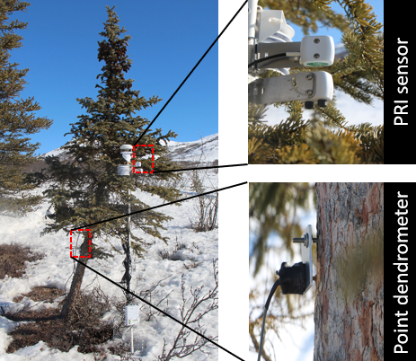
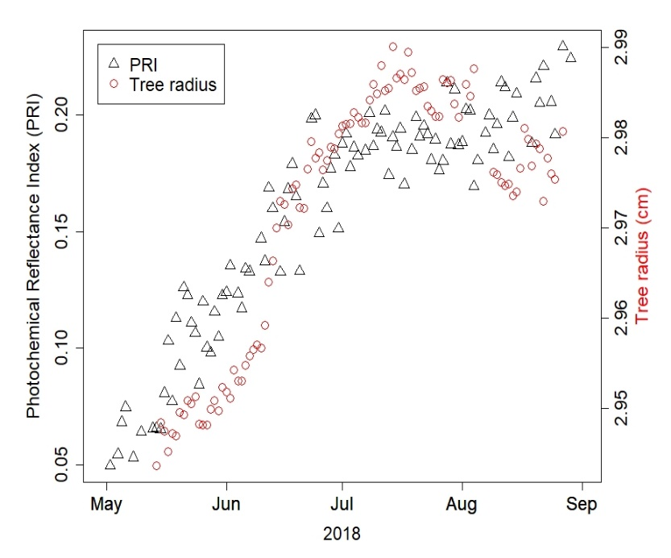
Remote sensing tracks daily radial wood growth of evergreen needleleaf trees Eitel, J.U.H., Griffin, K.L., Boelman, N.T., Maguire, A.J., Meddens, A.J.H., Jensen, J., Vierling, L.A.,
Schmiege, S.C., Jennewein, J.S. 2020. Global Change Biology
Background
The Photochemical Reflectance Index (PRI) is a promising remote sensing approach which is sensitive to gross plant carbon uptake. Presently, little is known about the sensitivity of PRI time-series to radial tree growth because the fate of fixed carbon is complex.
Objective: We explored the suitability of PRI time-series to understand intra-annual stem-growth dynamics at one of the world’s largest terrestrial carbon pools – the boreal forest.
Methods
Tree-level measurements were collected in 2018 (N = 25) and 2019 (N = 18) to link daily resolved PRI observations unambiguously with information on daily radial tree growth collected via point dendrometers.
Results
PRI showed to be a statistically significant (p<0.0001) predictor of seasonal radial tree growth dynamics, and tracked these dynamics in remarkable detail with conditional and marginal coefficients of determination of 0.48 and 0.96 (for 2018) and 0.43 and 0.98 (for 2019), respectively.
Left: Seasonal patterns of the photochemical reflectance index (PRI) and radial growth for a selected tree out of 25 total trees monitored in 2018.
Photochemical reflectance index (PRI)
Tree radius (cm)
Significance
PRI could provide novel insights into nuances of carbon cycling dynamics by alleviating important uncertainties associated with seasonal vegetation response to climate change.
Notes:
Full Citation:
Eitel, J.U.H., Griffin, K.L., Boelman, N.T., Maguire, A.J., Meddens, A.J.H., Jensen, J., Vierling, L.A., Schmiege, S.C., Jennewein, J.S. 2020. Remote sensing tracks daily radial wood growth of evergreen needleleaf trees? Global Change Biology, accepted.
Award Information:
The funding for this work came from the NASA ABoVE grant NNX15AT86A.
Datasets:
Eitel, J.U.H., K.L. Griffin, K.L., N.T. Boelman, L.A. Vierling, J. Jensen, A.J. Maguire, and S.C. Schmiege. 2020. In-situ Photochemical Reflectance Index and Tree Growth in Northern
Alaska, 2018-2019. ORNL DAAC, Oak Ridge, Tennessee, USA. https://doi.org/10.3334/ORNLDAAC/1781

