Slide 1
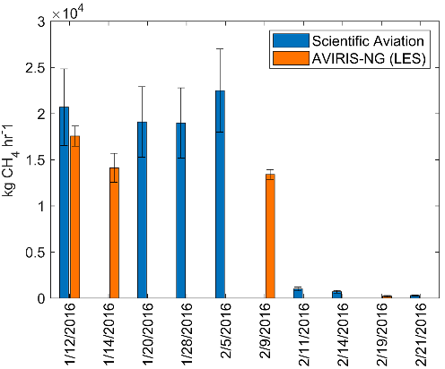
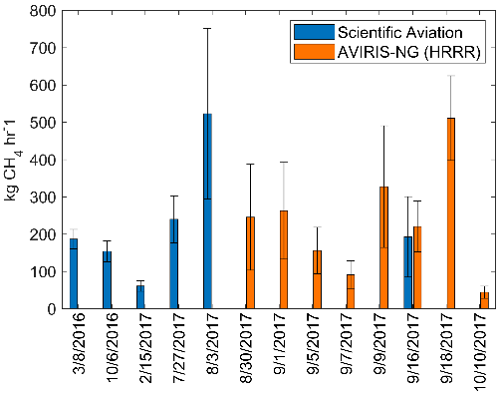
Methane emissions from underground gas storage in California Thorpe, A. K., Duren, R. M., et al., Environmental Research Letters (2020)
Science Question
What are the methane emissions associated with Underground Gas Storage (UGS) facilities in California?
Analysis
Airborne instruments were used to quantify emissions, including the imaging spectrometers AVIRIS, AVIRIS-NG, and in situ gas sampling using Scientific Aviation.
Results
Net annual methane emissions from the UGS sector in California range from 11.0 ± 3.8 GgCH4 yr⁻¹ (AVIRIS-NG) to 12.3 ± 3.8 GgCH4 yr⁻¹ (Scientific Aviation). Emissions were ~5 times higher than reported.
Significance
Detection, quantification, and attribution of methane emissions from UGS facilities is essential for improving confidence in greenhouse gas inventories and enabling emission mitigation by facility operators.
Estimated methane emissions from 12 gas storage facilities
Aliso Canyon blowout
C
Return to operations

