Slide 1

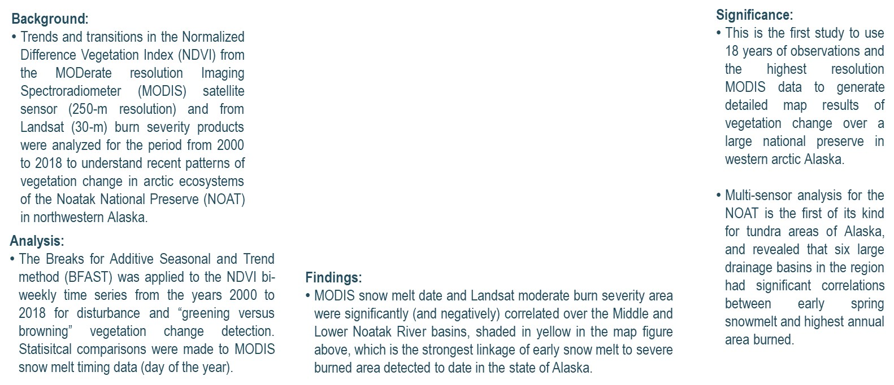
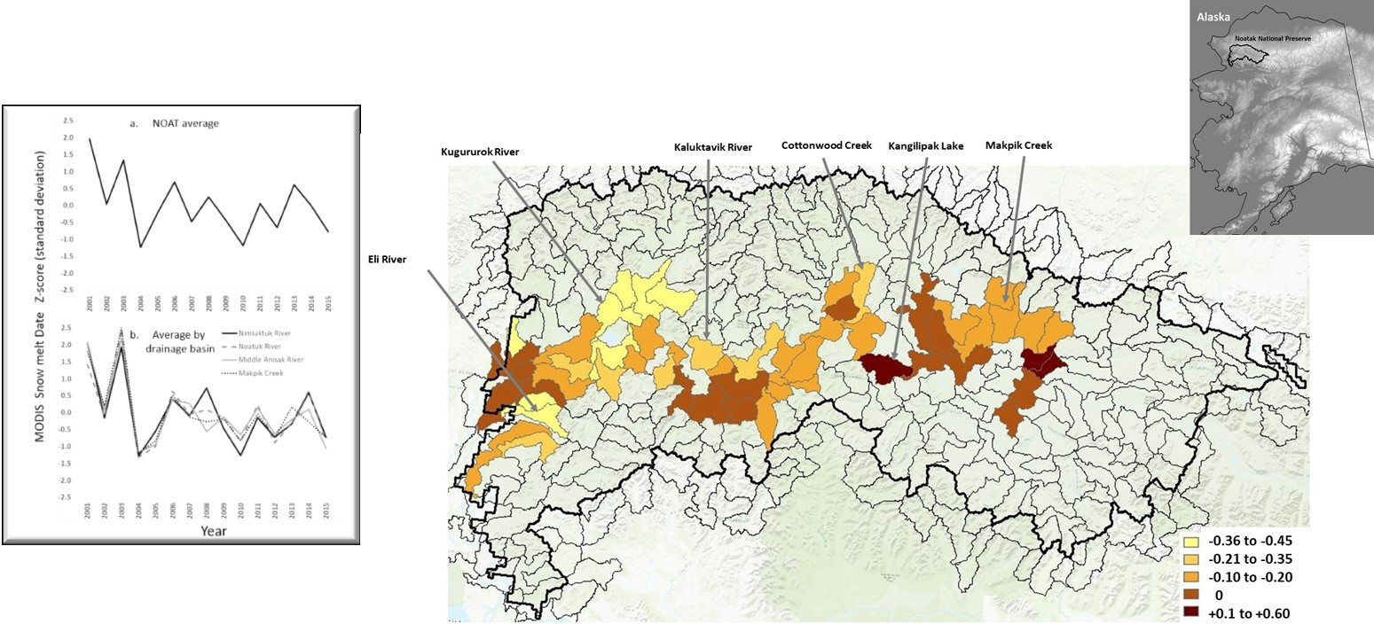
Changes in Vegetation Cover and Snowmelt Timing in the Noatak National Preserve of Northwestern Alaska Estimated from MODIS and Landsat Satellite Image Analysis
Christopher Potter and Olivia Alexander, NASA Ames, (Nov 2019). European Journal of Remote Sensing (in press)
Correlation of snowmelt timing with burned area for drainage basins with wildfires, 2001 to 2015
Notes:
Citation: Potter, C. and O. Alexander 2019, Changes in Vegetation Cover and Snowmelt Timing in the Noatak National Preserve of Northwestern Alaska Estimated from MODIS and Landsat Satellite Image Analysis, European Journal of Remote Sensing (in press).
This work was conducted with the support from NASA Ames Research Center and the Earth Science Mission Directorate under the Arctic Boreal Vulnerability Experiment (ABoVE) field campaign.

