Slide 1
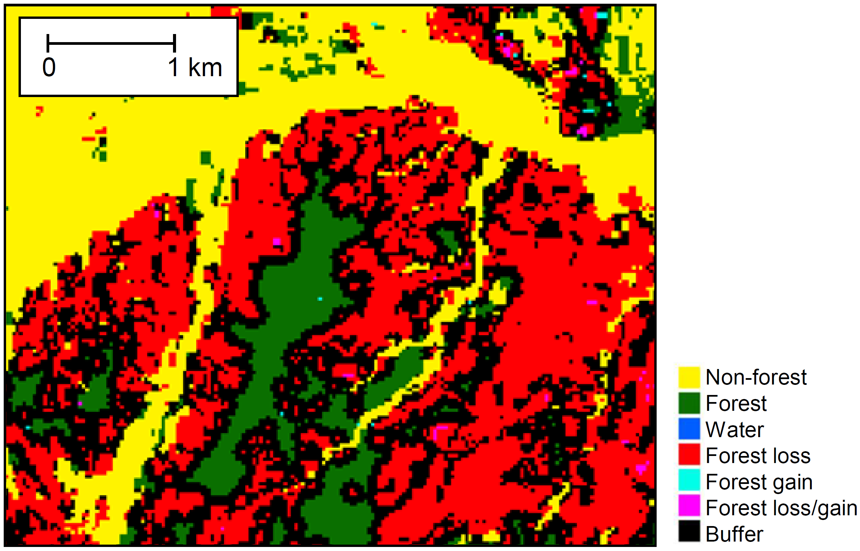
Mitigating the effects of omission errors on area estimates Olofsson et al. (2020) Remote Sens Environ 236:111492
Background
Sample-based estimation is a requirement per IPCC guidelines for reporting deforestation rates under international frameworks aimed reducing deforestation (REDD+). Certain classification errors have been shown to introduce so much uncertainty in area estimates that it’s impossible to deduce that deforestation has been reduced (or changed at all). Solutions are needed to reduce the impact of such errors.
Analysis
The paper outlines the underlying statistical reasons for the impact of certain errors and what can be done to mitigate their impact. A simulation of mitigation approaches using times series of Landsat data collected across the Colombian Amazon was conducted.
Significance
Errors become especially problematic in studies of deforestation when the area of deforestation and the area of intact forest is large (a very common situation!). Using a stratification when sampling the study area is almost always required in such situations. An easy to way make a stratification more efficient is to create a buffer around areas of mapped deforestation into mapped forest. We hypothesize that more efficient approaches to mitigate the effects of errors will be based on metrics that indicate the lack of fit between model and observations for most automated mapping approaches. The larger the residuals of a model fitted to satellite observations, the greater the likelihood of errors.
The use of a buffer (black) around areas of mapped deforestation (red) into mapped forest (green) when stratifying a study area is a simple yet powerful way of mitigating certain errors that have proven problematic.
Notes:
This slide contains a sample of the contents of an MSR Slide that we suggest

Slide 2
Notes
Citation:
Olofsson, P., Arévalo, P., Espejo, A. B., Green, C., Lindquist, E., McRoberts, R. E., & Sanz, M. J. (2020). Mitigating the effects of omission errors on area and area change estimates. Remote Sensing of Environment, 236, 111492.
Award Information:
This research was funded by support from the NASA Carbon Monitoring System (NNX16AP26G) to Boston University (PI Pontus Olofsson).

