Slide 1
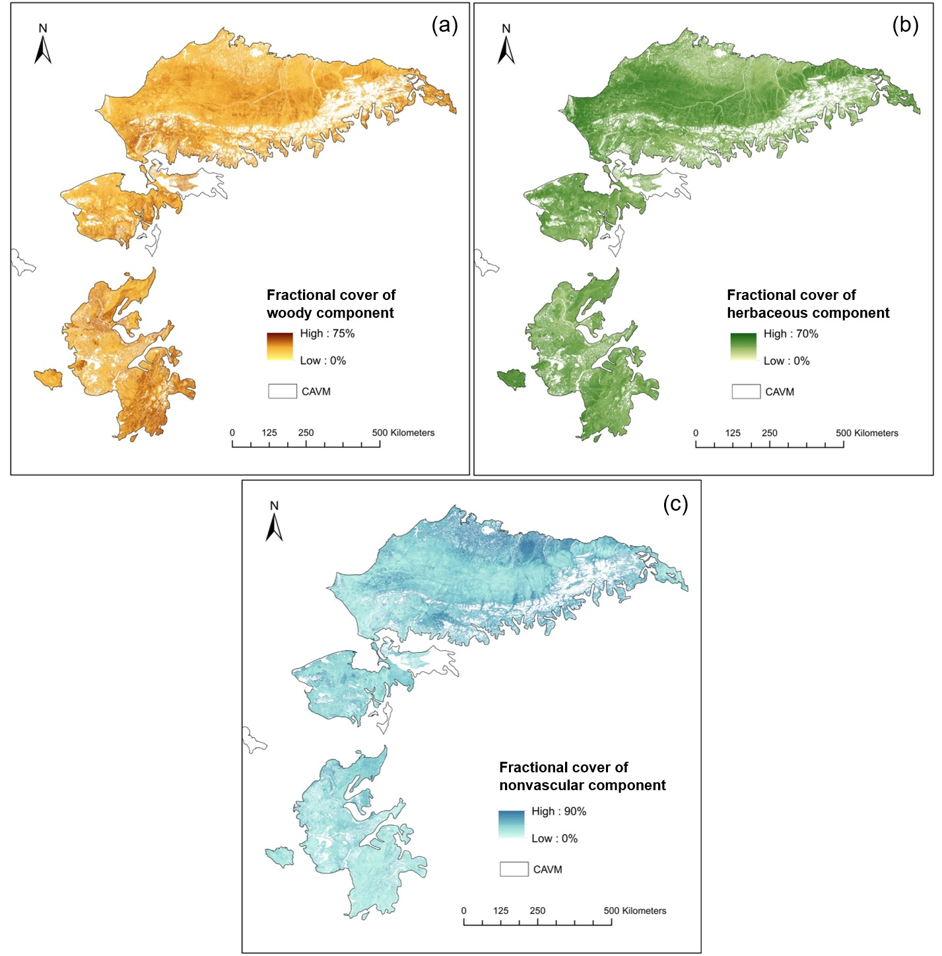
Mapping fractional cover of major fuel type components across Alaskan tundra
He et al., 2019. Remote Sensing of Environment
Scientific Question
What is the spatial distribution of major fuel types in Alaskan tundra?
Methods
A four-step method was designed to map the spatial distribution of these fuel components: (1) developing seasonal composites of spectral bands and indices with multi-temporal Landsat imagery for the tundra; (2) generating a “tundra vegetation mask” to identify the shrub or graminoid dominated tundra with land cover classification; (3) Random Forest modeling of fractional fuel component cover; (4) mapping fractional cover of major fuel components across the shrub or graminoid dominated tundra in Alaska.
Findings
We presented a method for mapping 30-m fractional fuel components across Alaskan tundra using multi-seasonal and multispectral Landsat data.
We developed fractional cover maps of woody, herbaceous and nonvascular components circa 2015.
Significance
We demonstrated the strong capability of exploiting multi-seasonal spectral information to identify these component types at subpixel level.
We delivered the most detailed characterization of fuel distribution to date in Alaskan tundra.
Fractional cover of three major fuel type components across Alaskan tundra: (a) woody, (b) herbaceous, and (c) nonvascular components.

