Slide 1
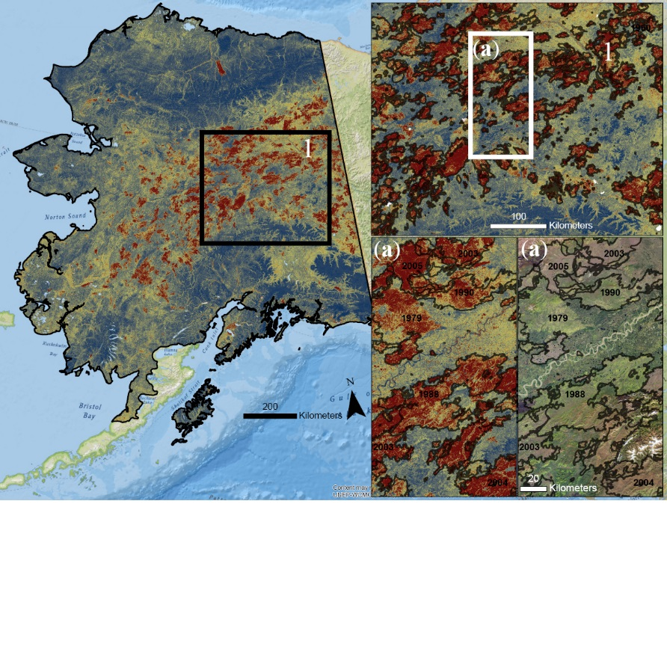
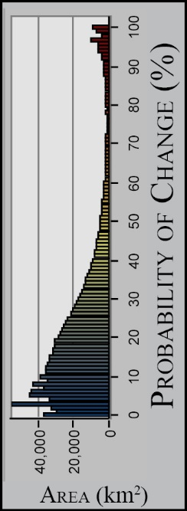
Spatiotemporal remote sensing of ecosystem
change and causation across Alaska
Pastick, N.J., et al. (2018), Global Change Biology, 20180527, https://doi.org/10.1111/gcb.14279
Background
Arctic and boreal landscapes have experienced rapid changes in recent decades. Despite a legacy of studies documenting the heightened sensitivity of northern landscapes to change, characterization of ecosystem change and associated drivers has remained elusive.
Methods
Satellite remote sensing and climate reanalysis data were integrated into a modeling framework to fingerprint the sensitivity of Alaska’s ecosystems to changing environmental conditions and disturbances.
Results
Approximately 13% (~174,000 ± 8700 km²) of Alaska has experienced change over the last 32 years, with the majority of change processes occurring in coastal, riverine, and boreal ecozones (e.g. wildfire, glacial retreat, shrub expansion).
Increasing air temperatures have generally promoted vegetation growth, while increases in evaporation have resulted in drought stress predisposing vegetation to mortality from other stressors.
Significance
Our reconstruction of landscape change fills a critical gap in the understanding of the historical and potential future trajectories of change in Alaska, with direct relevance to other northern high latitude regions.
0.002
0.001
Vegetation Productivity (NDVI / year)
0.000
-0.001
0.020
0.015
-5e-04
0.010
0e+00
T_{JJA} (°C/yr)
VPD_{JJA} (kPa/yr)
5e-04
0.005
1e-03
Notes:
Full citation:
Pastick, N.J., Jorgenson, M.T., Goetz, S.J., Jones, B.M., Wylie, B.K., Minsley, B.J., Genet, H., Knight, J.F., Swanson, D.K., and Jorgenson, J.C. (2018). Spatiotemporal remote sensing of ecosystem change and causation in Alaska. Global Change Biology. p. 1–20. doi: 10.1111/gcb.14279
Grants: Lead author Pastick was supported by the USGS (LandCarbon Program) and co-author Goetz was supported by NASA NNX17AE44G (NASA ABoVE).
Top Figure: Predictions of the probability (%) of change occurrence (30 m spatial resolution), derived from a boosted decision tree model using spectral change metrics, a digital elevation model, and photo interpretations of change type. Insets show fire boundaries from the Bureau of Land Management (BLM) Large Fire Database and Landsat 8 imagery (bottom right; 2016) north of Fairbanks, Alaska
Bottom Figure: Surface plots showing the relationships between mean changes in remotely-sensed, late-season vegetation productivity (NDVI_{JA}/year), mean summer temperature (T_{JJA}; °C/year), and vapor pressure deficit (VPD_{JJA}; kPa/year) for ecozones of Alaska (Nowacki et al., 2003; n = 29), as described by a generalized additive model (GAM) using cubic regression splines (Adjusted R² = 0.72). The black to white color gradient of the response surface reflect lower and higher trend values (NDVI_{JA}/year), respectively
Satellite Data:
Landsat (Thematic Mapper, Thematic Mapper Plus, OLI)
Digital Globe (WorldView-2 and 3, Geoeye-1)
Aerial Imagery (Advanced High Altitude Photography)
How is this study different from previous work:
First study to characterize 32 years of land and surface-water dynamics across mainland Alaska and to assess underlying drivers of these changes.
Detailed analysis related to ecological, climatic, hydrologic, and geomorphological drivers of greening and browning trends observed by Landsat.
Additional Significance
Trend analysis of remotely-sensed surface water extents indicate that permanent surface water extent has generally increased in areas underlain by permafrost that have experienced that largest increases in annual air temperature. Surface water losses predominately occurred in areas underlain by coarse grained deposits typically devoid of permafrost in the near surface.
Abstract:
Contemporary climate change in Alaska has resulted in amplified rates of press and
pulse disturbances that drive ecosystem change with significant consequences for
socio-environmental systems. Despite the vulnerability of Arctic and boreal landscapes
to change, little has been done to characterize landscape change and associated drivers
across northern high-latitude ecosystems. Here we characterize the historical sensitivity
of Alaska’s ecosystems to environmental change and anthropogenic disturbances
using expert knowledge, remote sensing data, and spatiotemporal analyses and modeling.
Time-series analysis of moderate—and high-resolution imagery was used to
characterize land- and water-surface dynamics across Alaska. Some 430,000
interpretations of ecological and geomorphological change were made using historical
air photos and satellite imagery, and corroborate land-surface greening, browning, and
wetness/moisture trend parameters derived from peak-growing season Landsat imagery
acquired from 1984 to 2015. The time series of change metrics, together with climatic
data and maps of landscape characteristics, were incorporated into a modeling
framework for mapping and understanding of drivers of change throughout Alaska.
According to our analysis, approximately 13% (~174,000 8700 km2) of Alaska has
experienced directional change in the last 32 years (95% confidence intervals). At
the ecoregions level, substantial increases in remotely sensed vegetation productivity
were most pronounced in western and northern foothills of Alaska, which is explained
by vegetation growth associated with increasing air temperatures. Significant browning
trends were largely the result of recent wildfires in interior Alaska, but browning trends
are also driven by increases in evaporative demand and surface-water gains that have
predominately occurred over warming permafrost landscapes. Increased rates of photosynthetic
activity are associated with stabilization and recovery processes following
wildfire, timber harvesting, insect damage, thermokarst, glacial retreat, and lake infilling
and drainage events. Our results fill a critical gap in the understanding of historical and
potential future trajectories of change in northern high-latitude regions.

