Slide 1
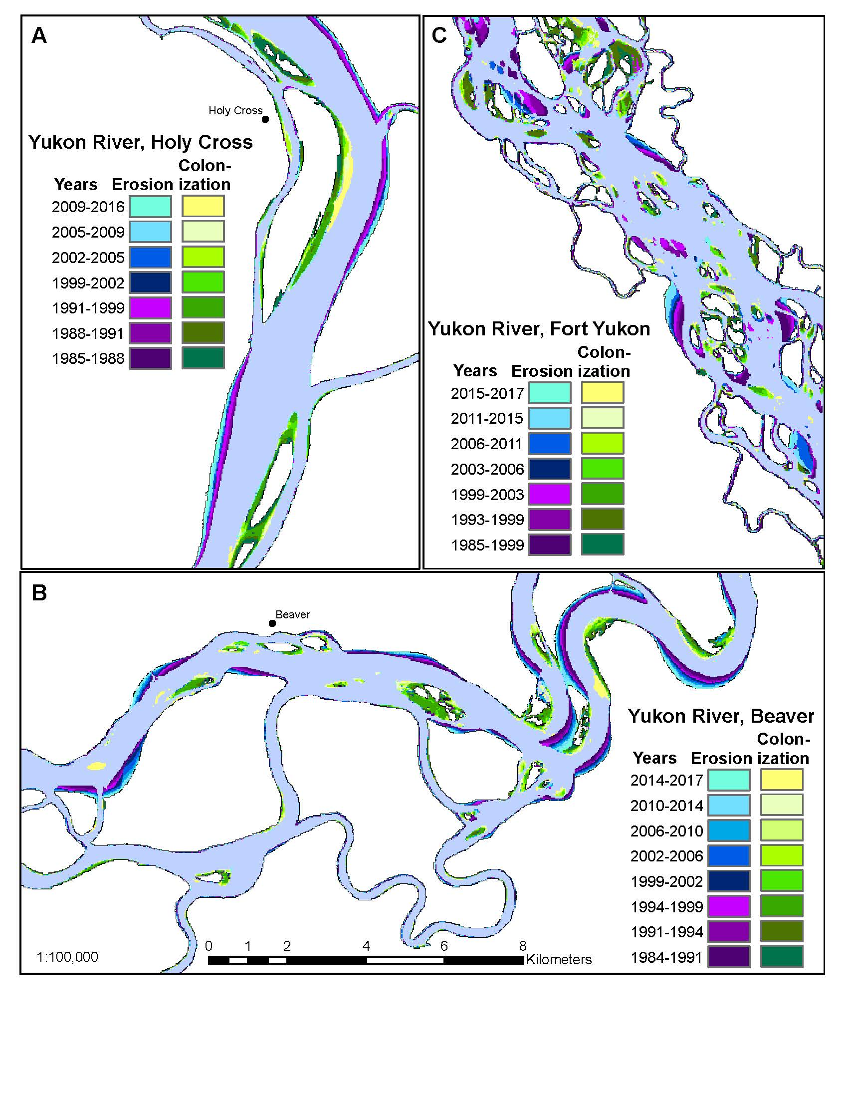
Changing Hydroclimatic Drivers of
Subarctic Riverbank Erosion
Brown, D.R.N., et al. (in review). Climatic Change
Background: Changes in climate are expected to alter the rate and seasonality of subarctic riverbank erosion. We identified hydroclimatic drivers of riverbank erosion in the Yukon River Basin, assessed the impact of climate change on erosion rates, and explored the implications for local residents.
Analysis: Time series of Landsat imagery (TM, ETM+, OLI) were used to map and quantify rates of riverbank erosion (1984-2017) using shifts in NDVI-derived classes. Erosion rates were related to hydroclimatic variables and trends were assessed.
Findings: (1) Winter river discharge was positively related to erosion rate in large subarctic rivers. Winter discharge increased over last ~50 yrs. (2) Earlier break-up dates and prolonged freshet discharge were associated with increased erosion rates in large rivers. (3) Increased springtime air temperatures likely reduced erosion rates in some places by limiting ice scour or ice jam flooding.
Significance: Climate-related changes to fluvial dynamics impact communities through effects on infrastructure, travel safety, channel navigability, fish and wildlife habitat, and access to subsistence resources.
Maps of riverbank erosion and vegetation colonization along reaches of the Yukon River, derived from Landsat imagery (1984-2017).

Slide 2
Notes
Analysis: An NDVI threshold of 0.2 was used to delineate vegetated from non-vegetated pixels. Shifts over time among vegetated and non-vegetated classes were regarded as either riverbank erosion or vegetation colonization.
Citation:
Brown, D.R.N., Brinkman, T.J., Verbyla, D.L., Bolton, W.R., Hollingsworth, T.N. (in review). Changing hydroclimatic drivers of subarctic riverbank erosion. Climatic Change.
Award Information:
This research contributes to the Arctic-Boreal Vulnerability Experiment Project “Biophysical Characteristics and Mechanisms of Environmental Disturbances Influencing Human Access to Ecosystem Services in Boreal Alaska” (NASA Award number NNX15AT83A).

