Slide 1
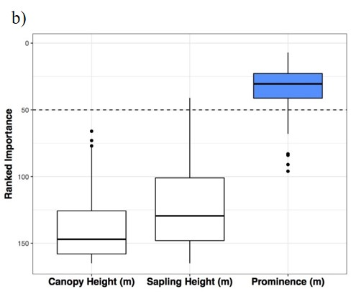
Terrestrial lidar scanning reveals fine-scale linkages between microstructure and photosynthetic functioning of small-stature spruce trees at the forest-tundra ecotone
AJ Maguire, JUH Eitel, LA Vierling, DM Johnson, KL Griffin, NT Boelman, JE Jensen, HE Greaves
AJH Meddens. Agricultural and Forest Meteorology, accepted
Background
The Forest-Tundra Ecotone is inherently responsive to fine-scale changes in environmental conditions.
Mounting evidence suggests that microstructure (i.e., vegetation canopy and topography at cm to m scales) may be important for modulating environmental conditions to which plant processes are sensitive.
Objective: We evaluated the relationship between microstructure and Chlorophyll fluorescence (ChlF) of small-stature spruce trees at the Forest-Tundra ecotone.
Analysis
In situ ChlF observations of small-stature spruce trees were acquired in combination with terrestrial lidar scanning, the latter of which was used to derive microstructural attributes at the FTE in Alaska.
A Random Forest approach was used to quantify the total variance explained by microstructural metrics and to identify the most important microstructural metrics for driving variance in ChlF.
Results
Microstructural metrics explained 28% of the variance in ChlF.
Canopy and ground insolation, canopy roughness, and tree prominence were the most important drivers of variance in ChlF.
Importance of individual metrics was scale-dependent.
Ranked importance
Ranked importance
Canopy Height
Tree height
Prominence
Tree height
Fig 1. Ranked importance of microstructural metrics by Random Forest modeling.
Scale (m)
Significance: Results suggest microstructure may modulate the physiological response of small-stature trees at the Forest-Tundra Ecotone to coarse-scale climate change.
Notes:
Full Citation:
Maguire, A.J., Eitel, J.U.H., Vierling, L.A., Johnson, D.M., Griffin, K.L., Boelman, N., Jensen, J., Greaves, H.E., Meddens, A.J.H. Terrestrial lidar scanning reveals fine-scale linkages between microstructure and photosynthetic functioning of small-stature spruce trees at the forest-tundra ecotone. Agricultural and Forest Meteorology, accepted.
Award Information:
The funding for this work came from the NASA ABoVE grant NNX15AT86A.
Datasets:
In-situ measurements of ChlF and terrestrial lidar scanning

