Slide 1
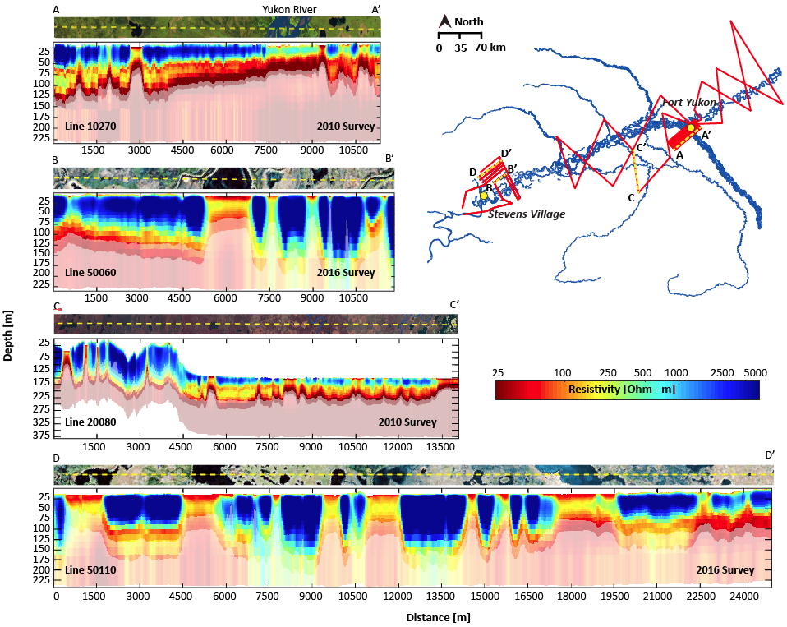
Airborne Electromagnetic Surveys and Landsat Time-series Clustering Inform Lake-area Dynamics
Rey, D, Walvoord, M., B. Minsley, Rover, J., and Singha, K. (2019), ERL. DOI: 10.1088/1748-9326/aaf06f.
Goals:
Elucidate mechanisms driving lake-area dynamics in regions of variable permafrost and lake talik conditions.
Analysis:
2010 and 2016 AEM surveys constrain permafrost distribution, statistical clustering of Landsat derived lake surface-area time-series highlight mechanisms driving lake behavior.
Results:
Areas with continuous permafrost show synchronous lake-area dynamics, areas of discontinuous permafrost show asynchronous lake-area dynamics.
Lakes ~37% ephemeral and ~63% perennial surface-water features. ~66% driven primarily by surface-water connectivity, ~19% driven primarily by shallow subsurface connectivity, ~15% appear to have no connectivity.
Significance:
This synthesis provides a space-for-time proxy of lake area/permafrost change.
AEM data provides deep subsurface information co-located with ABoVE data collection efforts in the Yukon Flats, AK.
Comparison of two AEM lines from the 2010 and 2016 surveys. Cross-sections display log(resistivity) vs. depth for each flight line. The resistive blue zones are interpreted as permafrost. Location map of the Yukon Flats, AK with AEM flight lines (in red) shown in the upper right.
Notes:
This slide contains a sample of the contents of an MSR Slide that we suggest

Slide 2
Notes
Citation:
Rey, D, Walvoord, M., B. Minsley, Rover, J., and Singha, K. (2019), Investigating lake-area dynamics across a permafrost-thaw spectrum using airborne electromagnetic surveys and remote sensing time-series data in Yukon Flats, Alaska, Environmental Research Letters, 14, 025001 DOI: 10.1088/1748-9326/aaf06f
Award Information:
This research was supported by the Arctic-Boreal Vulnerability Experiment (ABoVE), a NASA Terrestrial Ecology project, under Award 14-TE14-0012

