Slide 1
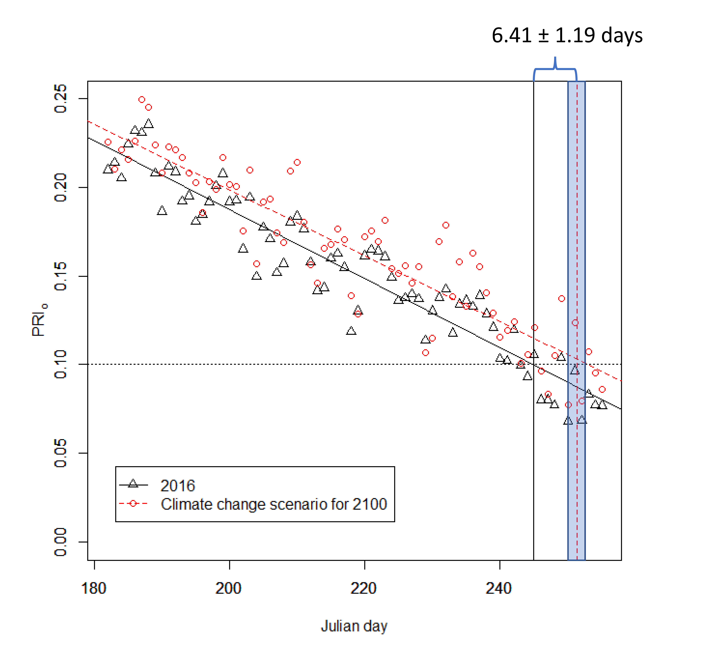
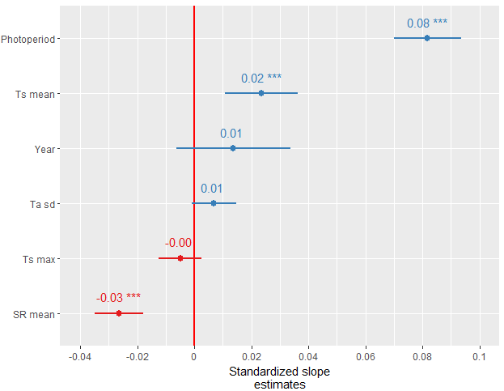
Proximal remote sensing of tree physiology at northern treeline: Do late-season changes in the photochemical reflectance index (PRI) respond to climate or photoperiod?
JUH Eitel, AJ Maguire, NTB Boelman, LA Vierling, KL Griffin, J Jensen, TS Magney, PJ Mahoney,
AJH Meddens, C Silva, O Sonnentag. Remote Sensing of Environment, accepted
Background
Relatively little is known of how the world’s largest vegetation transition zone – the Forest Tundra Ecotone (FTE) – is responding to climate change.
Newly available, satellite-derived time-series of the Photochemical Reflectance Index (PRI) could provide new insights into the physiological response of the FTE to climate change.
Objective: We tested if late-season changes of PRI respond to climate or photoperiod.
Analysis
Ground-based, time-series of PRI were acquired from individual trees in combination with meteorological variables and photoperiod information at six FTE sites in Alaska.
A linear mixed-effects modeling approach was used to determine the significance (α=0.001) and effect size (i.e., standardized slope b*) of environmental factors on late-seasonal changes in the PRI signal.
Results
Fig 1. Photoperiod had the strongest, significant effect on late-season changes in PRI (b*=0.08, p<0.001), but environmental variables susceptible to climate change were also significant (i.e., daily mean solar radiation (b*=-0.03, p<0.001) and daily mean soil temperature (b*=0.02, p<0.001)).
Fig 2. Estimates of PRI for a select tree for 2016 (black triangles)
and predicted PRI for 2100 (red circles) based on projected climate variables.
6.41±1.19 days
Photoperiod
Mean soil temp
Year
Stdev air temp
PRI
Max soil temp
Mean solar radiation
Standardized slope estimates
Julian Day
Significance
PRI time-series of late-season phenological transitions may indeed facilitate our understanding of the FTE responds to climate change.
Notes:
Full Citation:
Eitel, J.U.H., Maguire, A.J., Boelman, N., Vierling, L.A., Griffin, K.L., Jensen, J., Magney, T.S., Mahoney, P.J., Meddens, A.J.H., Silva, C., Sonnentag, O. Proximal remote sensing of tree physiology at northern treeline: Do late-season changes in the photochemical reflectance index (PRI) respond to climate or photoperiod? Remote Sensing of Environment, accepted.
Award Information:
The funding for this work came from the NASA ABoVE grant NNX15AT86A.
Datasets:
In-situ measurements of PRI and meteorological variables

