Slide 1
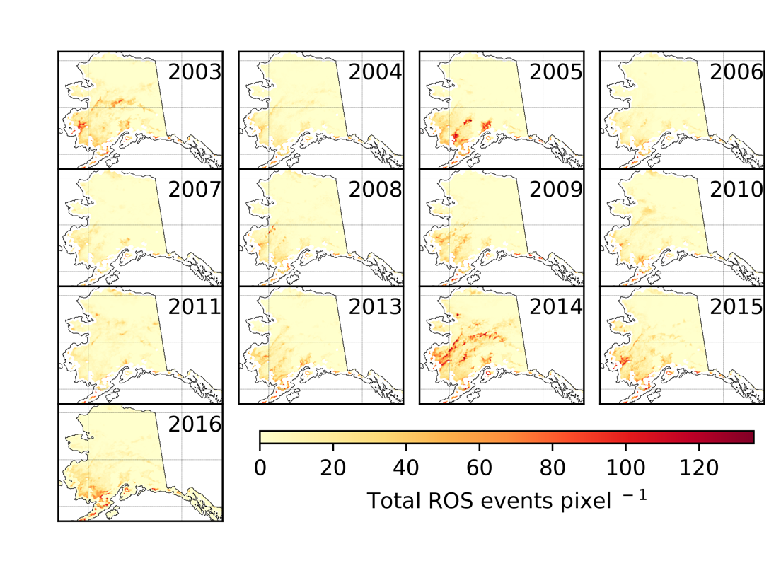
Satellite Data Fusion for Monitoring Rain-on-Snow Events in Alaska
C.G. Pan, P.B. Kirchner, J.S. Kimball, Y. Kim, and J. Du, 2018. ERL. 13, 075004.
Motivation:
Wintertime rain-on-snow (ROS) and icing events severely impact Arctic ecosystems by increasing wildlife mortality risk and snowmelt-driven flooding. Better understanding of ROS patterns and drivers is constrained by limited capabilities for regional monitoring.
Number of rain-on-snow (ROS) days per year derived from AMSR and MODIS
Methods:
Developed a new satellite record of daily ROS dynamics by fusing MODIS snow cover and AMSR freeze-thaw observations.
Quantified cold season (Nov-Mar) ROS variability across Alaska over the recent satellite record (2003-2016)
ROS accuracy and influence of surface temperature and precipitation evaluated from regional weather stations.
Findings:
Favorable (75-100%) ROS detection accuracy.
ROS most common in spring and fall, and in southwest and interior Alaska, coincident with warm temperature anomalies rather than precipitation. Regional warming expected to increase ROS risk.
Significance:
New ROS record available to support regional ecosystem studies. New satellite capabilities for ROS monitoring from operational sensors (MODIS, AMSR).

Slide 2
Notes
Citation:
C.G. Pan, P.B. Kirchner, J.S. Kimball, Y. Kim and J. Du, 2018. Rain-on-snow events in Alaska, their frequency and distribution from satellite observations. Environmental Research Letters 13, 075004, https://doi.org/10.1088/1748-9326/aac9d3.
Award Information:
This research was supported by the NASA Terrestrial Ecology Program (NNH14ZDA001N-Task A4.) under NASA Award number NNX15AT74A.
This research supported the Arctic-Boreal Vulnerability Experiment.

