Slide 1
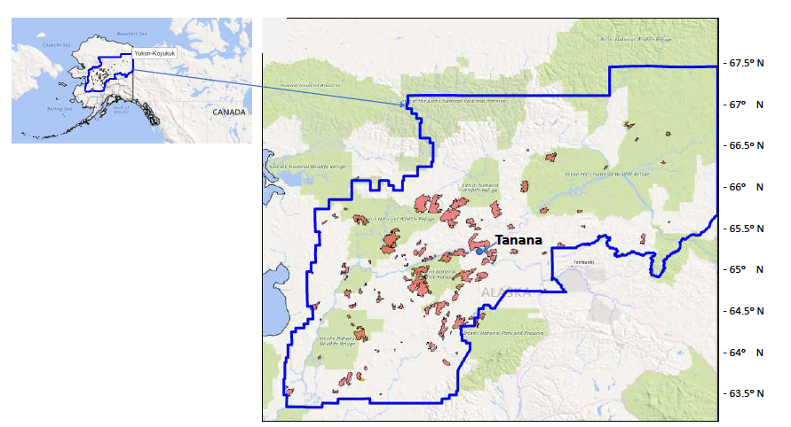
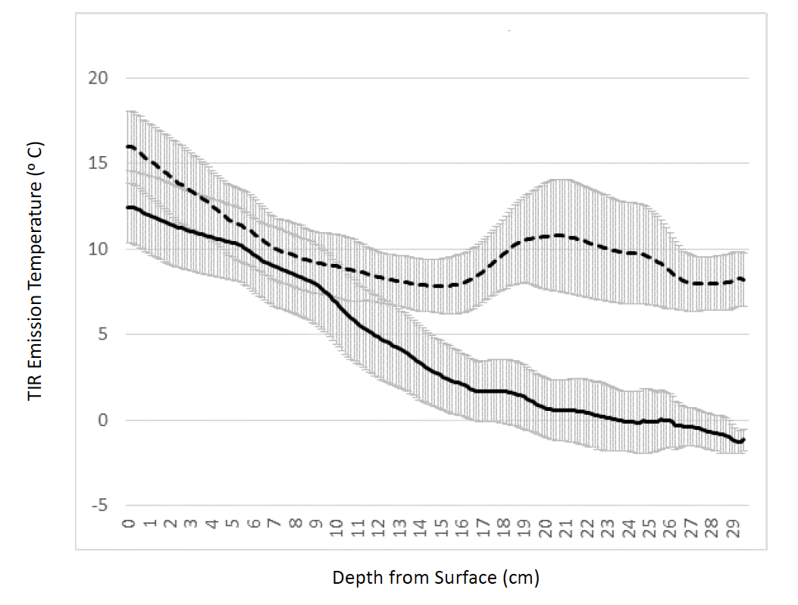
Ecosystem Carbon Emissions from 2015 Forest Fires in Interior Alaska
Christopher S. Potter (Jan 2018). Carbon Balance and Management. 13(1):2.
Background:
In the summer of 2015, hundreds of wildfires burned across the state of Alaska, and consumed more than 1.6 million hectares of boreal forest and wetlands in the Yukon-Koyukuk region. Mapping of all wildfires using Landsat images indicated that nearly 60% area was burned at moderate-to-high severity levels.
Analysis:
Field measurements near the town of Tanana on the Yukon River were carried out in July of 2017 in both unburned and 2015 burned forested areas to measure changes in forest moss layers, depth to permafrost and losses of mineral soil carbon and nitrogen.
Map - Wildfires from 2015 analyzed for Landsat burn severity classes and carbon losses in the Yukon-Kuyukuk region of Alaska; Plot - Measured temperature profiles for severely burned (dashed line) and unburned (solid line) Alaska soil pits excavated to 30 cm depth
Findings:
Soil temperature profiles to 30 cm depth at burned forest sites were higher by an average of 8º-10º C compared to unburned forest sites. Sampling and laboratory analysis indicated a 65% reduction in soil carbon content and a 58% reduction in soil nitrogen content in severely burned forest sites, compared to samples from nearby unburned spruce forests.
Significance:
Combined with nearly unprecedented forest estimated as severely burned from Landsat image analysis, 2015 ecosystem fire-related losses of carbon to the atmosphere exceeded most previous estimates for Alaska.
Notes:
Main Message: Burning of the moss surface layer will raise post-fire soil temperatures and increase thaw depths, leading to large losses of carbon and greenhouse gases from mineral soils layers of forests in Alaska.
This work was undertaken as a contribution to the NASA Arctic Boreal Vulnerability Experiment (ABoVE) field campaign. One of the major questions being addressed by ABoVE is “What processes are controlling changes in boreal-arctic land cover properties and what are the impacts of these changes?”
Acknowledgements - This work was supported by NASA Ames Research Center and the NASA ABoVE Logistics Office in Fairbanks, Alaska.

