Slide 1
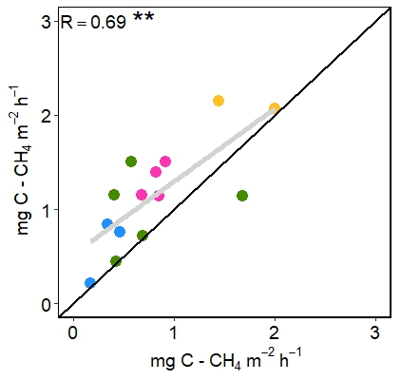
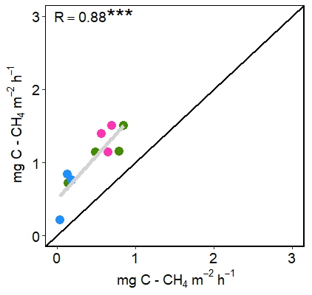
Upscaling CH₄ Fluxes Using High-Resolution Imagery
in Arctic Tundra Ecosystems
Davidson et al., (2017) Remote Sensing, 9, 1227 doi:10.3390/rs9121227
Background
Arctic tundra ecosystems are major sources of atmospheric methane (CH₄)
Model – data comparisons require non-trivial upscaling of site level measurements to landscape scale
Vegetation type plays a critical role in explaining CH₄ flux variability
Analysis
We compared four different mapping methods and two different methods for upscaling plot level CH₄ emissions to the measurements from eddy covariance (EC) towers
Findings
Linear discriminant analysis (LDA) provides the most accurate representation of the tundra vegetation within the EC tower footprint
Unweighted upscaling of fluxes showed a positive correlation of R = 0.69 with EC tower measurements (Fig a)
Footprint-weighted upscaling of fluxes improved the EC tower measurements correlation to R = 0.89 (Fig b)
a)
b)
FIGURE 1: Comparisons between a) non-footprint-weighted upscaled fluxes and EC tower measurements and b) footprint-weighted upscaled fluxes and EC tower measurements. R is the correlation coefficient and ** denotes significance, p < 0.01, *** denotes significance, p < 0.001. The black line shows a 1:1 relationship and the grey line is the linear regression.
Significance
Assimilating remotely-sensed vegetation maps of tundra in a footprint model is key in upscaling fluxes across scales
Notes:
Kahru, M., Z. Lee, B.G.Mitchell1and C.D. Nevison (2016), Effects of sea ice cover on satellite-detected primary production in the Arctic Ocean, Biology Letters, 12: 20160223.
http://dx.doi.org/10.1098/rsbl.2016.0223.
Satellite Data:
OCTS - Ocean Color Temperature Scanner (NASDA)
SeaWiFS - Sea-Viewing Wide Field-of-View Sensor (NASA)
MERIS - MEdium Resolution Imaging Spectrometer (ESA)
MODIS-Aqua (NASA)
Primary productivity (NPP) in the Arctic Ocean has increased by 47% from the first half (1998-2006) to the 2nd half of the series (2007-2015) but changes after 2011 have been minor. NPP per open water area has actually decreased. Increased open water area is related to increased NPP in the summer with the strongest effect in June. In northern Barents Sea, sea ice retreat has become earlier at a rate of -4.5 day/year and the high-productivity season is starting earlier at a rate of -3.0 day/year. Freeze-up is occurring later but the timing of the end of the high NPP period has not changed.

Slide 2
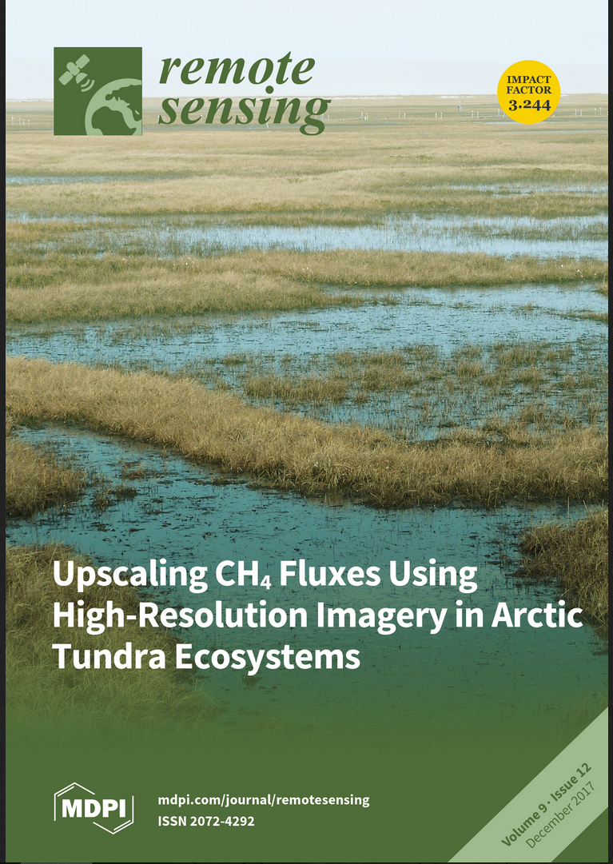
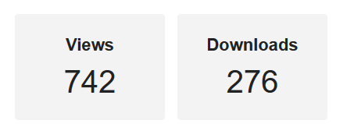
Selected for the cover of Remote Sensing December 2017

