Slide 1
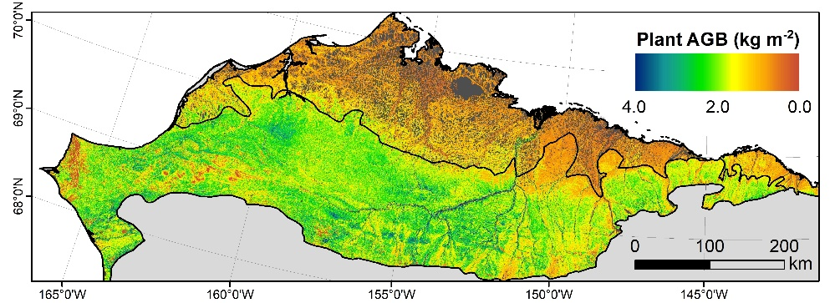
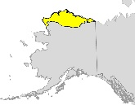
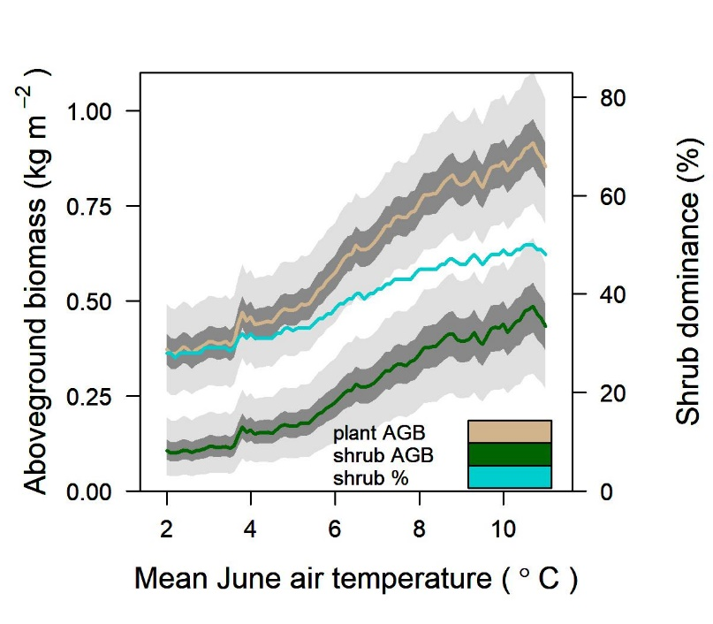
Landsat observations enable mapping and monitoring of plant biomass in arctic tundra ecosystems Berner, Jantz, Tape and Goetz (2018) Environmental Research Letters
Background: Tundra ecosystems are becoming more productive (greening) and shrubbier, which affects wildlife and climate feedbacks. The amount and distribution of plant biomass remains highly uncertain but is fundamental to address these topics.
Analysis: Plant and shrub aboveground biomass (AGB) were mapped across northern Alaska at 30 m resolution using >2,000 Landsat scenes and field biomass harvests. Changes in plant AGB, shrub AGB, and shrub dominance were examined along regional gradients in air temperature.
Results
Landsat peak summer NDVI is a robust predictor of plant AGB in tundra ecosystems
Plant AGB and shrub dominance both notably increased with higher summer air temperatures
Significance: Continued warming will likely increase plant AGB and shrub dominance in tundra ecosystems across northern Alaska. These ecological responses to warming can be monitored both regionally and across the broader tundra biome using Landsat combined with field measurements.
(Top) Plant aboveground biomass mapped across northern Alaska at 30 m resolution using Landsat.
(Bottom) Plant and shrub aboveground biomass increase notably between areas with the coldest and warmest summer air temperatures.
Notes:
Abstract
Arctic tundra is becoming greener and shrubbier due to recent warming. This is impacting climate feedbacks and wildlife, yet the spatial distribution of plant biomass in tundra ecosystems is uncertain. In this study, we mapped plant and shrub aboveground biomass (AGB; kg m⁻²) and shrub dominance (%; shrub AGB / plant AGB) across the North Slope of Alaska by linking biomass harvests at 28 field sites with 30 m resolution Landsat satellite imagery. We first developed regression models (p < 0.01) for predicting plant AGB (r²=0.79) and shrub AGB (r²=0.82) based on the Normalized Difference Vegetation Index (NDVI) derived from imagery acquired by Landsat 5 and 7. We then predicted regional plant and shrub AGB by combining these regression models with a regional Landsat NDVI mosaic built from 1,721 summer scenes acquired between 2007 and 2016. Our approach employed a Monte Carlo uncertainty analysis that propagated sampling and sensor calibration errors. We estimated that plant AGB averaged 0.74 [0.60, 0.88] kg m⁻² [95% CI] and totaled 112 [91, 135] Tg across the region, with shrub AGB accounting for ~43% of regional plant AGB. The new maps capture landscape variation in plant AGB visible in high resolution satellite and aerial imagery, notably shrubby riparian corridors. Modeled shrub AGB was strongly correlated with field measurements of shrub canopy height at 25 sites (r_{s} = 0.88) and with a regional map of shrub cover (r_{s} = 0.76). Modeled plant AGB and shrub dominance were higher in shrub tundra than graminoid tundra and increased between areas with the coldest and warmest summer air temperatures, underscoring that future warming has the potential to greatly increase plant AGB and shrub dominance in this region. These new biomass maps provide a unique source of ecological information for a region undergoing rapid environmental change.
Additional Significance
These new maps of plant and shrub aboveground biomass can provide an observational benchmark against which to evaluate the performance of ecosystem models. These new biomass data sets will be added to the database being developed by the International Land Model Benchmarking Project (ILAMB; https://www.ilamb.org/).
The methods developed in this study can be applied to mapping plant and shrub aboveground biomass across the whole tundra biome using Landsat, which would provide biomass estimates at ~171,000 times higher spatial resolution than currently available.

Slide 2
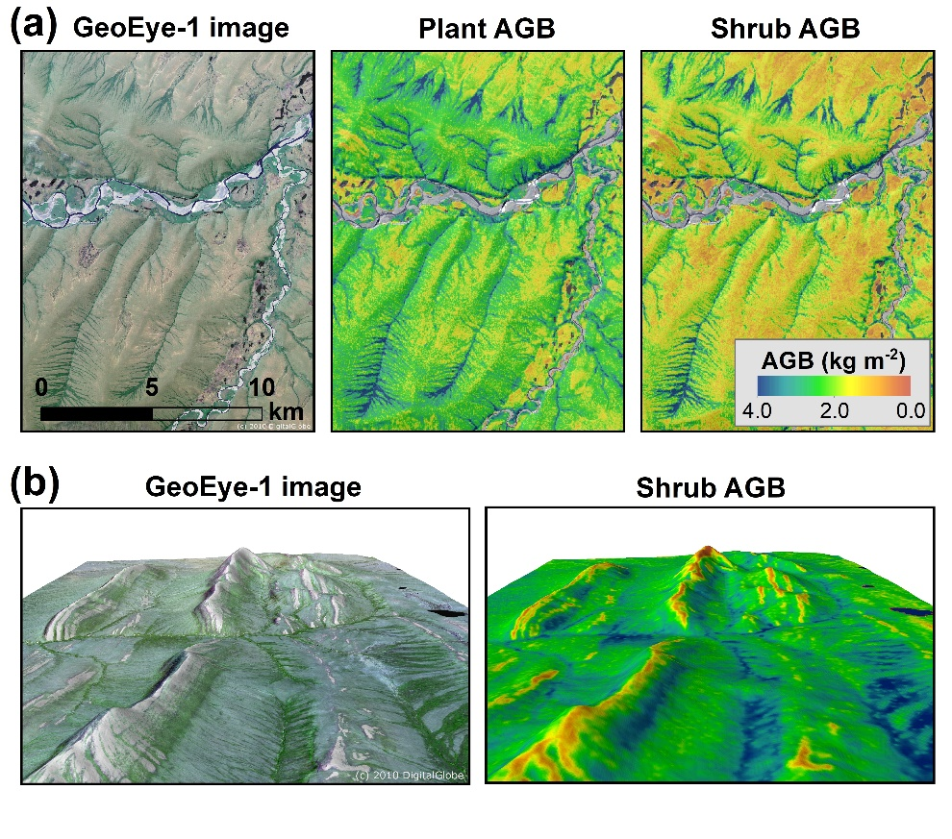
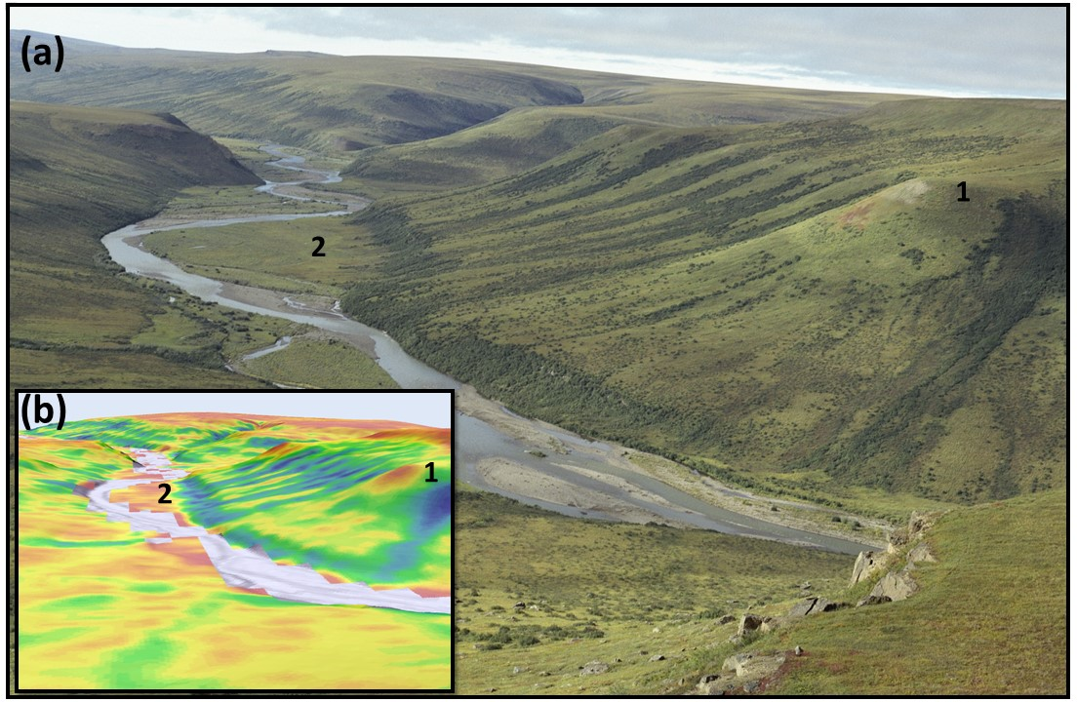
Notes
Citation:
Berner, L.T., P. Jantz, K.D. Tape, and S.J. Goetz. “Tundra plant above-ground biomass and shrub dominance mapped across the North Slope of Alaska”. Environmental Research Letters (2018) https://doi.org/10.1088/1748-9326/aaaa9a
(ABoVE Focus Collection)
Award Information:
This research was supported by the NASA Terrestrial Ecology Program (NNH14ZDA001N-TE) under NASA Award number NNX17AE44G as part of the Arctic-Boreal Vulnerability Experiment.

