Slide 1
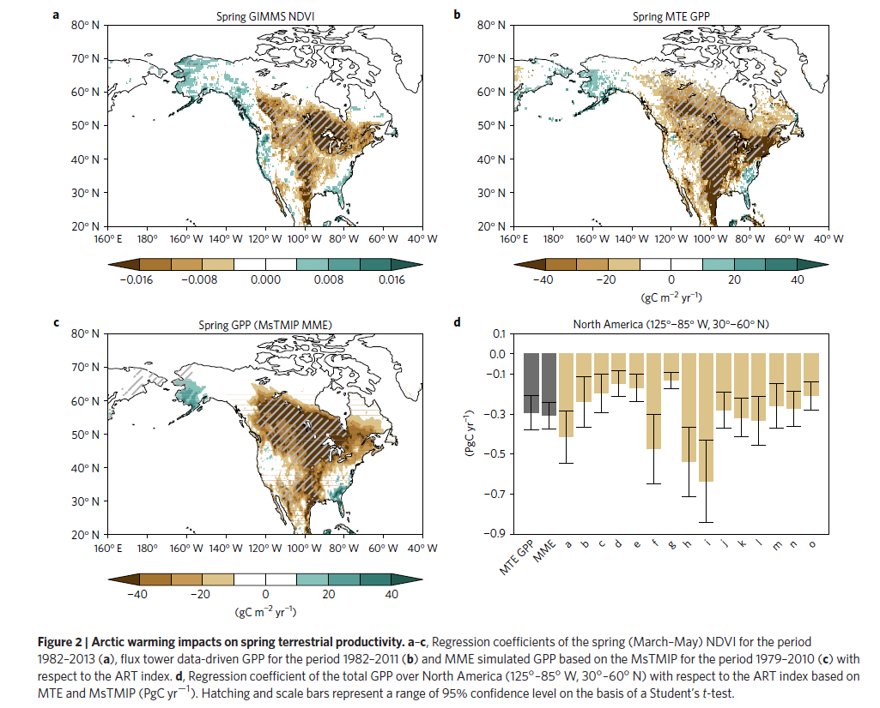
What happens in the Arctic doesn’t stay in the Arctic
J-S Kim, J-S Kug, S-J Jeong, D.N. Huntzinger, A.M Michalak, C.R. Schwalm, Y.Wei, and K. Schaefer
Background:
Warming in the Arctic can lead to severe cold events and changes in precipitation in the continental U.S. due to atmospheric teleconnections.
Analysis:
Evaluates the link between Arctic temperatures and terrestrial ecosystem productivity in North America (NA).
Uses Arctic temperature (ART) index derived from HadCRUT4; along with temperature and precipitation from CRU.
Estimates of GPP obtained from three products: 1) NDVI; 2) up-scaled GPP from flux tower data; and 3) terrestrial biospheric model simulation output from MsTMIP.
Findings:
Warmer than normal springtime temperatures in the Arctic → decreased plant productivity over most of North America.
Decline is explained by two factors: 1) severe cold temperatures in northern NA; and 2) decreased precipitation in the South Central U.S.
Translates into a reduced crop yield of 1 to 4% across U.S., with some states experience crop yield declines of up to 20%.
Significance:
Demonstrates for the first time, the linkage between Arctic temperature variations and ecosystem and agricultural productivity in the continental U.S.
Notes:
Full Citation: Kim, Jin-Soo, J-S. kug, S-J. Jeong, D.N. Huntzinger, A.M. Michalak, C.R. Schwalm, Y. Wei, K. Schaefer, “Reduced North American terrestrial primary productivity linked to anomalous Arctic warming,” Nature Geoscience, DOI: 10.1038/NGEO2986, 2017.
Funding for the Multi-scale synthesis and Terrestrial Model Intercomparison Project (MsTMIP; http://nacp.ornl.gov/MsTMIP/shtml) was provided through NASA ROSES Grant #NNX10AG01A. Data management support for preparing, documenting and distributing model driver and output data was performed by the Modeling and Synthesis Thematic Data Center at Oak Ridge National Laboratory with funding through NASA ROSES Grant#NNH10AN681. Finalized MsTMIP data products are archive at ORNL DAAC (http://daac.ornl.gov).
Arctic here is 160E to 160W, 65 to 80 N over the East Siberian-Chukchi Sea.
Over past 3 decades, plant productivity across NA has decreased by 0.31 PgC yr⁻¹ due to anomalous warming in the Arctic.

Slide 2
Limit to the predictability of land carbon cycle
D.N. Huntzinger, A.M Michalak, C.R. Schwalm, P. Ciais, A.W. King, Y. Fang, K. Schaefer, Y. Wei, et al.
Background:
Terrestrial ecosystems regulate the accumulation of carbon (C) in the atmosphere. However, how the land C cycle will respond to changing environmental conditions is unclear.
Analysis:
Uses an ensemble of 12 models from MsTMIP and series of sensitivity simulations to link changes in the land C cycle to different environmental factors.
Findings:
Models disagree on the primary control on land C uptake in over 85% of vegetated land area.
Variability in sensitivity to environmental drivers is due to indirect model tuning, e.g., comparable estimates of C uptake can arise despite a broad range of sensitivities.
The number of different factors (climate, LCC, CO₂, and N-deposition) identified as the primary driver of cumulative net sink across models. Insets show histograms of land cell fraction with 1 to 4 different drivers.
Significance:
Sensitivity simulations show how models are arrive at similar “answers”(e.g., land sink strength), but for different reasons.
Each model represents a potential pathway to land C cycle response to a changing world.
Using an ensemble approach (akin to weather prediction) provides an opportunity for a robust exploration of possible land C cycle responses.
Sensitivity of the cumulative net land sink to different environmental drivers compared to the Global Carbon Project estimate (black dashed line) and uncertainty (grey shaded region).
Notes:
Full citation: Huntzinger, D., A.M. Michalak, C. Schwalm, P. Ciais, A.W. King, Y. Fang, K. Schaefer, Y. Wei, R.B. Cook, J.B. Fisher, D. Hayes, M. Huang, A. Ito, A.K. Jain, H. Lei, C. Lu, F. Maignan, J. Mao, N. Parazoo, S. Peng, B. Poulter, D. Ricciuto, X. Shi, H. Tain, W. Wang, N. Zeng, F. Zhao, “Uncertainty in the response of terrestrial carbon sink to environmental drivers undermines carbon-climate feedback predictions,” Scientific Reports, 7:4765, DOI: 10.1038/s41598-017-03818-2, 2017.
Funding for the Multi-scale synthesis and Terrestrial Model Intercomparison Project (MsTMIP; http://nacp.ornl.gov/MsTMIP/shtml) was provided through NASA ROSES Grant #NNX10AG01A. Data management support for preparing, documenting and distributing model driver and output data was performed by the Modeling and Synthesis Thematic Data Center at Oak Ridge National Laboratory with funding through NASA ROSES Grant#NNH10AN681. Finalized MsTMIP data products are archive at ORNL DAAC (http://daac.ornl.gov).
The indirect tuning used here is defined as tuning that is systematic of both social anchoring (i.e., once aware of a benchmark typically used for model evaluation, this knowledge invariably influences decisions in model development) and equifinality (i.e., multiple equality valid parameter sets giving rise to same sensitivities). This is in contrast to explicit tuning, such as arbitrary adjustments to achieve a more realistic model output.

