Slide 1
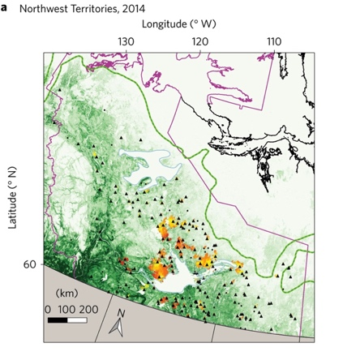
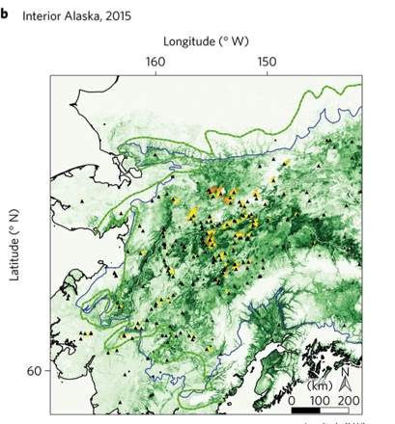
Lightning as a Major Driver of Recent
Large Fire Years in North American Boreal Forests
S Veraverbeke, et al. (2017), Nature Climate Change (2017). doi:10.1038/nclimate3329
Background
Changes in climate and fire regimes are transforming the boreal forest, the world’s largest biome.
Boreal North America recently experienced two years with large burned area: 2014 in the Northwest Territories and 2015 in Alaska
Analysis
We used climate, lightning, fire and vegetation data sets to assess the mechanisms contributing to large fire years
Findings
Lightning ignitions have increased since 1975
The 2014 and 2015 extreme fire events coincided with a record number of lightning ignitions and exceptionally high levels of burning near the northern treeline
Lightning ignition explained more than 55% of the interannual variability in burned area
Maps of fire ignition locations and burned area for 2014 Northwest Territories (top left) and 2015 Alaska (top right).
Lightning ignitions increased by ~2%/yr and ~5%/yr in the Northwest Territories (bottom left) and Alaska (bottom right) since 1975
Significance
Our work highlights the importance of lightning as an Earth system process that influences fire dynamics and the transition between biomes. Lightning drives interannual and long-term ignition and burned area dynamics in boreal North America, and implies future ignition increases may increase carbon loss while accelerating the northward expansion of boreal forest into tundra ecosystems.
Notes:
Kahru, M., Z. Lee, B.G.Mitchell1and C.D. Nevison (2016), Effects of sea ice cover on satellite-detected primary production in the Arctic Ocean, Biology Letters, 12: 20160223.
http://dx.doi.org/10.1098/rsbl.2016.0223.
Satellite Data:
OCTS - Ocean Color Temperature Scanner (NASDA)
SeaWiFS - Sea-Viewing Wide Field-of-View Sensor (NASA)
MERIS - MEdium Resolution Imaging Spectrometer (ESA)
MODIS-Aqua (NASA)
Primary productivity (NPP) in the Arctic Ocean has increased by 47% from the first half (1998-2006) to the 2nd half of the series (2007-2015) but changes after 2011 have been minor. NPP per open water area has actually decreased. Increased open water area is related to increased NPP in the summer with the strongest effect in June. In northern Barents Sea, sea ice retreat has become earlier at a rate of -4.5 day/year and the high-productivity season is starting earlier at a rate of -3.0 day/year. Freeze-up is occurring later but the timing of the end of the high NPP period has not changed.

Slide 2
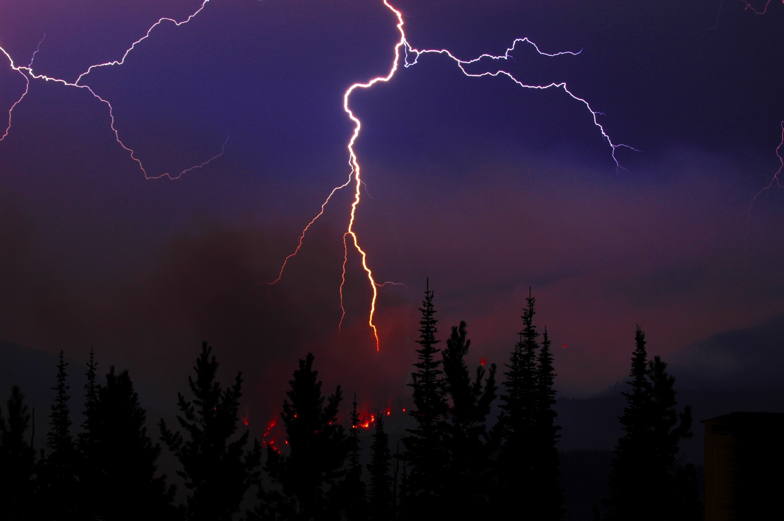
Lightning igniting boreal forest fire
Recent increases in lightning ignitions earlier in the growing season and closer to the boreal forest – tundra treeline are driving extreme fire years in North America.

Slide 3
Full Citation & Abstract
Sander Veraverbeke, Brendan M. Rogers, Mike L. Goulden, Randi R. Jandt, Charles E. Miller, Elizabeth B. Wiggins, James T. Randerson, Lightning as a major driver of recent large fire years in North American boreal forests, Nature Clim. Change (2017), advance online publication 26 June 2017. http://dx.doi.org/10.1038/nclimate3329
http://www.nature.com/nclimate/journal/vaop/ncurrent/full/nclimate3329.html
Abstract
Changes in climate and fire regimes are transforming the boreal forest, the world’s largest biome. Boreal North America recently experienced two years with large burned area: 2014 in the Northwest Territories and 2015 in Alaska. Here we use climate, lightning, fire and vegetation data sets to assess the mechanisms contributing to large fire years. We find that lightning ignitions have increased since 1975, and that the 2014 and 2015 events coincided with a record number of lightning ignitions and exceptionally high levels of burning near the northern treeline. Lightning ignition explained more than 55% of the interannual variability in burned area, and was correlated with temperature and precipitation, which are projected to increase by mid-century. The analysis shows that lightning drives interannual and long-term ignition and burned area dynamics in boreal North America, and implies future ignition increases may increase carbon loss while accelerating the northward expansion of boreal forest.

