Slide 1
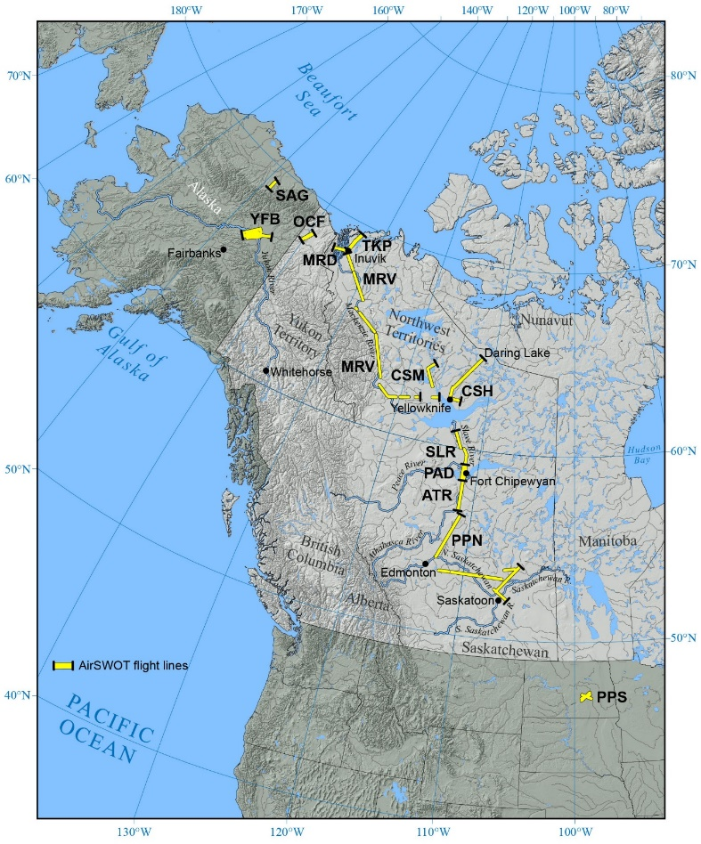
A High-Resolution Airborne Color-Infrared Camera Water Mask for the NASA ABoVE Campaign
Ethan D. Kyzivat, Laurence C. Smith, Lincoln H Pitcher, Jessica V. Fayne, Sarah W. Cooley, et al. (Sept. 2019) Remote Sensing 11
https://doi.org/10.3390/rs11182163
Background:
The total surface area of water on Arctic-Boreal landscapes is poorly known for water bodies too small to resolve from satellites such as Landsat 8 and Sentinel-2 (<0.001 km2). Yet, these small water bodies are important for greenhouse gas exchange, ecosystem services, and biodiversity.
The airborne AirSWOT instrument suite, consisting of an interferometric Ka-band synthetic aperture radar and color-infrared (CIR) camera, was deployed to AK and Canada in summer 2017 to measure surface hydrology as part of the NASA Arctic-Boreal Vulnerability Experiment (ABoVE).
AirSWOT CIR
Far left: ABoVE domain map showing AirSWOT flight lines and the 13 regions used for water body distribution analysis.
Right top: 1-meter resolution, color-infrared (CIR) imagery collected as part of the NASA AirSWOT instrument suite in the Peace-Athabasca Delta, AB.
Right bottom: Same scene as imaged by the L-band synthetic-aperture radar flown on NASA’s UAVSAR aircraft. Water bodies classified from the CIR imagery are superimposed in blue. The water classification excludes the emergent vegetation fringing the lake, which can be seen as high double-bounce (red) regions in the UAVSAR image.
UAVSAR L-band
AirSWOT camera flight lines
Significance:
These data provide a rare, synchronous and co-registered reference for Ka-band water classification algorithms such as will be used for the upcoming NASA Surface Water and Ocean Topography (SWOT) satellite mission.
Analysis:
Mapped surface water over 23,380 km² of the ABoVE domain using an unsupervised, object-based classification.
Tested the resulting water body distributions for power-law behavior across a variety of landscapes.
Findings:
Found a power-law cutoff for lakes <0.34 km², implying that lake abundance estimates are invalid at smaller scales.
Many synergies between sensors are unexplored, and this study offers suggestions for how the CIR dataset might assist data collected concurrently from other NASA aircraft.
Notes:
Citation: Ethan D. Kyzivat, Laurence C. Smith, Lincoln H Pitcher, Jessica V. Fayne, Sarah W. Cooley, Matthew G. Cooper, Simon N. Topp, Theodore Langhorst, Merritt E. Harlan, Christopher Horvat, Colin J. Gleason, and Tamlin M. Pavelsky. 2019. “A High-Resolution Airborne Color-Infrared Camera Water Mask for the NASA ABoVE Campaign.” Remote Sensing 11. https://doi.org/10.3390/rs11182163.
Funding: This work was funded by the NASA Terrestrial Ecology Program Arctic-Boreal Vulnerability Experiment (ABoVE), grant number NNX17AC60A, managed by Hank Margolis; and the NASA Surface Water and Ocean Topography mission, grant number NNX16AH83G, managed by Eric Lindstrom.

