Slide 1
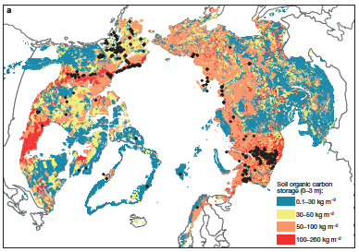
Take-home Message Title Citation (short form)
Science Question
Compelling statement of the science question.
What are we learning about the Earth System?
Why is the research important?
Analysis
What NASA resources were used (satellites, ground networks, datasets, models, etc.)
Results
What do you want the reader to remember?
What are the important findings from this study? What is the essence that should be drawn from the results?
What has been accomplished and learned using NASA assets?.
Significance
Communicate the most significant element that you want the audience to know about the research and how the results contributed to society/Earth system science. What do we now know that we did not know before? What can we do with this knowledge? What are the potential societal impacts/benefits?
Figure Caption
Describe a figure that captures the essence of the science result and conveys its importance to the non-expert
Notes:
This slide contains a sample of the contents of an MSR Slide that we suggest

Slide 2
Notes
Citation:
Full, formal citation, Ex.
Schuur, E. A. G., A. D. McGuire, C. Schädel, G. Grosse, J. W. Harden, D. J. Hayes, G. Hugelius et al. "Climate change and the permafrost carbon feedback." Nature 520, no. 7546 (2015): 171-179.
Award Information:
Title of the solicitation (including ROSES call number)
NASA Award/contract number
Ex. This research was supported by the NASA Terrestrial Ecology Program (NNH16ZDA001N-Task A4.) under NASA Award number XXXXX
This research supported the NASA Terrestrial Ecology Arctic-Boreal Vulnerability Experiment

Slide 3
SMAP Observes Flooding from Land to Sea: The Texas Event of 2015
S. Fournier, J.T. Reager, T. Lee, J. Vazquez-Cuervo, C.H. David, & M.M. Gierach (Oct 2016). GRL Vol 43: 19. DOI: 10.1002/2016GL070821
Background:
Floods can have damaging impacts on both land and sea, yet studies of flooding events tend to focus on only one side of the land/sea continuum.
Analysis:
Analysis of a 2015 Texas flood is the first to document the full life cycle and impacts of a flood on both land and ocean.
The research team used measurements from SMAP with observations from TRMM, GPM, GRACE, MODIS (flown on Terra and Aqua), and the Jason series of satellites to create a comprehensive timeline and map of the flood and its regional effects.
Monthly maps of (a) May and (b) August 2015 SMAP soil moisture inland and sea surface salinity (SSS). The black line delimits the Texas Gulf Coast Hydrologic Region. The colored dots correspond to the gauge for each major Texas river. The colored squares delimit five different boxes used to compute the averaged SSS.
Findings:
Reported comprehensive chronology of the flooding:
above average rainfall preceding the flood caused soils to saturate;
record rainfall then generated record river discharge; and
subsequently, an unusual freshwater plume associated with anomalous ocean currents formed in the north central Gulf of Mexico.
Significance:
Integrated land/sea analysis of flood evolution can improve impact assessments of future extreme flooding events.
Notes:
Revised figure

Slide 4
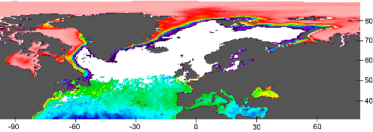
Effects Of Sea Ice Cover On Primary Production In The Arctic Ocean
Kahru, M., et al. (2016), Biology Letters, 12: 20160223, http://dx.doi.org/10.1098/rsbl.2016.0223.
Background
Decrease in the summer extent of Arctic sea ice has been correlated with an increase in net primary production (NPP), but the magnitude of increase has been debatable due to large errors in satellite estimates.
Analysis
Novel algorithm and merged satellite data (OCTS, SeaWiFS, MERIS, MODIS) from multiple satellites was applied for 1997-2015.
Findings
Primary productivity in the Arctic Ocean has increased by 47% from the first half (1998-2006) to the 2nd half of the series (2007-2015); changes after 2011 have been minor.
Increased open water area has the strongest effect on increasing NPP in June.
In the northern Barents Sea, sea ice retreat has begun earlier (-4.5 days/year), and so has the high-productivity season (-3.0 days/year). Freeze-up is occurring later, but the timing of the end of the high NPP period has not changed.
Missing ocean colour data (white) during the winter season (January, 2015), ice cover (pink to purple) in the north and the detected chlorophyll-a (blue to yellow) in the south.
Monthly time series of NPP between latitudes 66˚ N and 84˚ N.
Significance
Increased NPP makes more food available for Arctic food webs including benefits for commercial fisheries, but changes in timing may reduce its positive effect.
Notes:
Kahru, M., Z. Lee, B.G.Mitchell1and C.D. Nevison (2016), Effects of sea ice cover on satellite-detected primary production in the Arctic Ocean, Biology Letters, 12: 20160223.
http://dx.doi.org/10.1098/rsbl.2016.0223.
Satellite Data:
OCTS - Ocean Color Temperature Scanner (NASDA)
SeaWiFS - Sea-Viewing Wide Field-of-View Sensor (NASA)
MERIS - MEdium Resolution Imaging Spectrometer (ESA)
MODIS-Aqua (NASA)
Primary productivity (NPP) in the Arctic Ocean has increased by 47% from the first half (1998-2006) to the 2nd half of the series (2007-2015) but changes after 2011 have been minor. NPP per open water area has actually decreased. Increased open water area is related to increased NPP in the summer with the strongest effect in June. In northern Barents Sea, sea ice retreat has become earlier at a rate of -4.5 day/year and the high-productivity season is starting earlier at a rate of -3.0 day/year. Freeze-up is occurring later but the timing of the end of the high NPP period has not changed.

Slide 5
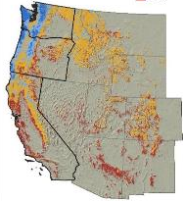
Water Availability Constrains Tree Productivity and Biomass in Mature Forests across the Western United States Berner, Law, and Hudiburg 2017. Biogeosciences
Background: Forests in the western US range from dry woodlands to high biomass coastal rainforest. Water availability is projected to decline over the coming century, with rising temperatures increasing evapotranspiration. Forest response remains uncertain.
Methods: Evaluated forest response to long-term changes in water availability by quantifying changes in tree productivity and biomass. Quantified water availability as difference between input (precipitation, P) and demand (reference evapotranspiration, ET₀) over water year (Oct-Sep). Quantified forest characteristics using inventories from ~2,000 sites (WA, OR, CA) and remote sensing spanning ~18 Mha of mature forests across the western US.
Results:
Annual water availability varied widely across the region, with most areas too dry to support forests.
Tree productivity and biomass increased with annual water availability across mature forests in the region.
Bioclimatic relationships broadly similar with forest inventories or remote sensing; however, remote sensing estimates saturated in high-productivity, high-biomass forests.
Significance: Annual water availability is a key constraint on forest distribution, productivity and biomass in the region, highlighting sensitivity to projected declines in water availability. Remotely sensed forest characteristics enable tracking of forest response to climate, yet saturation issues hinder monitoring high-biomass forests.
Mean annual water availability 1985-2014 P-ET₀; cm/yr
Forest inventories
(WA, OR, and CA)
Remote sensing
(Western US)
Tree biomass
(Mg C ha⁻¹)
Tree productivity
(Mg C ha⁻¹ yr⁻¹)
Annual water availability (P-ET₀; cm/yr)
Notes:
Allison Leidner submitted
Full citation: Water availability limits tree productivity, carbon stocks, and carbon residence time in mature forests across the western United States. Logan T. Berner, Beverly E. Law, and Tara W. Hudiburg. 2017. Biogeosciences. Published online XX January 2017. DOI:
Grants: Lead author Berner was supported by NASA NNX14AN65H (NASA Earth and Space Science Fellowship in the Biodiversity and Carbon Cycle programs)
Top figure: Mean annual water availability (1985-2014) across the western United States.
Bottom figure: Changes in tree biomass and productivity with annual water availability based on (left panel) forest inventory measurements from WA, OR, and CA and (right panel) remote sensing observations covering 18 million hectare of mature forest across the western United States. note: The thin black lines in the bottom four-panel figure depict median tree biomass or productivity computed at 10 cm yr⁻¹ intervals in water availability. The dark gray bands encompass 50% of observations, while the light gray bands encompass 90% of observations.
Abstract: Water availability constrains the structure and function of terrestrial ecosystems and is projected to change in many parts of the world over the coming century. We quantified the response of tree net primary productivity (NPP), live biomass (BIO), and mean carbon residence time (CRT=BIO/NPP) to spatial variation in water availability in the western US. We used forest inventory measurements from 1,953 mature stands (>100 years) in Washington, Oregon, and California (WAORCA) along with satellite and climate data sets covering the western US. We summarized forest structure and function in both domains along a 400 cm yr⁻¹ hydrologic gradient, quantified with a climate moisture index (CMI) based on the difference between precipitation and reference evapotranspiration summed over the water-year (October-September) and then averaged annually from 1985-2014 (). Median NPP, BIO, and CRT computed at 10 cm yr⁻¹ intervals along the gradient increased monotonically with increasing across both WAORCA (r_{s}=0.93-0.96, p<0.001) and the western US (r_{s}=0.93-0.99, p<0.001). Field measurements from WAORCA showed that median NPP increased from 2.2 to 5.6 Mg C ha⁻¹ yr⁻¹ between the driest and wettest 5% of sites, while BIO increased from 26 to 281 Mg C ha⁻¹ and CRT increased from 11 to 49 years. The satellite data sets revealed similar changes over the western US, though these data sets tended to plateau in the wettest areas, suggesting that additional efforts are needed to better quantify NPP and BIO from satellites in high-productivity, high-biomass forests. Our results illustrate that long-term average water availability is a key environmental constraint on tree productivity, carbon storage, and carbon residence time in mature forests across the western US, underscoring the need to assess potential ecosystem response to projected warming and drying over the coming century.
Remote sensing: Quantified forest net primary productivity and leaf area across the western United States using standard MODIS products. Quantified regional forest biomass using three existing biomass maps derived from Landsat, MODIS, and other satellites. Lastly, restricted analysis to mature forests (>100 yrs) using the MODIS land cover product and a forest age map derived using Landsat.
How is this study different from previous work:
Spatial extent: Authors demonstrate these bioclimatic relationships using both forest inventory and remote sensing observations across a much large spatial extent than prior studies. For instance, prior field studies from the region focused on <20 sites, whereas this study examined nearly 2,000 sites, along with remote sensing observations to cover another 18 Mha of mature forest. Additionally, study area included forests ranging from dry woodlands to coastal temperate rainforest and thus nearly spanned the known global range in forest biomass.
Metric for water availability. Authors quantified water availability as monthly precipitation minus reference evapotranspiration (ET₀) summed over the water year, recognizing that both atmospheric input and demand influence the amount of water available to plants. Prior studies mostly used mean annual precipitation to quantify water availability when examining bioclimatic relationships, yet this misses an important component of the water budget that is expected to change with regional warming. Including ET₀ allowed researchers to better resolve how water availability constrained forest characteristics, especially in areas with very low precipitation, but variable ET₀ .
Additional Significance
Examined mean carbon residence time (CRT) in live tree biomass, which is an important source of uncertainty in ecosystem models. We show that CRT increased from ~10 years in the driest forests to ~50 years in the wettest forests, underscoring a pronounced change in ecosystem dynamics that should be reflected in projections from ecosystem models.
Evaluated bioclimatic relationships derived from remote sensing against those derived from field observations. The two approaches showed broad agreement though the comparison also highlighted current shortcomings in the ability of remote sensing to capture forest conditions in high-biomass forests

Slide 6
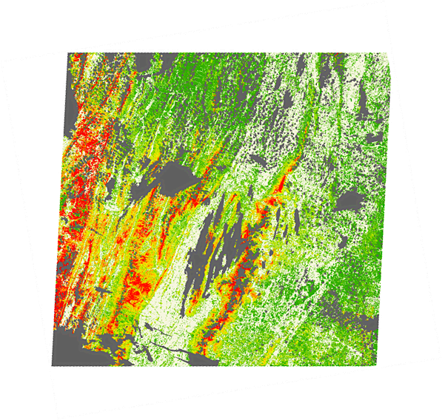
Forest Canopy Signals Reveal Belowground Fungal Associations
Fisher, J.B., Sweeney, S. et al, 2016. Tree–mycorrhizal associations detected remotely from canopy spectral properties. Global Change Biology 22(7): 2596-2607.
Mycorrhizal fungi
associating with
plant roots
Problem: Nearly all tree species form symbiotic relationships with only one of two types of mycorrhizal fungi—AM or ECM. The type of fungi determines the ability of trees to access nutrients and subsequently take up CO₂; but, we do not know where these fungi are or how they are distributed.
Analysis: Explored remotely sensed tree canopy
spectral properties to detect underlying mycorrhizal association across a gradient of AM- and ECM-dominated forest plots. Statistical mining of reflectance and reflectance derivatives across moderate/high-resolution Landsat data revealed distinctly unique phenological signals that differentiated AM and ECM associations. Approach was trained and validated against measurements of tree species and mycorrhizal association across ~130 000 trees throughout the temperate U.S/
Result: While all tree species have unique spectral signatures, we found that species associating with one fungal type had spectral properties more similar to each other than those associating with the other fungal type. We tested this successfully at ~130,000 trees throughout the US, and created regional maps of mycorrhizal association.
Percent AM
Image from: Alberton & Kuyper (2009)
ECM
0 - 5
5 - 10
10 -15
15 - 20
20 - 25
25 - 30
30 - 35
35 - 40
40 - 45
45 - 50
50 - 55
55 - 60
60 - 65
65 - 70
70 - 75
75 - 80
80 - 85
85 - 90
90 - 95
AM
95 - 100
Non-Forest
Clouds
Above: Landsat scene coverage of mycorrhizal composition in 1 of 4 study sites, the Smithsonian Conservation Biology Institute area in Virginia.
Significance: This capability to map mycorrhizal association is critical to our ability to understand how the terrestrial biosphere will respond to a changing CO₂ environment and climate.
Notes:
6
Kathy Hibbard sent
JPL was lead coordinator, but funding for analysis provided by DOE and NSF.
Kathy Hibbard also asked that while the conclusions attribute future improved analyses with GEDI, OCO3 and ECOSTRESS, would a HyspIRI spectrometer also add value to the Landsat data.
This work was supported by DOE’s Terrestrial Ecosystem Science program (Stover), NSF’s Ecosystem Science program (Kane), and NASA’s Terrestrial Ecology program (Margolis).
Fisher, J.B., Sweeney, S., Brzostek, E.R., Evans, T.P., Johnson, D.J., Myers, J.A., Bourg, N.A., Wolf, A.T., Howe, R.W., Phillips, R.P., 2016. Tree–mycorrhizal associations detected remotely from canopy spectral properties. Global Change Biology 22(7): 2596-2607.

